Slide 1

Department of Physics
Research Highlights
Some Facts

Slide 2
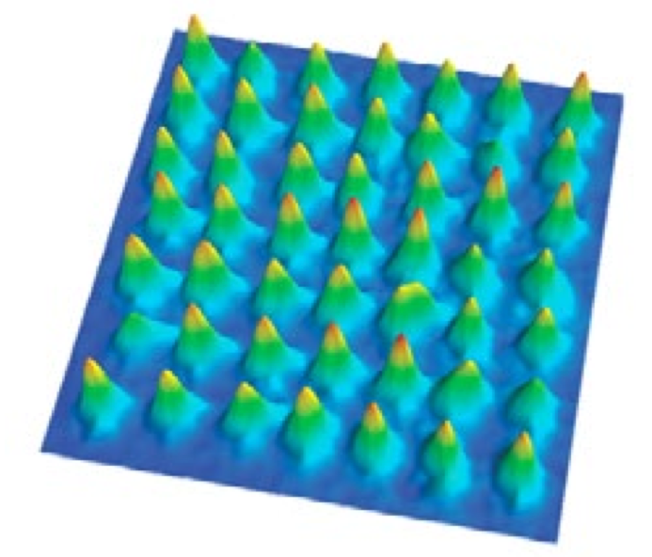
Condensed Matter and Atomic Physics
Highlights
Manipulation of quantum systems at the level of individual atoms.
Advances in the control capability of quantum physics in small systems opens fundamental new insights.
Future development from quantum information to quantum computing within reach.
Madison is at the forefront of this development.
49 laser cooled atoms are lined
up, waiting to be manipulated further
in Saffman’s lab.

Slide 3
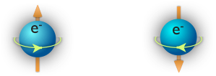



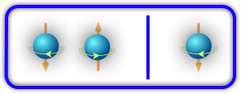
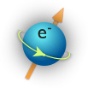

  The Hybrid Quantum Dot Qubit:
  How three electrons can be better than one or two
Highlights
Any bit — classical or quantum — can be a zero or one, up or down.
A single electron spin is the simplest qubit. It can be manipulated using the asame techniques as MRI imaging, but this method is slow: the spin must be rotated.
Spin up
Spin down
or
Professor Coppersmith and collaborators proposed that three electrons could offer much greater speed:
Only a quantum bit can be both at the same time.
Exchanging electrons is intrinsically fast.
Shi et al., Phys. Rev. Lett. 108, 140503 (2012).

Slide 4
Highlights

Slide 5
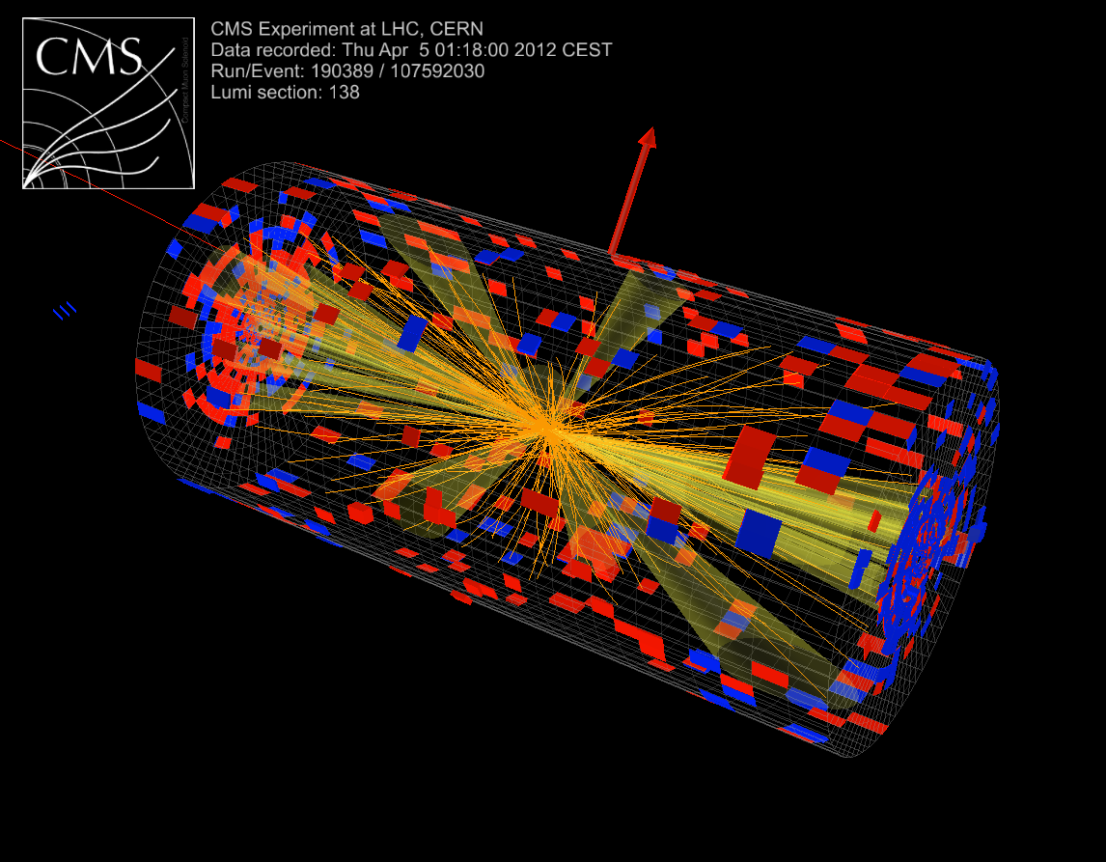
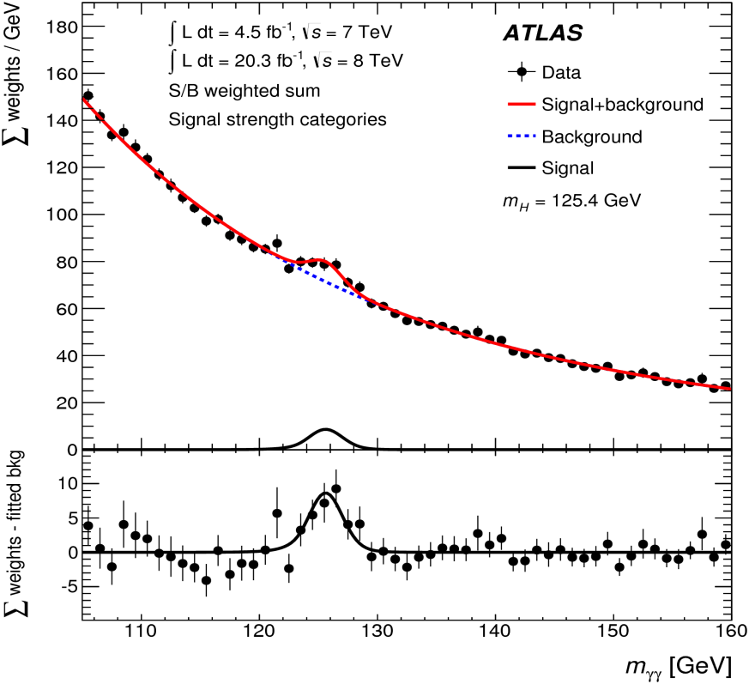
Higgs Particle Discovery
Highlights
There are two major experiments, ATLAS and CMS, at the Large Hadron Collider at CERN, which is currently the most powerful accelerator in the world.
The University of Wisconsin has made major contributions to both experiments and to the discovery of the Higgs particle with 6 faculty making fundamental contributions to detectors and analysis.
Strong theoretical particle group of 6 faculty.
Higgs
Visualization of a collision
of two energetic protons.
Higgs discovered after
billions of collisions

Slide 6
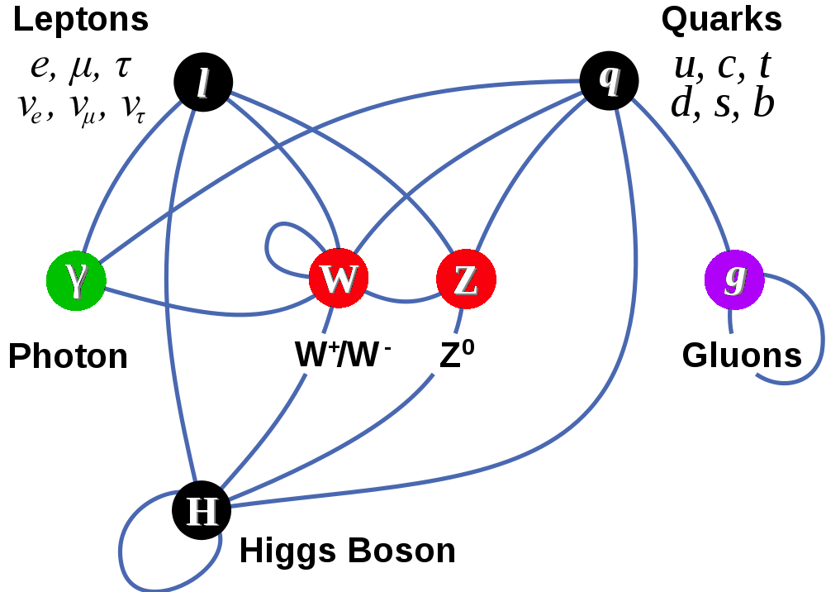
Completion of the Standard Model
Matter Particles (fermions)
Interactions by exchange of vector bosons
New fundamental field present everywhere in universe >> The Higgs boson
Other particles attain mass by coupling to this new fundamental field

Slide 7
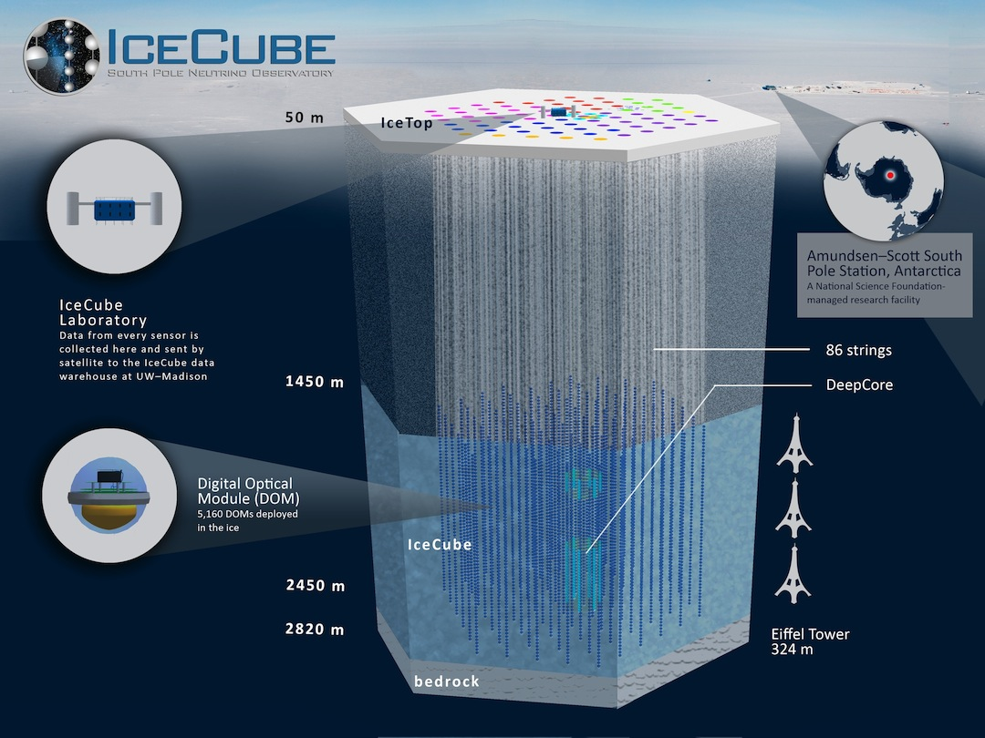

Slide 8
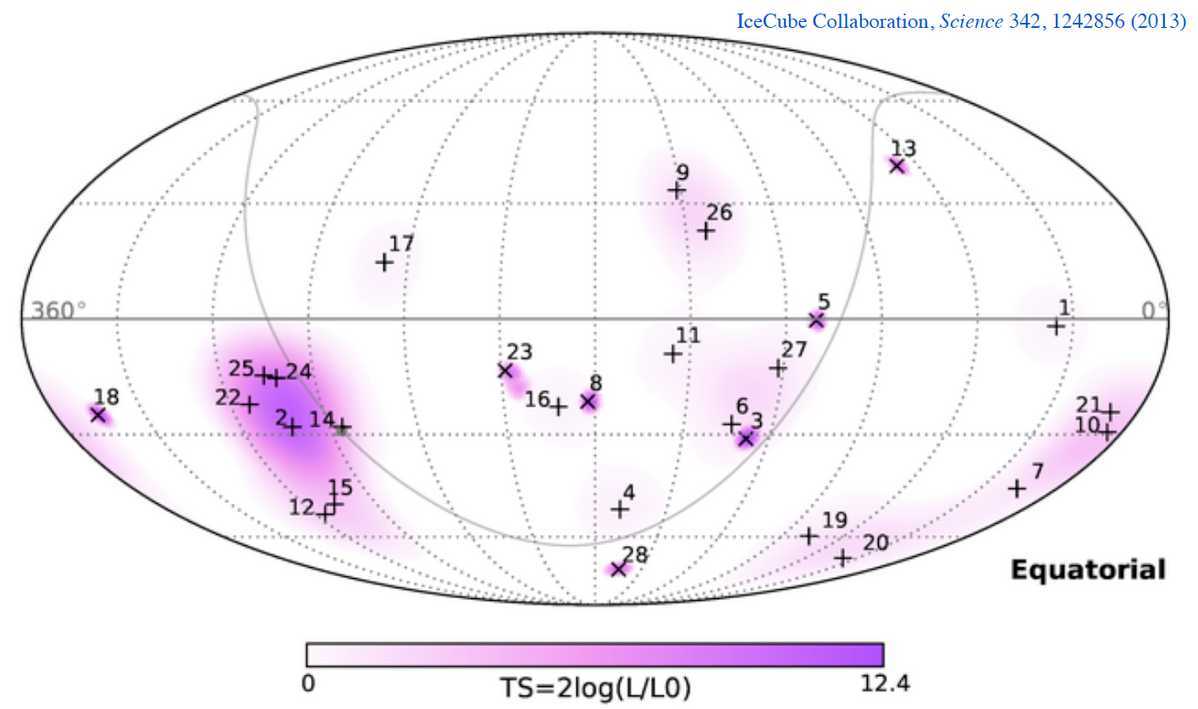
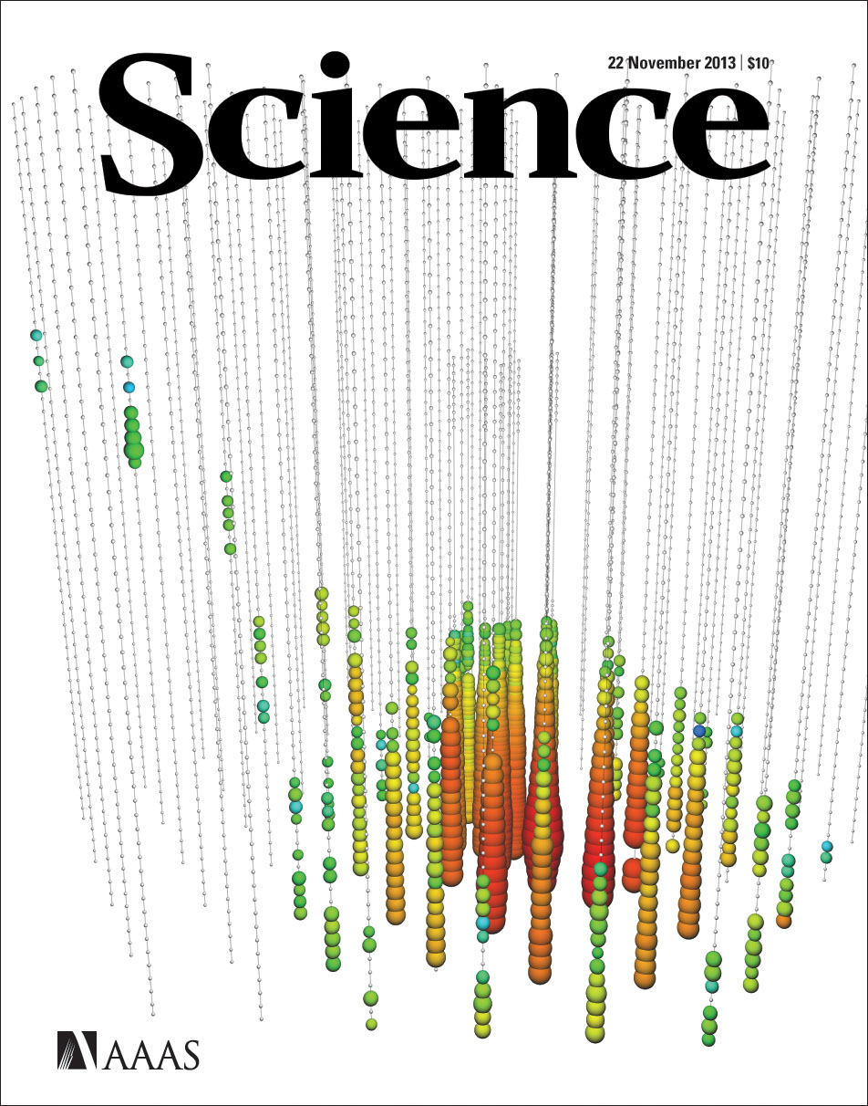
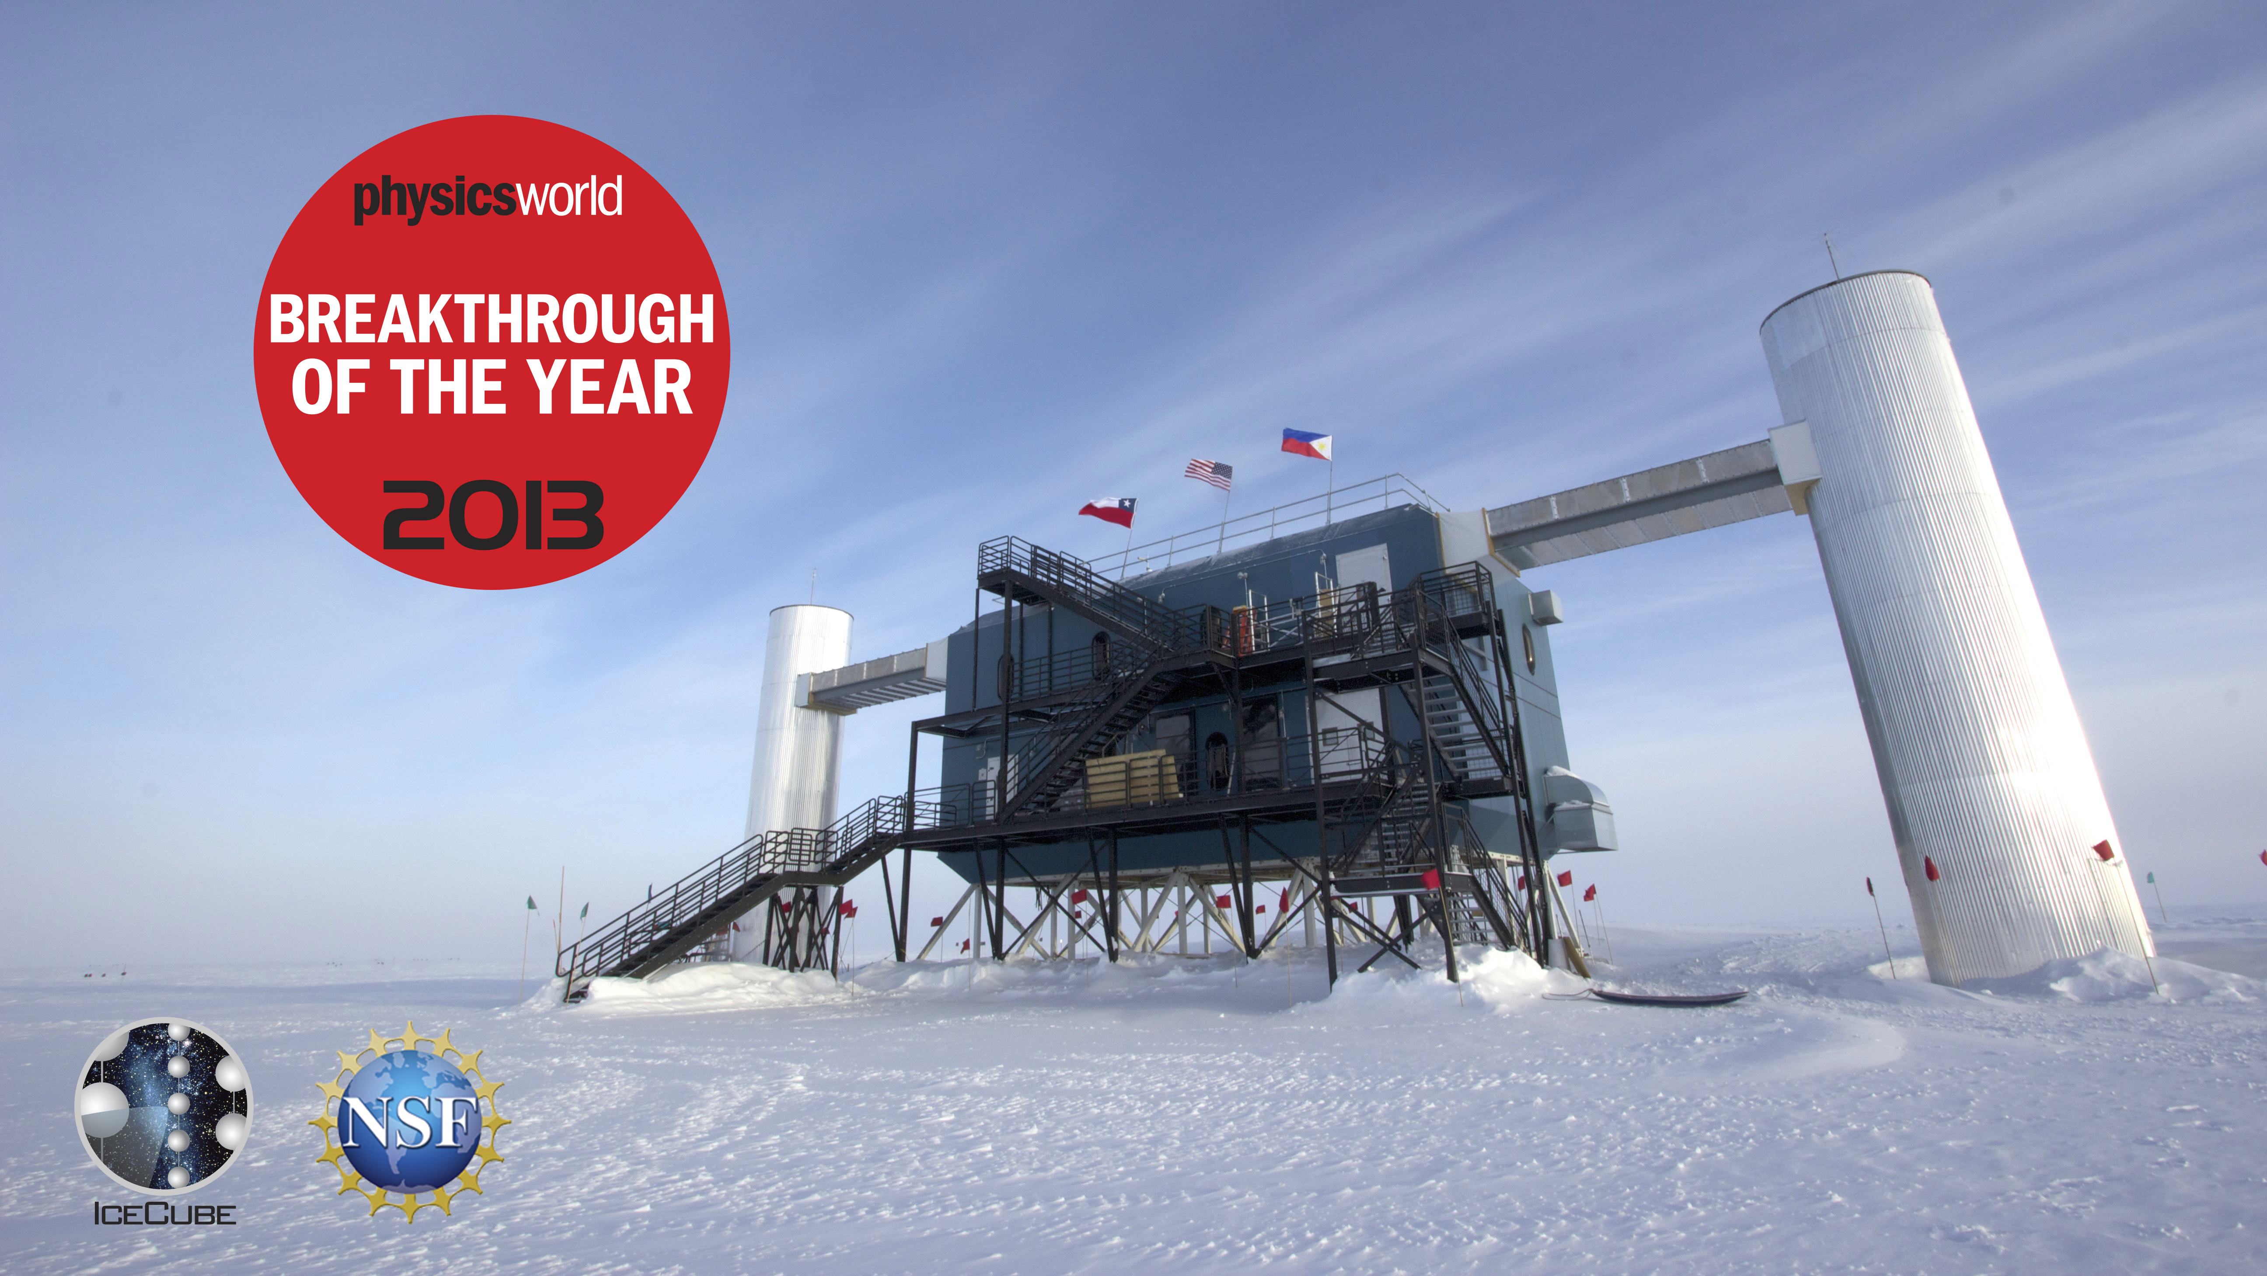
Discovery of cosmic neutrinos of very high energy
5 Physics Faculty members involved
In IceCube and astroparticle physics.
Univ. Wisconsin is the lead institution,
for construction and operation.
More than 100 cosmic neutrinos by now,including events with energies of more than 10^15 eV
(really high energy)
For science and the experimental accomplishment of building IceCube

Slide 9
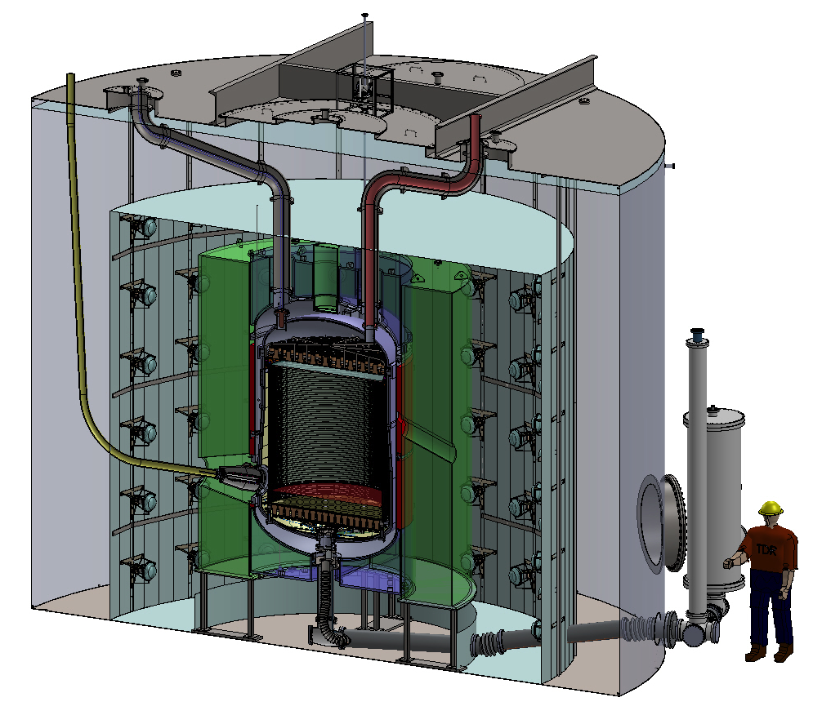

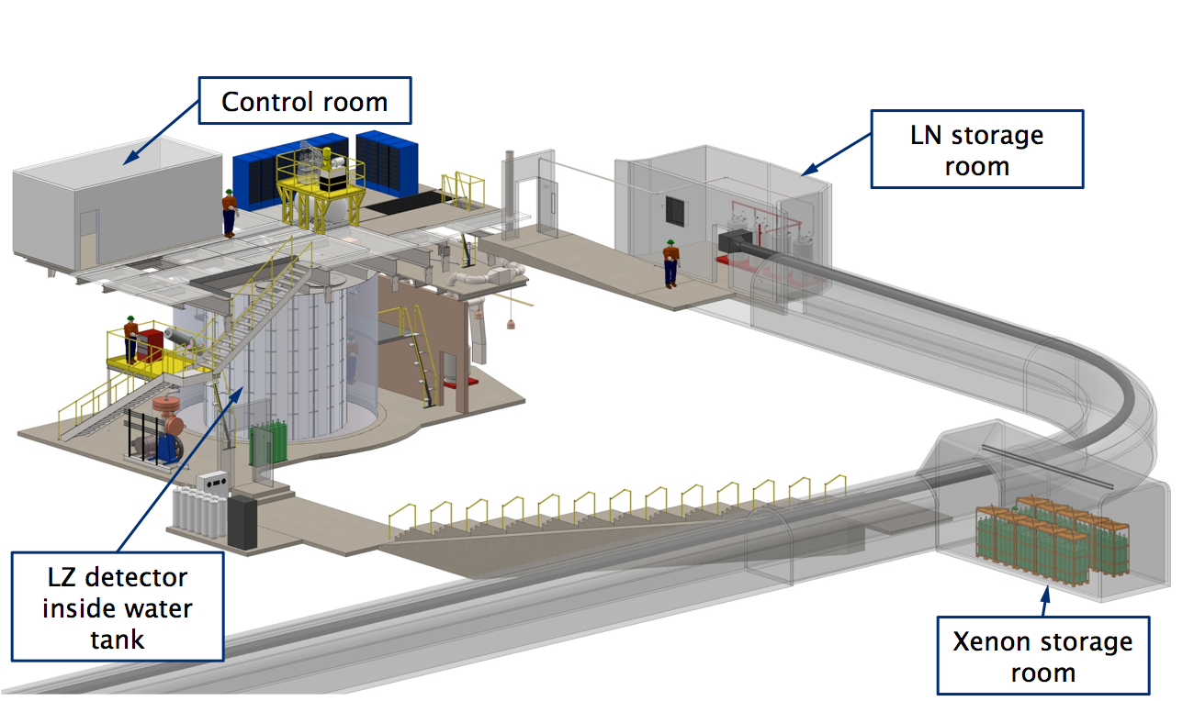

Search for New Physics – Dark Matter
Dark Matter is 27% of our Universe. SM has no DM candidate
LZ Experiment
About one mile underground in South Dakota
Xe TPC
UW playing a lead role in construction
UW searching for DM @ LHC, IceCube, HAWC
Latest effort is to look for DM interactions in its feeble interaction with Xenon, deep underground

Slide 10
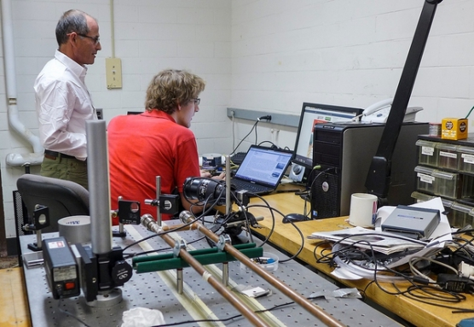
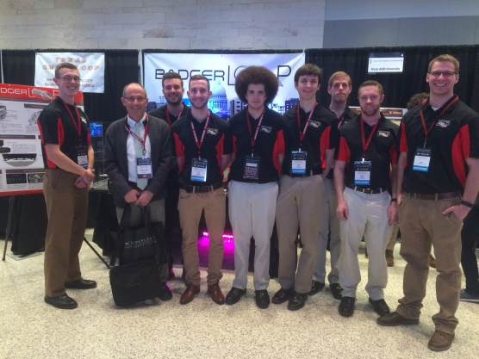
Research opportunities for undergraduates
Garage Physics
Badgerloop team develops maglev technology and wins 3rd place in the SpaceX Hyperloop competition featured on international news

Slide 11
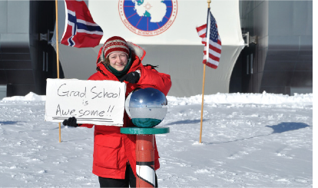
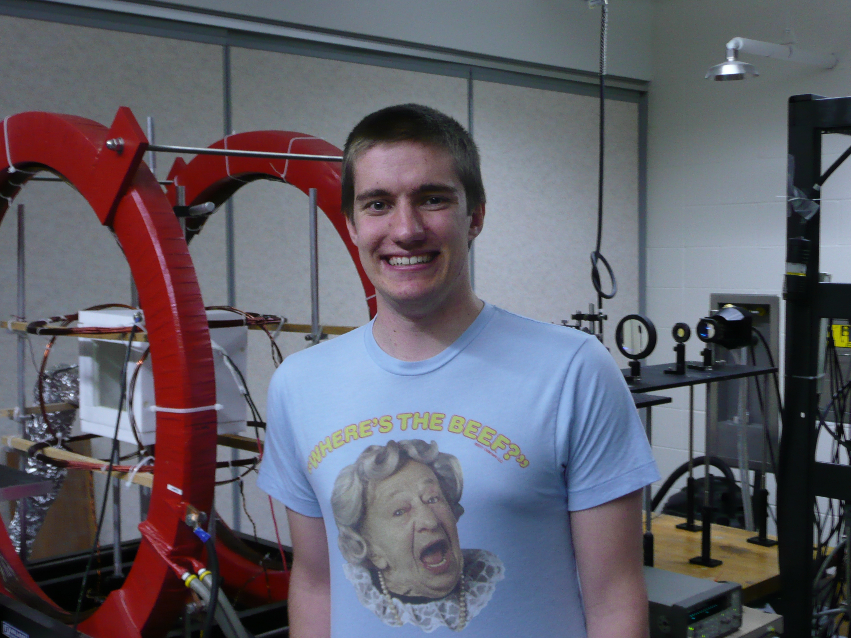
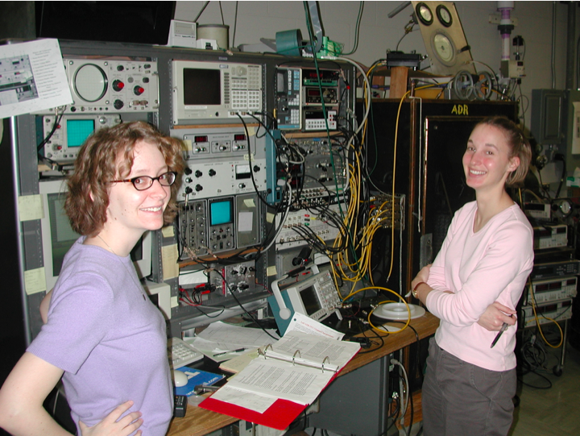
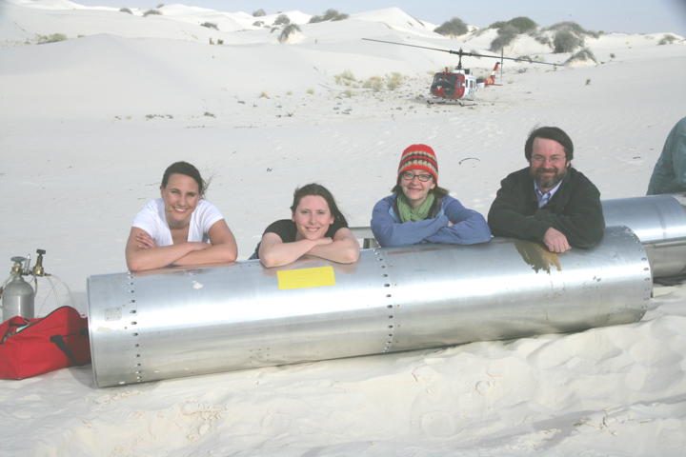
and for graduate students …

Slide 12
Some external awards in the past several years:
Highlights
National Academy of Sciences: Coppersmith, Haberli (emer.)
American Physical Society: 23 Fellows, 4 Outstanding Referees
American Academy of Arts and Sciences: 3 Coppersmith, Haeberli (emeritus), Wu
2016 – Balantekin – Laureate of the 2016 Breakthrough prize in Fundamental Physics
2016 – Coppersmith –Sigma Xi Lecturer
2015 – Lin – Honorary degree, University of Oklahoma
2015 – Levchenko – DAAD Fellowship
2015 – Halzen – Balzan Prize
2015 – Halzen – European Physical Society Prize for Particles and Cosmology
2014 – Halzen - Smithsonian American Ingenuity Award
2014 – Halzen - International Francqui Professor, VUB–ULB–UGent–UMons–UA–ULg–KULeuven, Belgium
2014 – Saffman - Elected Fellow of the Optical Society of America
2014 – Boldyrev - Elected Fellow of the American Physical Society
2014 – Coppersmith - National Security Science and Engineering Faculty Fellowship
2014 – Gilbert - Harvard Radcliffe Institute Fellowship
2013 – Balantekin - Elected member of the Turkish Science Academy
2013 – Gilbert - First Prize 2012 International Science and Engineering Visualization Challenge, Photography
2013 – Halzen - American Physical Society Highlights of the Year
2013 – IceCube - Physics World Breakthrough of the Year Award
2013 – Halzen - Doctor Honoris Causa, Ghent University, Belgium
2012 – Eriksson - Elected Fellow of the American Physical Society
2012 – Distinguished Scientist Daniel Den Hartog - Elected Fellow of the American Physical Society
2011 – Gilbert - Best DOE Basic Energy Sciences Research Award
2010 – Balantekin - American Physical Society Division of Nuclear Physics Distinguished Service Award
2010 – Gilbert - Elected Fellow of the American Physical Society
2009 – Karle - Elected Fellow of the American Physical Society
2009 – Coppersmith elected to National Academy of Sciences
2009 – Yavuz - Air Force Junior Investigator Award
2007 – Himpsel - Davisson-Germer Prize of the American Physical Society

Slide 13
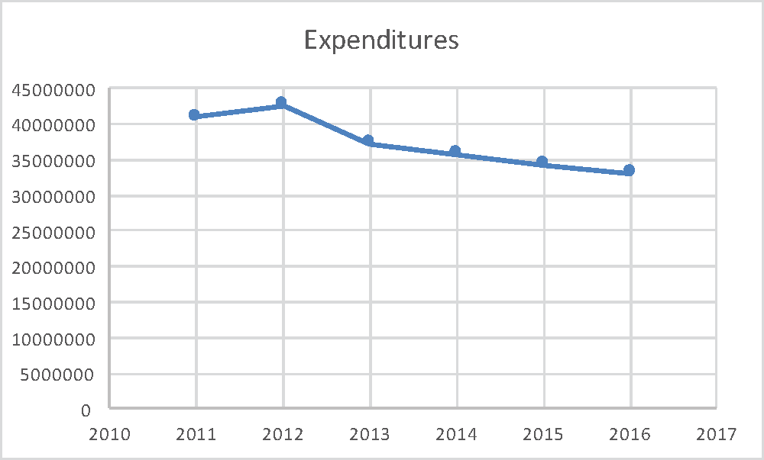
Size of Physics Faculty vs Research Expenditures

Slide 14
Expenditure Pie
Overhead larger than salaries of all faculty combined

Slide 15
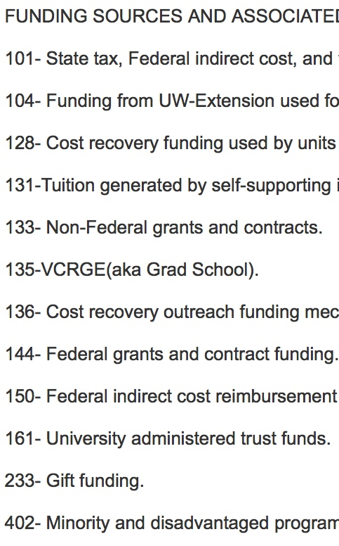
Another Slice of Expenditure Pie
UW Base Support
Extramural Research Funds

Slide 16
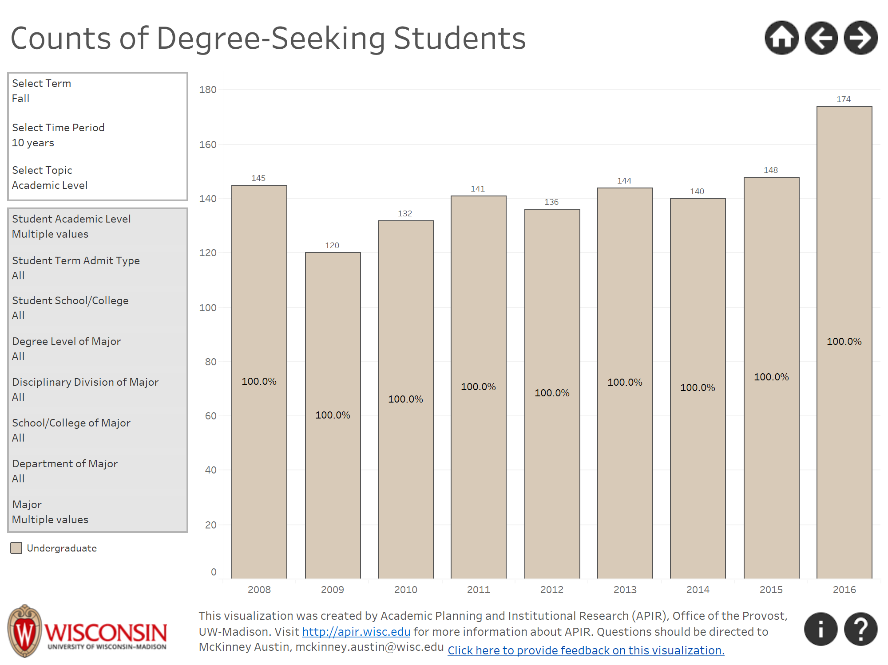
Physics Undergraduate Students
From UW DataViz site:
https://dataviz.wisc.edu/views/TrendsinStudentEnrollments/Homepage?%3Aiid=1&%3AisGuestRedirectFromVizportal=y&%3Aembed=y
My selection includes all Undergrad Majors in the programs:
Physics
Astronomy-Physics
AMEP

Slide 17
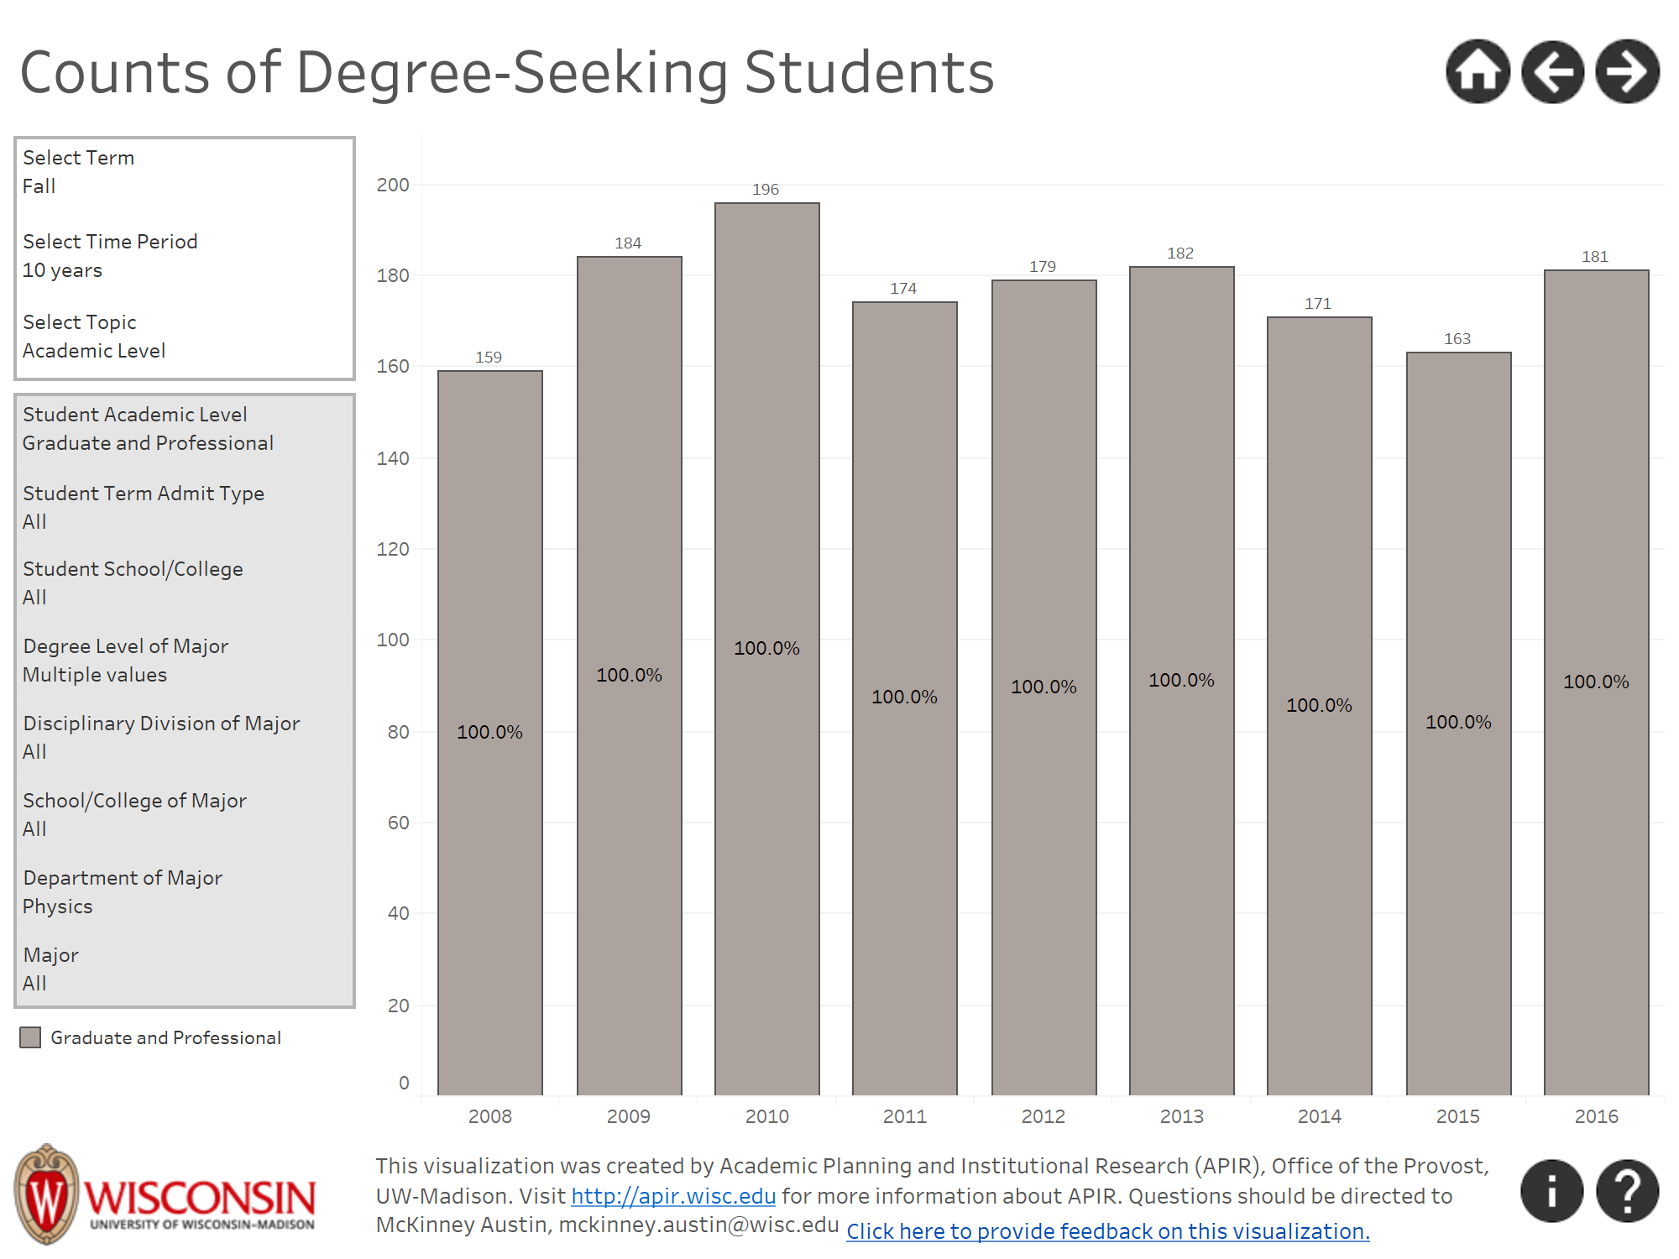
Graduate Students

