Slide 1
Electronics for Particle Physics Discoveries
Sridhara Dasu

Slide 2
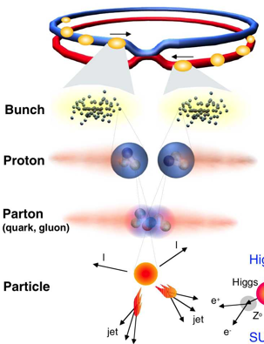
Proton-Proton Collisions at the LHC
 | Run-2 | Run-1
Beam energy | 6.5 TeV | 4.0 TeV
Bunches/ beam | 2556 | 1380
Protons/ bunch | 2.5x10¹¹ | 2.2x10¹¹
N pp Collisions Created | ~10¹⁶ | 3.5 x 10¹⁴
N Higgs Events | ~10⁴ | ~few 10²
Fetch me my needle buried in those
hay stacks –
And, do it
As Soon As Possible
1 event in 10 000 000 000 000 !
Notes:
1 barn = 10⁻²⁴ cm-²
Proton c.s 40mb/110mb@7TeV

Slide 3
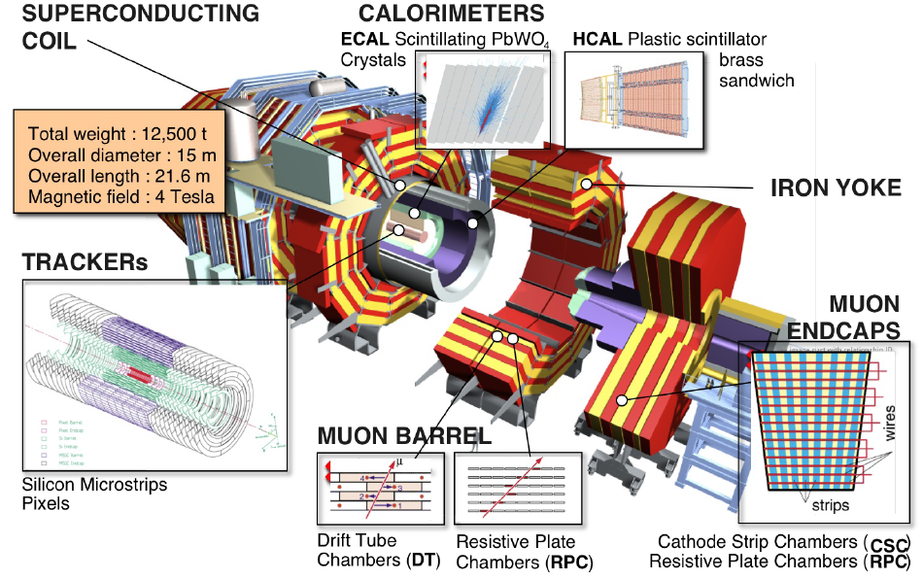
CMS Detector
Each event is >1MB!

Slide 4
LHC Physics @ 13 TeV – Trigger Challenge
Low ≅ 40 GeV
Electroweak Symmetry Breaking Scale
  Higgs discovery and higgs sector characterization
  Quark, lepton Yukawa couplings to higgs
New physics at TeV scale to stabilize higgs sector
  Spectroscopy of new resonances (SUSY or otherwise)
  Find dark matter candidate
Multi-TeV scale physics (loop effects)
  Indirect effects on flavor physics (mixing, FCNC, etc.)
    B_{s} mixing and rare B decays
  Lepton flavor violation
    Rare Z and higgs decays
Planck scale physics
  Large extra dimensions to bring it closer to experiment
  New heavy bosons
  Blackhole production
Low P_{T} γ, e, μ
Low P_{T} B, τ jets
Multiple low P_{T} objects
Missing E_{T}
~ Dedicated triggers (CMS) or experiment (LHCB)
Low P_{T} leptons
High P_{T} leptons and photons
Multi particle and jet events

Slide 5
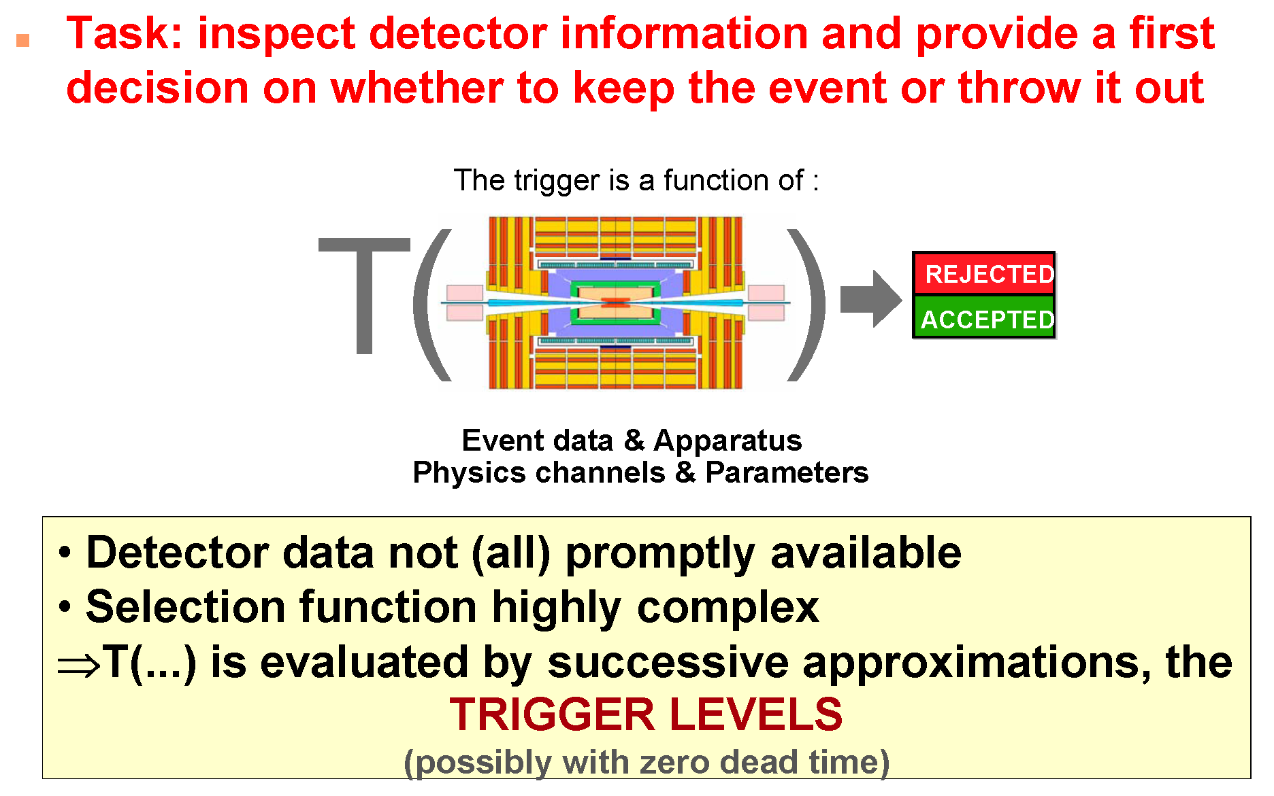
Trigger Task – Complex Decision in few μs

Slide 6
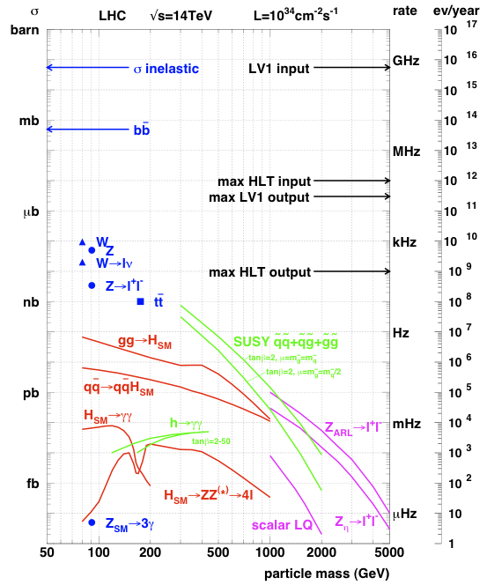
LHC Physics & Event Rates
L = 2 x10³⁴cm⁻²s⁻¹
  50 pp events/25 ns crossing
    ~ 1 GHz input rate
    “Good” events contain
    ~ 50 background overlap
  1 kHz W events
  10 Hz top events
  < 10⁴ detectable Higgs/year
Can store ~ 1000 Hz events
Select in stages
  Level-1 Triggers
    1 GHz (pp-interactions) to 100 kHz
  High Level Triggers
    100 kHz to 1000 Hz

Slide 7
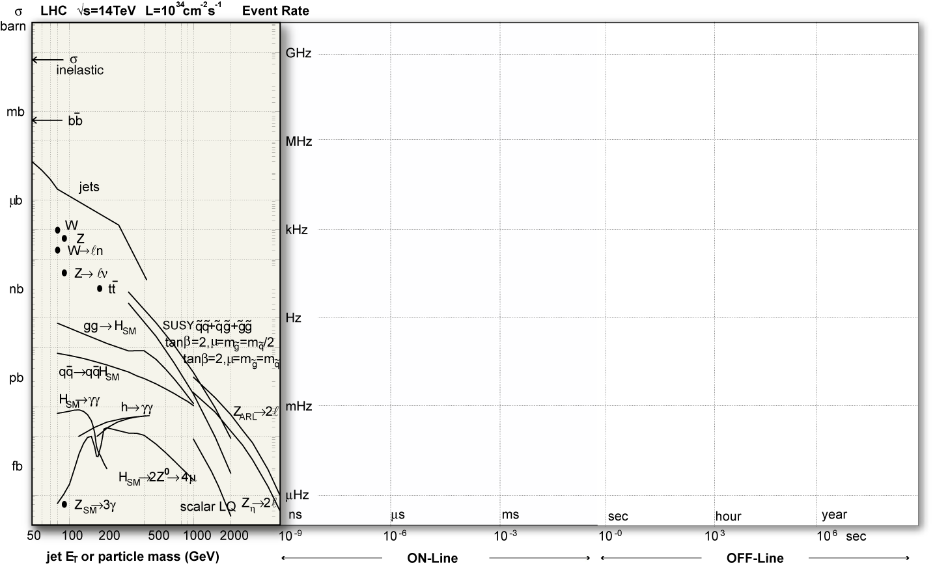
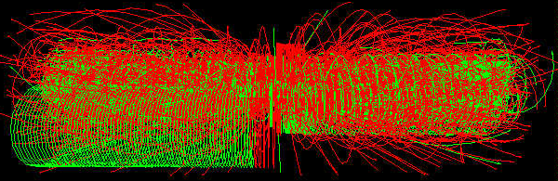
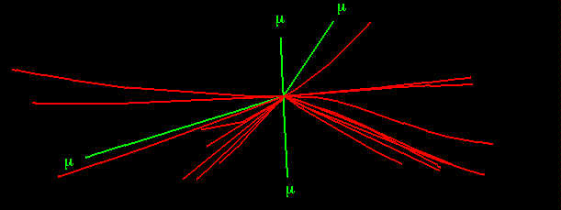
Collisions (p-p) at LHC
Operating conditions:
one “good” event (e.g Higgs in 4 muons )
+ ~40 minimum bias piledup events)
Event rate
All charged tracks with pt > 2 GeV
Reconstructed tracks with pt > 25 GeV
Event size: ~ 1 M bytes
Event Rate: ~ 32 M Hz

Slide 8
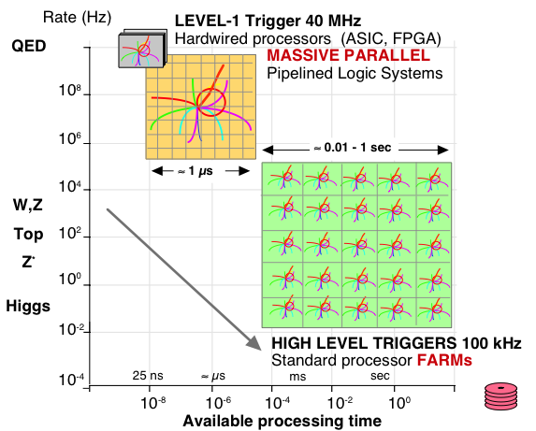
Processing LHC Data
QCD

Slide 9
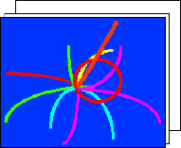





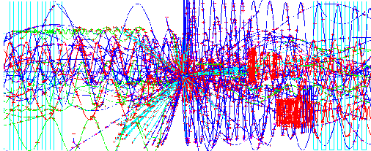
LHC Trigger & DAQ Challenges
Challenges:
1 GHz of Input Interactions
Beam-crossing every 25 ns with ~ 23 interactions produces over 1 MB of data
Archival Storage at about 300 Hz of 1 MB events
40 MHz
16 Million channels
COLLISION RATE
DETECTOR CHANNELS
3 Gigacell buffers
LEVEL-1
TRIGGER
Charge
Time
Pattern
Energy
Tracks
100 - 50 kHz
1 MB EVENT DATA
1 Terabit/s
200 GB buffers
READOUT
50,000 data
~ 400 Readout
memories
channels
EVENT BUILDER.
500 Gigabit/s
SWITCH NETWORK
A large switching network (400+400 ports) with total throughput ~ 400Gbit/s forms the interconnection between the sources (deep buffers) and the destinations (buffers before farm CPUs).
~ 400 CPU farms
EVENT FILTER.
300 Hz
A set of high performance commercial processors organized into many farms convenient for on-line and off-line applications.
FILTERED
5 TeraIPS
EVENT
Computing Services
Gigabit/s
Petabyte ARCHIVE
SERVICE LAN

Slide 10
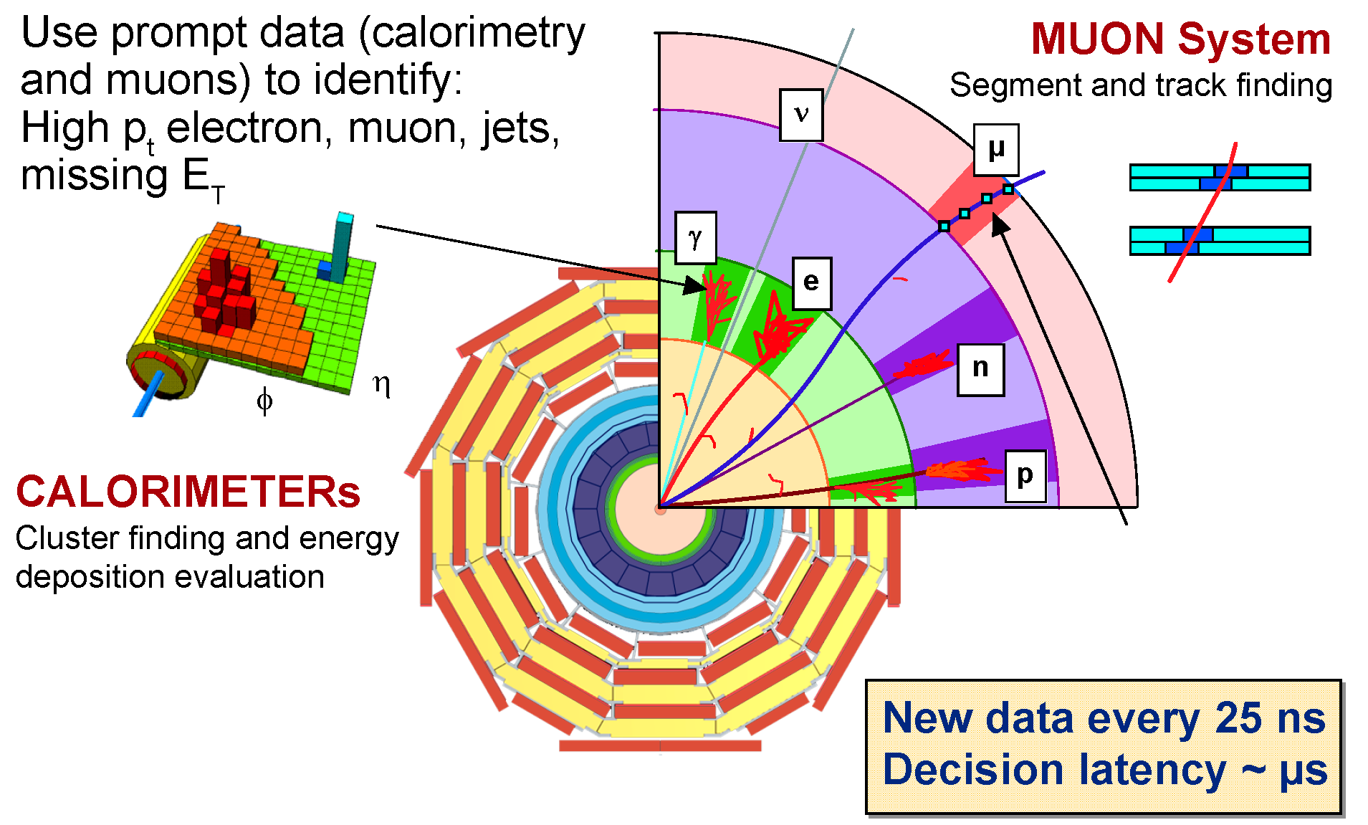
Level 1 Trigger Data

Slide 11
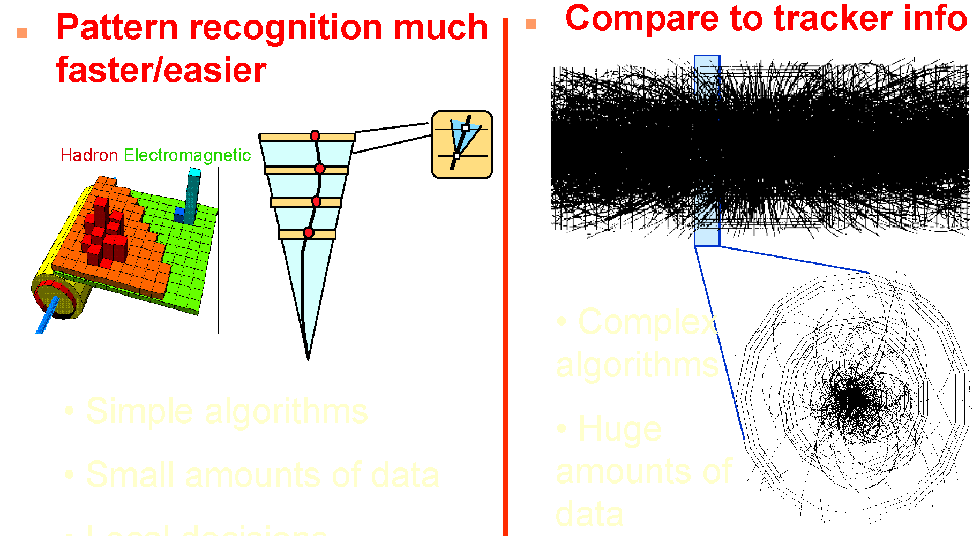
L1 @ LHC: Only Calorimeter & Muon – No Tracker
High Occupancy in high granularity tracking detectors
New tracker and track trigger envisioned for HL-LHC
Complex
Algorithms
Huge
amounts of
data
Simple Algorithms
Small amounts of data

Slide 12
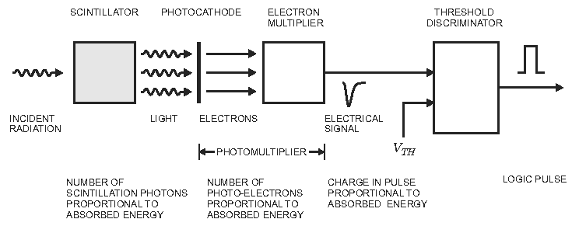
Example: Scintillator Signal
Photomultiplier serves as the amplifier
Measure if pulse height is over a threshold
from H. Spieler “Analog and Digital Electronics for Detectors”

Slide 13
Many Steps of Processing Before Readout!
Detector / Sensor
Amplifier
Filter
Shaper
clock
Sampling
Digital filter
Zero suppression
Range compression
L1 Trigger Logic
Buffer
Feature extraction
L2 Trigger Logic
Buffer
Format & Readout
to Data Acquisition System

Slide 14
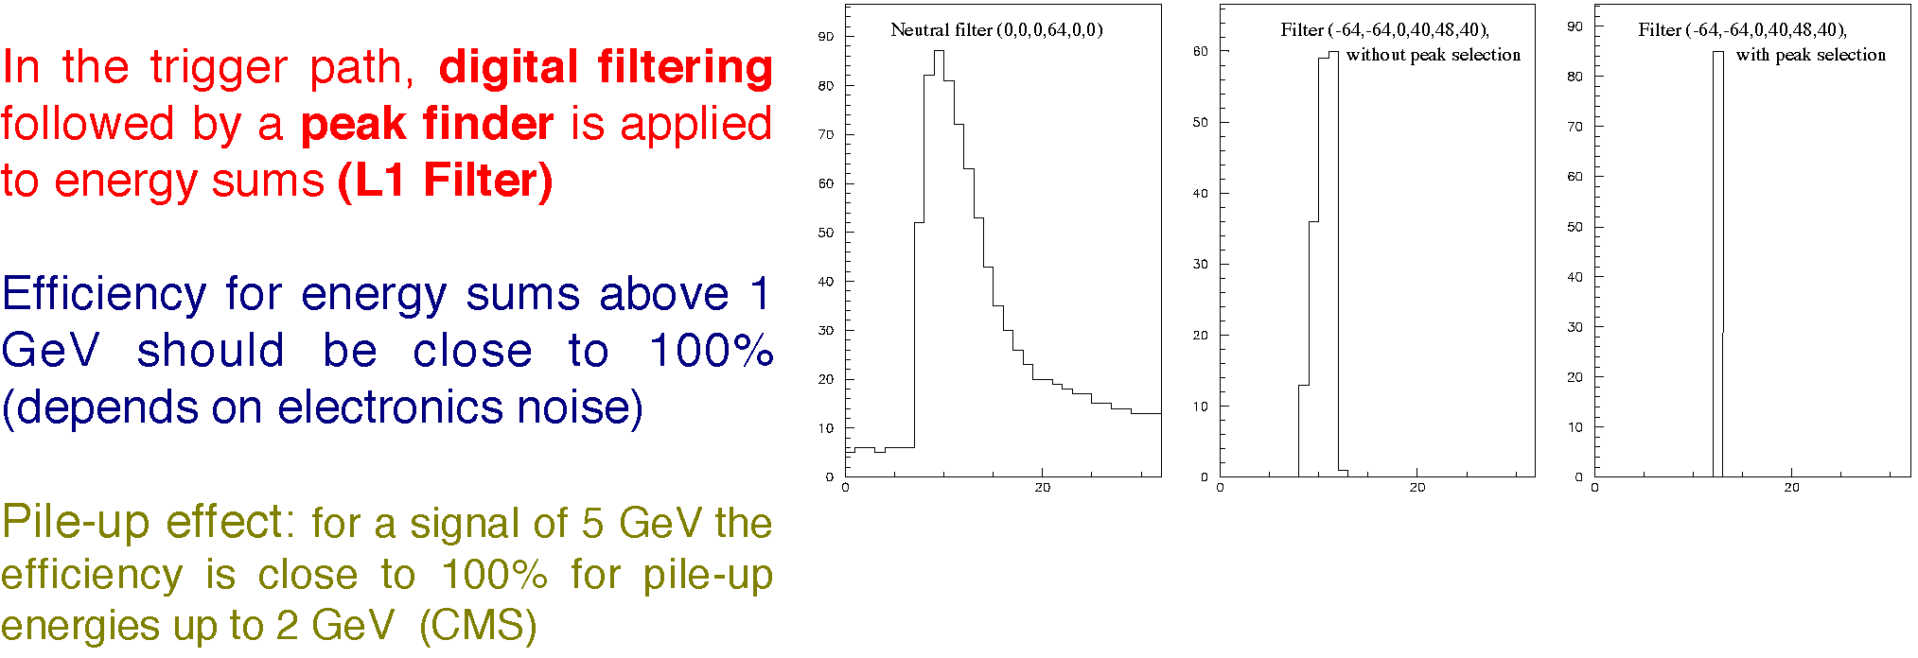
Filtering & Shaping
Purpose is to adjust signal for the measurement desired
  Broaden a sharp pulse to reduce input bandwidth & noise
    Make it too broad and pulses from different times mix
  Analyze a wide pulse to extract the impulse time and integral ⇒
Example: Signals from scintillator every 25 ns
  Need to sum energy deposited over 150 ns
  Need to put energy in correct 25 ns time bin
  Apply digital filtering & peak finding
    Will return to this example later

Slide 15
Sampling & Digitization
Signal can be stored in analog form or digitized at regular intervals (sampled)
  Analog readout: store charge in analog buffers (e.g. capacitors) and transmit stored charge off detector for digitization
  Digital readout with analog buffer: store charge in analog buffers, digitize buffer contents and transmit digital results off detector
  Digital readout with digital buffer: digitize the sampled signal directly, store digitally and transmit digital results off detector
  Zero suppression can be applied to not transmit data containing zeros
    Creates additional overhead to track suppressed data
Signal can be discriminated against a threshold
  Binary readout: all that is stored is whether pulse height was over threshold

Slide 16
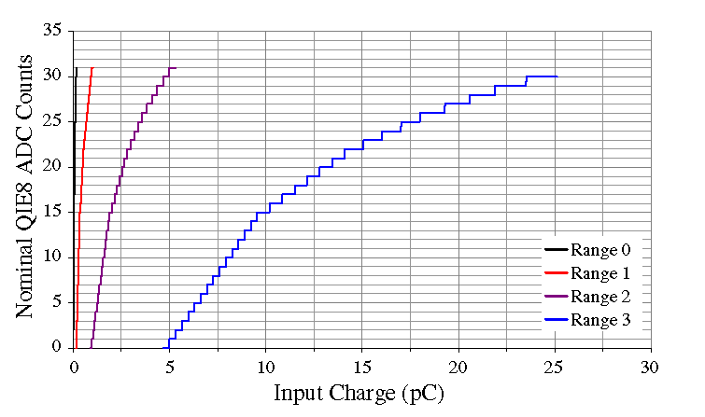
Range Compression
Rather than have a linear conversion from energy to bits, vary the number of bits per energy to match your detector resolution and use bits in the most economical manner.
  Have different
  ranges with
  different nos.
  of bits per pulse
  height
  Use nonlinear
  functions to
  match resolution

Slide 17
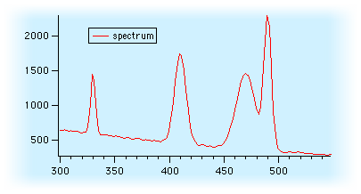
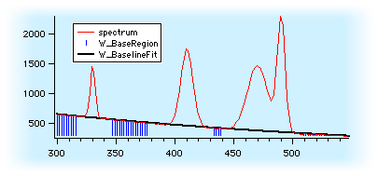
Baseline Subtraction
Wish to measure the integral of an individual pulse on top of another signal
  Fit slope in regions away from pulses
  Subtract integral under fitted slope from pulse height

Slide 18
EM Calorimeter Trigger/DAQ Processing
OD
TTC
TCS
Trigger Tower
25 Xtals (TT)
L1
Level 1 Trigger (L1A)
CCS
(CERN)
@100 kHz
Calo TRIGGER
Layer-1,2, DMUX
SLB (LIP)
TCC
(LLR)
Global TRIGGER
Trigger Tower Flags (TTF)
Trigger primitives @800 Mbits/s
Trigger Concentrator Card
Synchronisation & Link Board
Clock & Control System
Selective Readout Processor
Data Concentrator Card
Timing, Trigger & Control
Trigger Control System
SRP
(CEA
DAPNIA)
Selective Readout Flags (SRF)
Data path
@100KHz (Xtal Datas)
DCC
(LIP)
DAQ
From : R. Alemany LIP

Slide 19
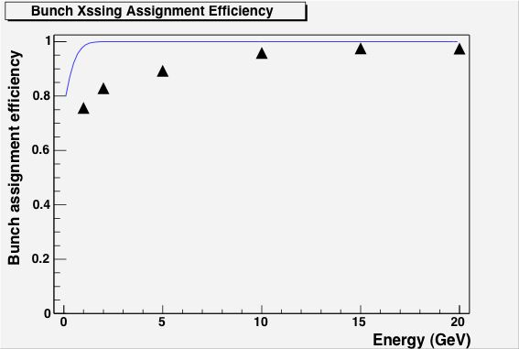
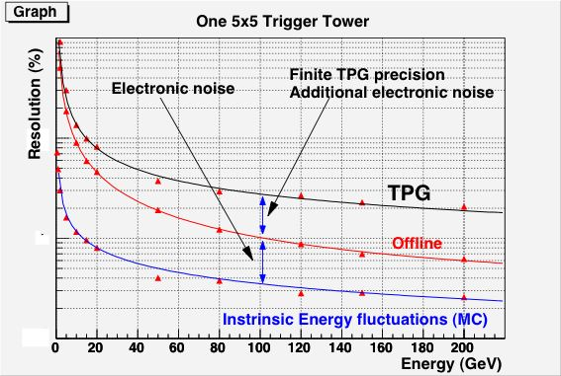
ECAL Trigger Primitives
Test beam results (45 MeV per xtal):

Slide 20
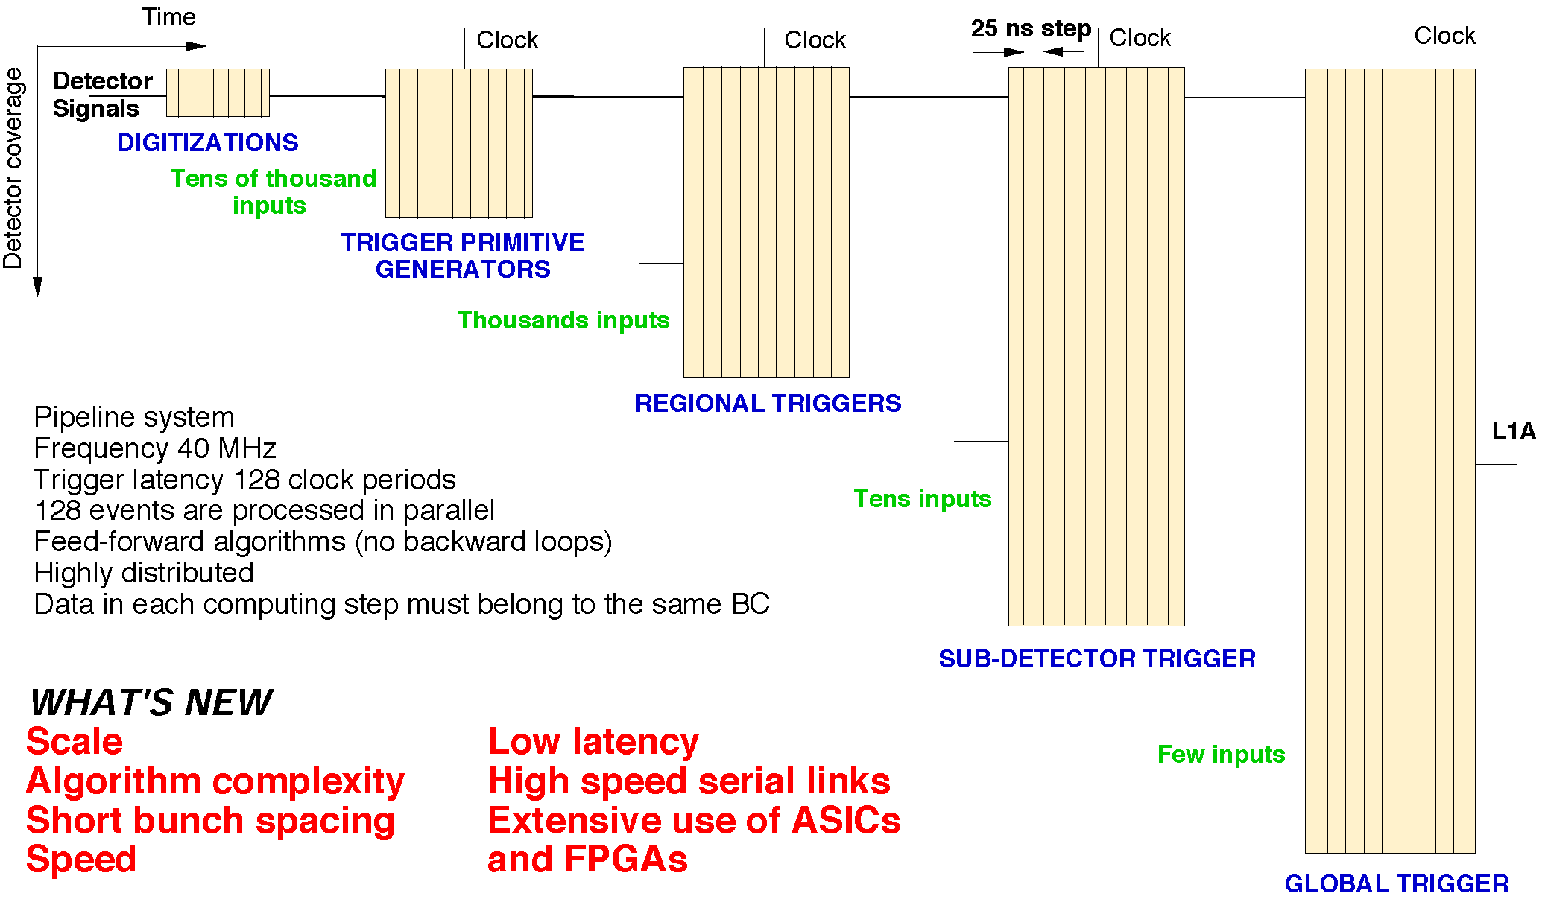
Level 1 Trigger Organization

Slide 21
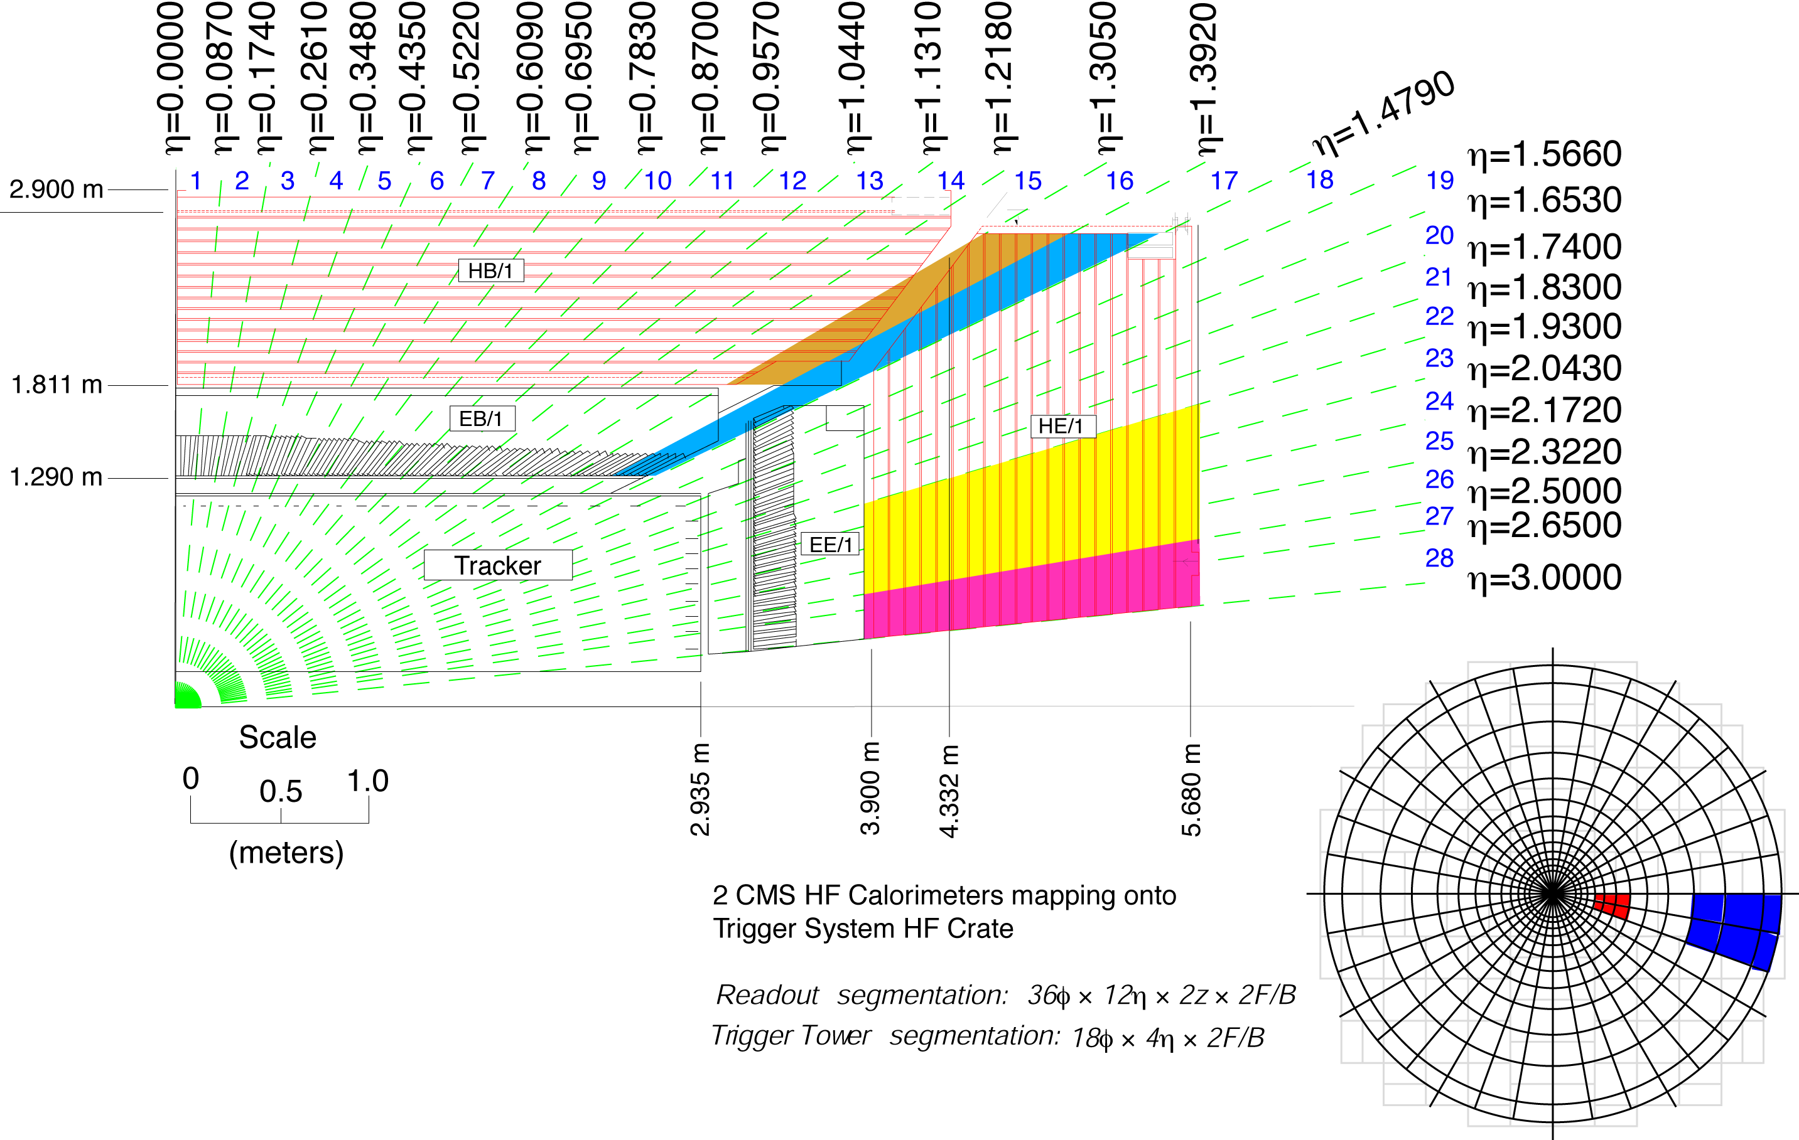
CMS Calorimeter Geometry
Channel Count
Full granularity: ~81000
Trigger level: ~5000
EB, EE, HB, HE map to 18 RCT crates
Provide e/γ and jet, τ, E_{T} triggers

Slide 22
Channels – Channels - Channels
Calorimeter Trigger Input from ECAL and HCAL (Phase-1)
Geometry | η-divisions | φ-divisions | Bits/E,H-tower ET, feature | Bandwidth (Gbps) | Fiber Count 4.8 – 6.4 Gbps
Barrel +/- | 17+17 | 72 | 8+1+8+6 | 2252 | 324 + 306
Endcap +/- | 11+11 | 72 | 8+1+8+6 | 1457 | 198 + 198
Total | 56 | 72 | 23 | 3609 | 1026
18 cards, 1 FPGA/card, ~56 4.8-6.4-Gbps inputs per card
Barrel Calorimeter Trigger Input ECAL & HCAL (Phase-2)
Geometry | η-divisions | φ-divisions | Bits/E-crystal Bits/H-tower | Bandwidth (Gbps) | Fiber Count 16 Gbps
ECAL Crystals | 17x5 | 72x5 | 10 | 208080 | 3060
HCAL Towers | 16 | 72 | 8+6 | 645 | 144
Total | - | - | - | 208745 | 3204
36 cards, 1 FPGA/card, 89 16-Gbps inputs per card

Slide 23
Technologies of Choice → LHC Schedules
FPGA & Telecom technology advances (VME → μTCA / ATCA)
  Ubiquitous >10 Gbps links
  FPGAs with O(100) rx/tx links with built in serdes
    Xilinx Kintex / Virtex-7 → Ultrascale platforms
    Gigantic cores
    DSP units, BRAM and Embedded processors (ZYNQ)
  Fiber optic components
    Avago mini-pods with 12x → Samtec Firefly 25 Gbps capable units
LHC long shutdown 1: 2013-2014 (Phase-1 Upgrades)
  Virtex-7 family cards
    CTP7 (Wisconsin), MP7 (Imperial), MTF7 (Florida)
  10 Gbps optics
LHC long shutdown 3: 2023-2025 (Phase-2 Upgrades)
  Ultrascale family card(s): APds Wisconsin
  14-16-25 Gbps optics

Slide 24

Xilinx Field Programmable Gate Arrays

Slide 25
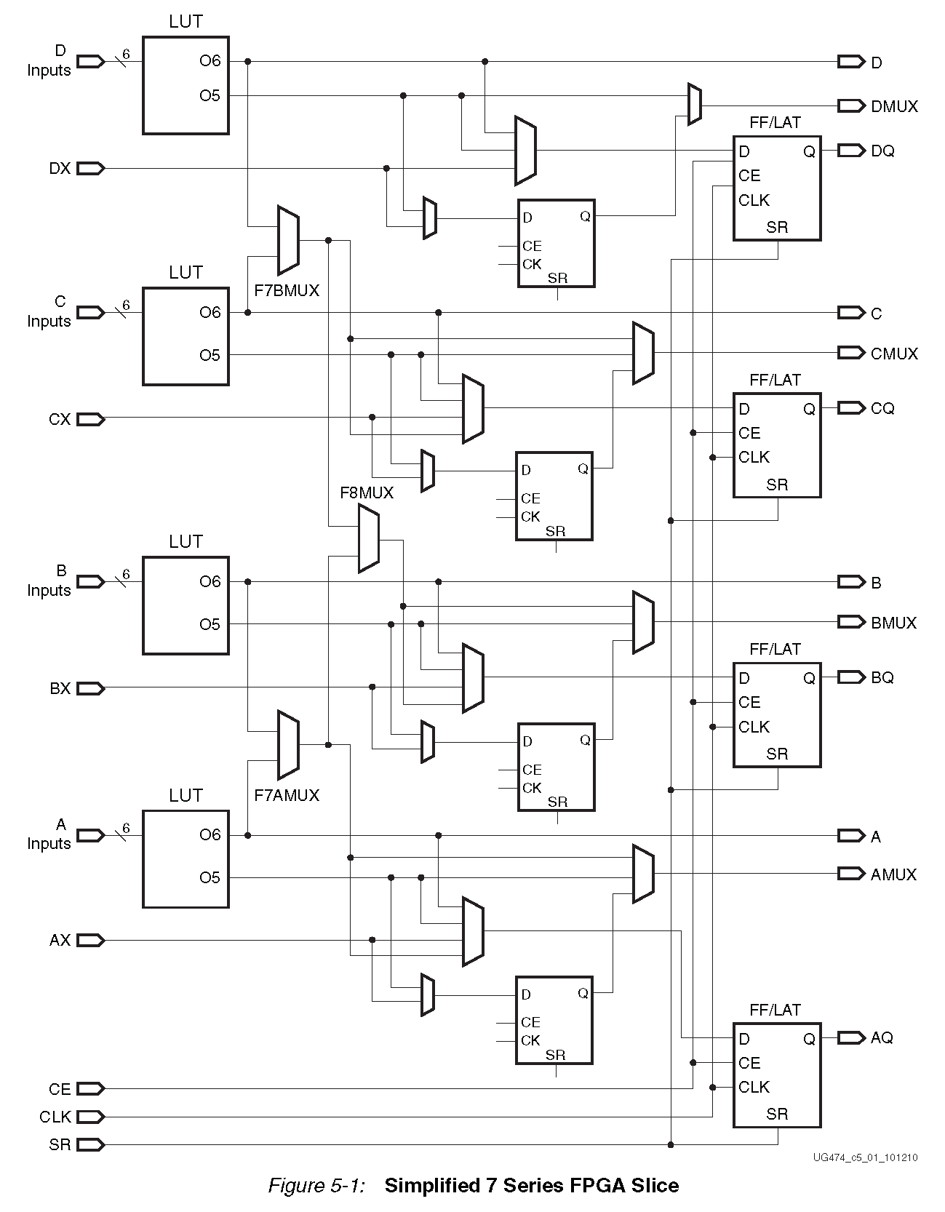
FPGA Slice
Array of well-defined logic cells, driven by LUTs
Software configured connections
Cleverly organized
Preconfigured digital logic elements

Slide 26
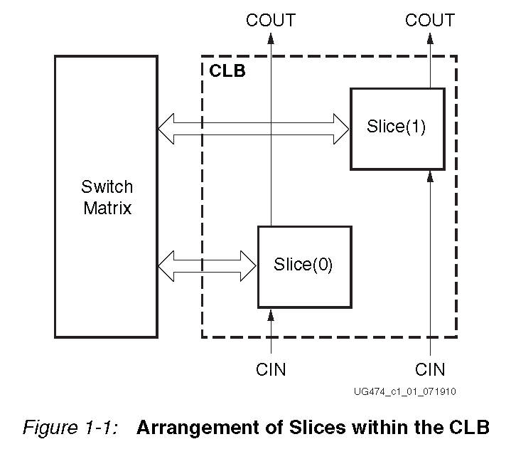
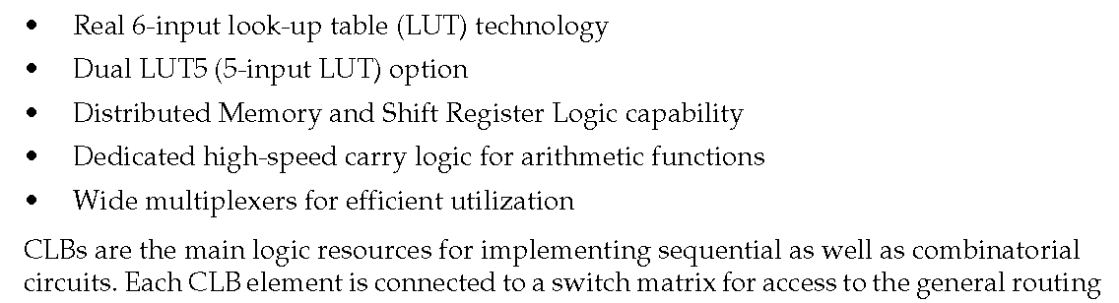
Configurable Logic Block
Firmware developer uses programming languages to define “connections”
Firmware tools create the “bit file” which defines the switch matrix / LUTs

Slide 27
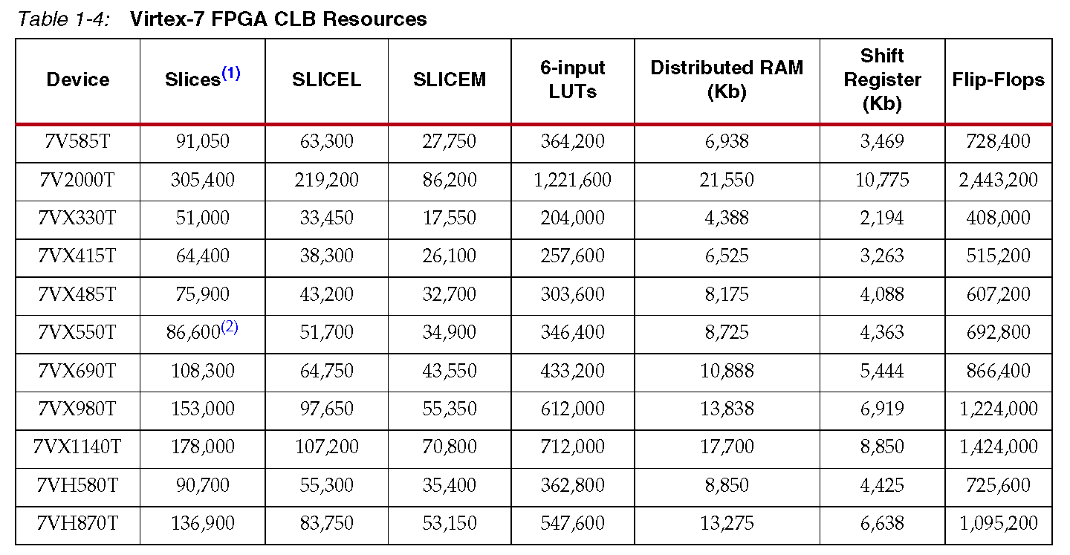
Abundant Logic Resources in Virtex-7 Family
In use for Run-2+Run-3 (2015-2023)

Slide 28
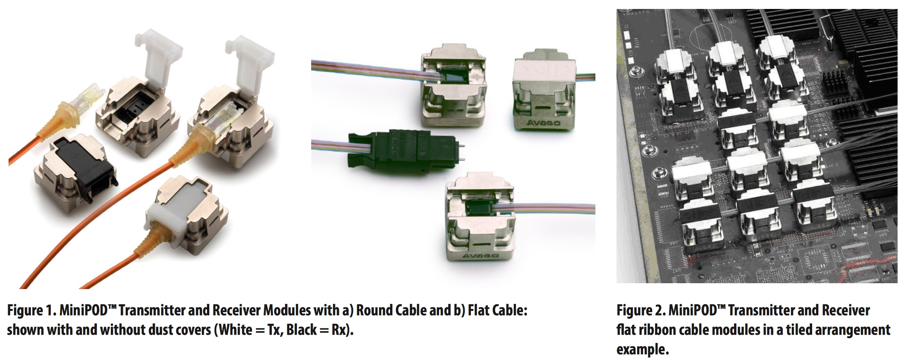
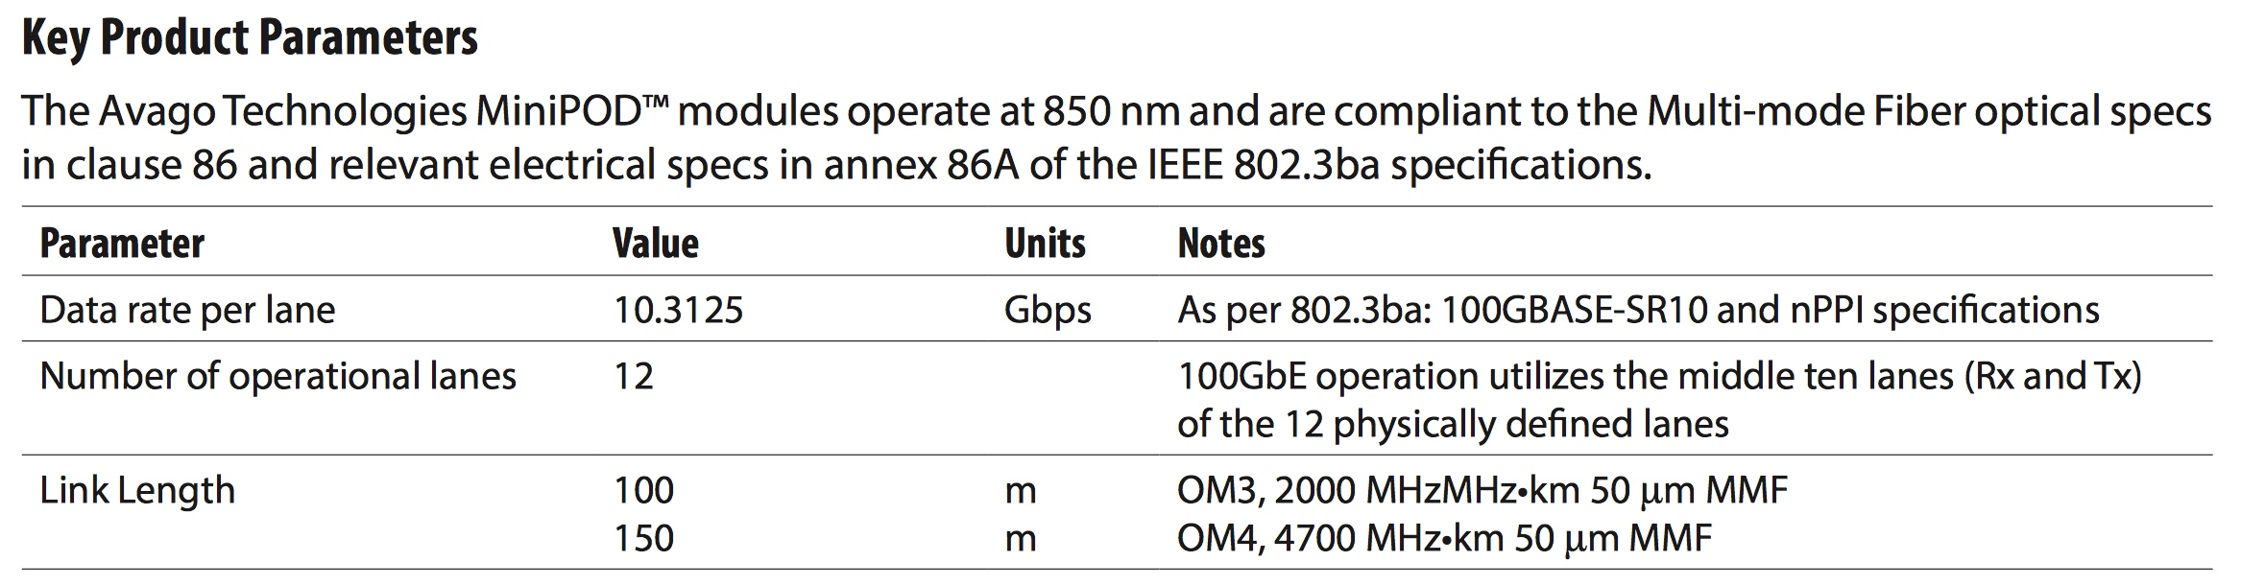
Key element - Multi-gigabit Opto-electronics

Slide 29
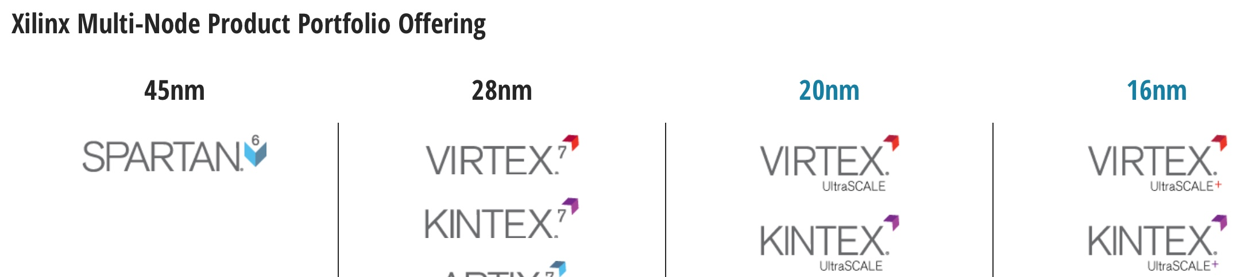
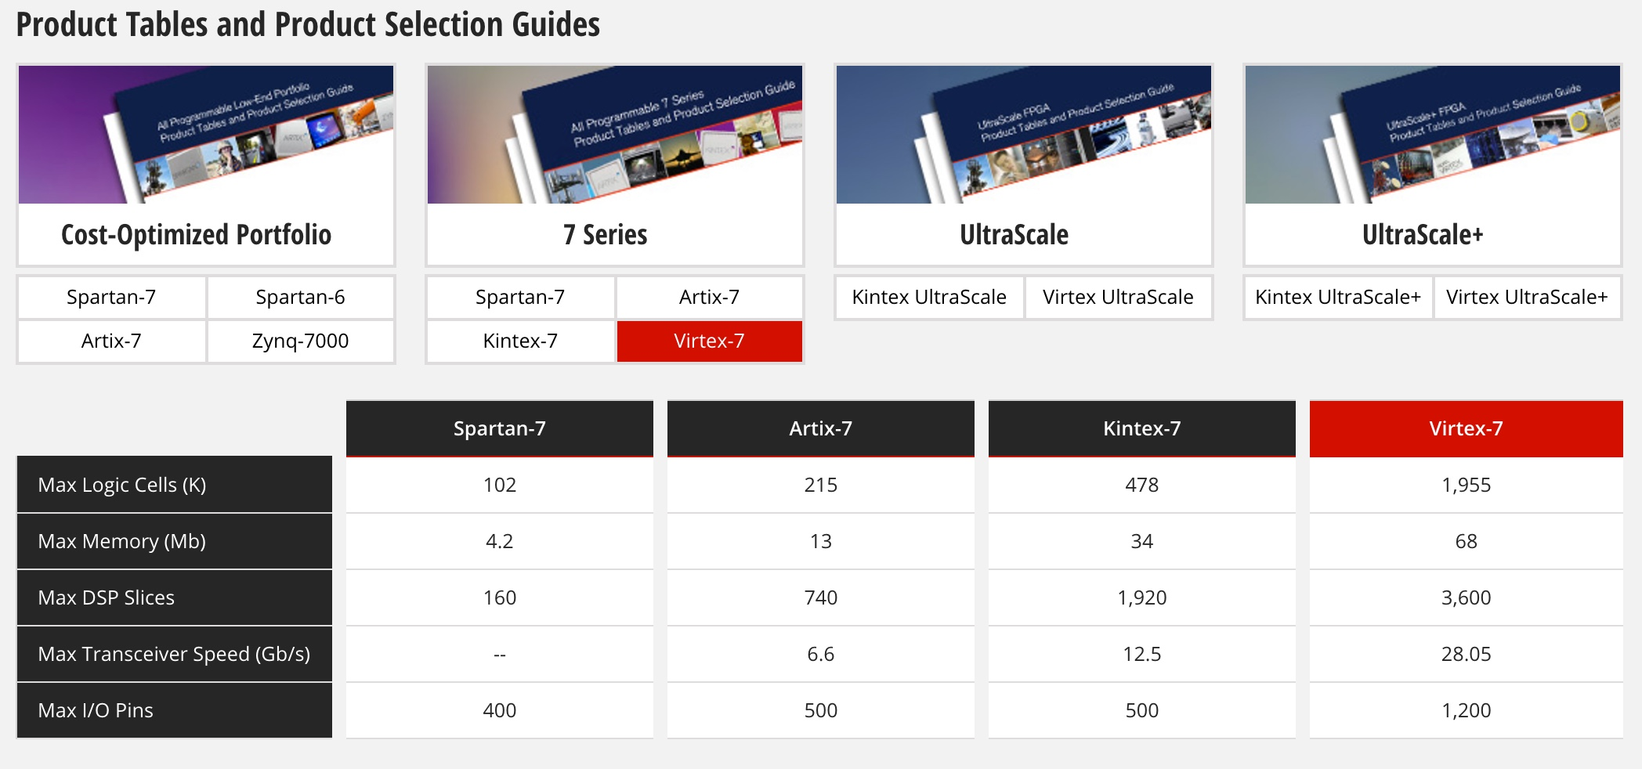
Xilinx FPGAs – Phase-1 Choice: V7 690T
Phase-1 Choice
Phase-2 Target

Slide 30
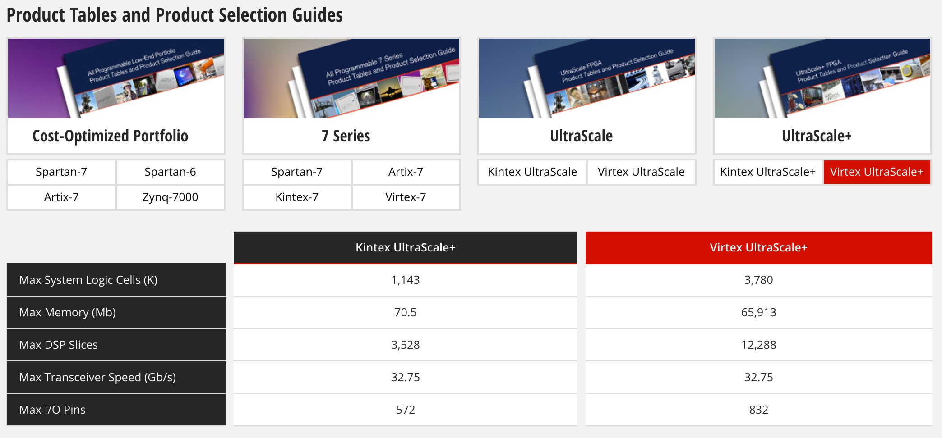
Xilinx – Ultrascale+ for Phase-2

Slide 31
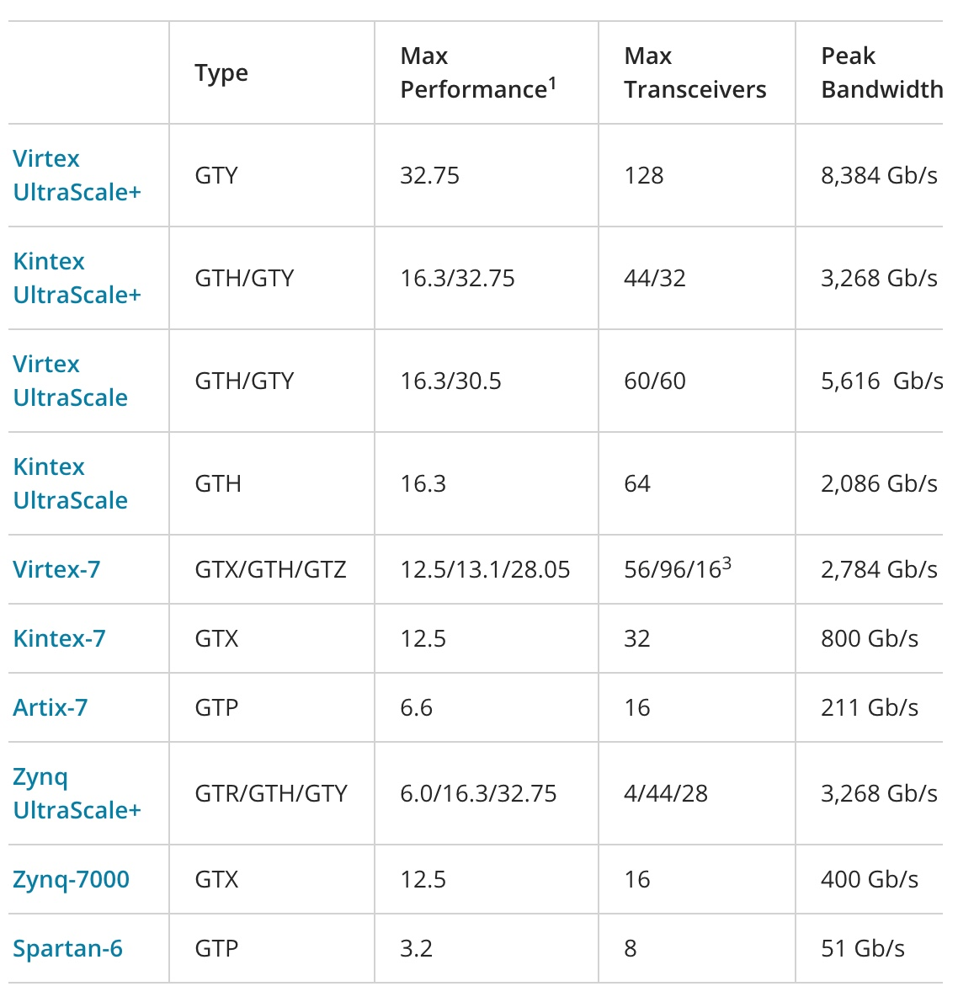
Multi-gigabit-per-second serial links
Phase-2
16 Gbps
Phase-1
10 Gbps

Slide 32
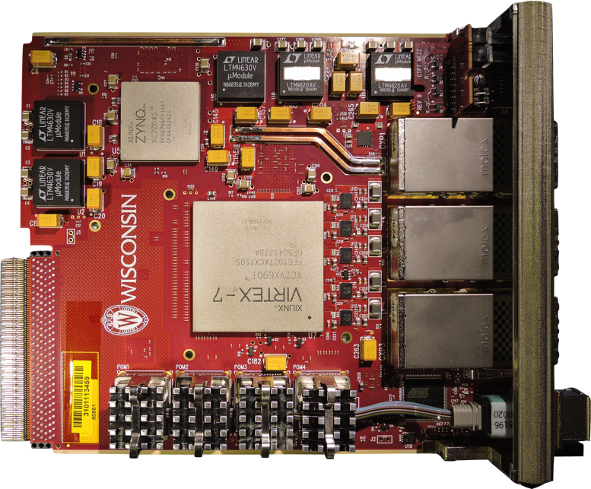
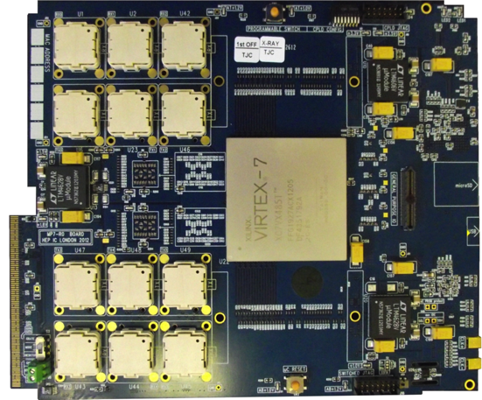
Phase-1 Calorimeter Trigger Electronics
JTAG
USB
Interface
Power Supplies
Rx
Tx
ZYNQ
2V5
3V3
μSD
3 CXP modules
1V5
1V8
2xQDR
(Bottom)
FPGA
FPGA
USB
Rx
Tx
μC
(Bottom)
MiniPODs
MMC
MiniPod modules
1V0
Calorimeter Trigger Processor(CTP7 – left), and Master Processor (MP7 - right)
  CTP7 (Layer-1) – μTCA Single Virtex 7 FPGA, 67 optical inputs, 48 outputs, 12 RX/TX backplane
    Virtex 7 allows 10 Gb/s link speed on 3 CXP(36 TX & 36 RX) and 4 MiniPODs (31 RX & 12 TX)
    ZYNQ processor running Xilinx PetaLinux for service tasks, including virtual JTAG cable
  MP7 (Layer-2) – μTCA Single Virtex 7 FPGA, up to 72 input & output links
    Virtex 7 has 72 input and output links at 10 Gb/s
    Dual 72 or 144MB QDR RAM clocked at 500 MHz
Notes:
oRSC – optical Receiver Summary Card
CTP7 – Calorimter Trigger Processor
MP7 ?

Slide 33
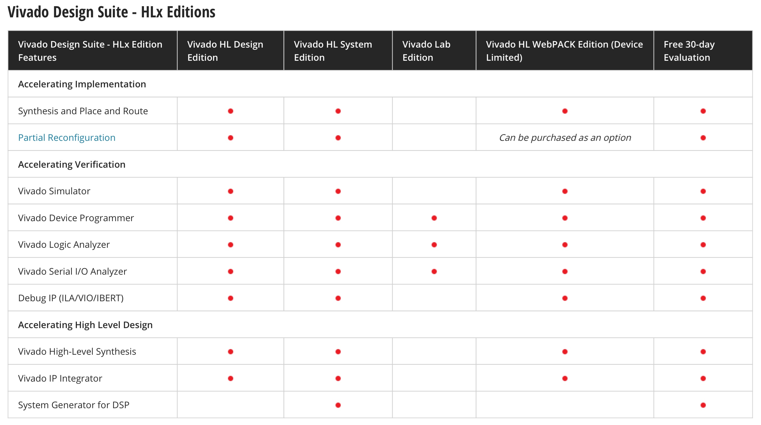
Xilinx Software – Vivado → Firmware

Slide 34
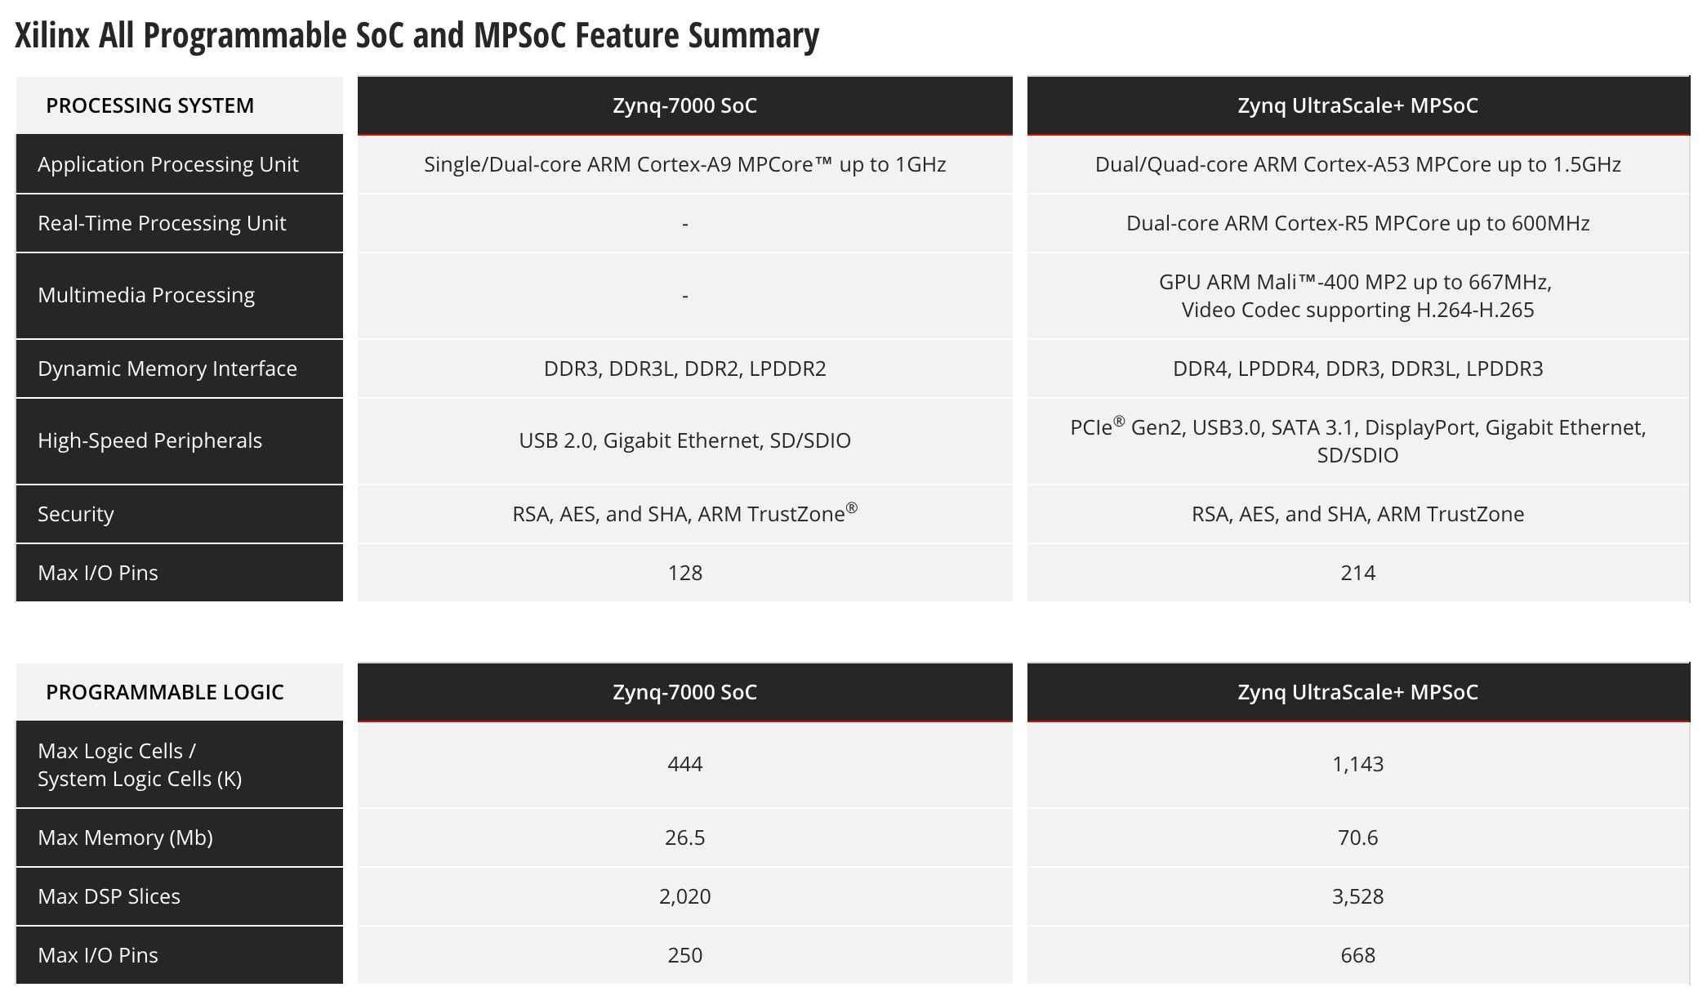
Xilinx ZYNQ – System on a Chip → Controls

Slide 35
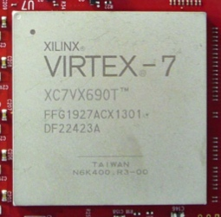
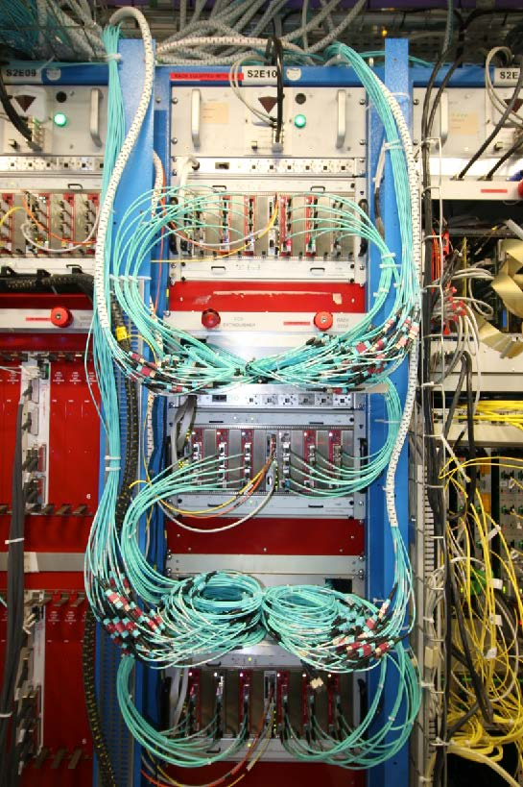
CMS Trigger for Run-2
CMS was built for a maximum sustainable trigger rate of 100 kHz
  To increase this requires major detector upgrades (e.g. tracker)
CMS wanted to keep its sensitivity to EWK physics, TeV scale searches
  Solution: increase level-1 trigger granularity, processing capacity, flexibility
CMS upgraded the trigger (to mitigate 2x instantaneous luminosity expected)
  Kept thresholds low, efficiencies high, and controlled the rates
  Commissioned in parallel to existing trigger
Took advantage of new technology
  Used modern FPGAs with high-speed links
    Fast links and increased data throughput
    Improved the algorithms
  Used modern μTCA format
    Compact (fits in spare rack space), hot
    swappable, redundant power supplies,
    high-speed backplane, control via LAN,
    and more…

Slide 36
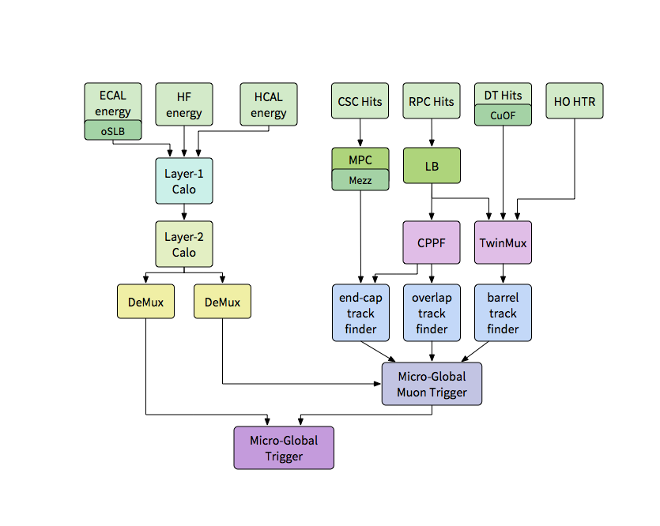
Level-1 Trigger Block Diagram (2016)

Slide 37
Phase-1 Cal Trigger Stage-1 Upgrade in 2015
Layer-1
RCT 0
RCT 1
RCT 2
…
RCT 17
Existing RCT
18 crates
oRSC 0
oRSC 1
oRSC 2
…
oRSC 17
18 oRSCs (w/Kintex)
USCMS
Layer-2
MP7 (new)
Algorithm Card(s) (1-3)
Imperial HW + Core FW/SW
USCMS Algorithm FW/SW
CTP7
Single Readout Card
In Situ RCT Test / Monitor
USCMS HW/FW/SW
Global Trigger (existing)
GT Inputs remain unchanged
DAQ – AMC 13 (new)

Slide 38
Phase-1 Cal Trigger Stage-2 Upgrade in 2016
Layer-1
CTP–0
CTP–1
CTP–2
…
CTP–17
18 CTP7s
USCMS
DAQ – AMC 13
Layer-2
MP7 Algorithm Cards (9+1)
Imperial HW + FW/SW
USCMS Algorithm FW/SW
Highest precision location of objects with dynamic clustering
μTCA Global Trigger
DAQ – AMC13

Slide 39
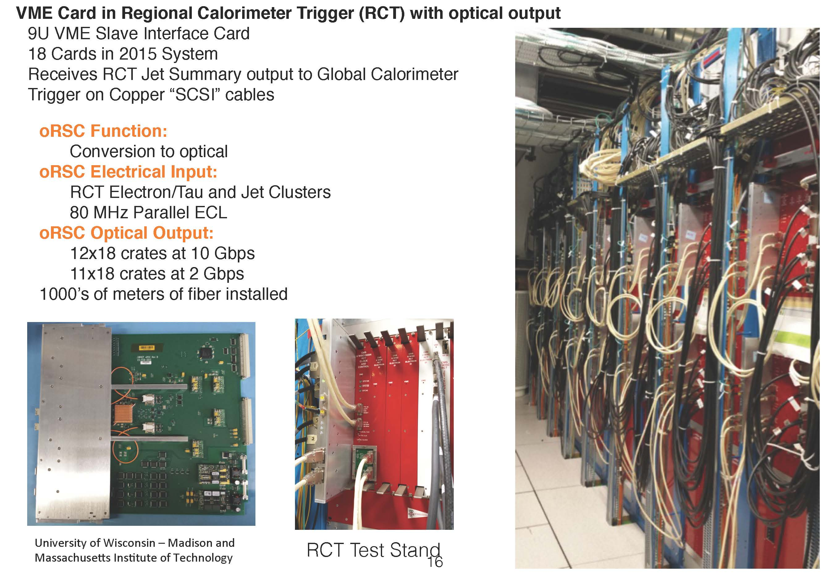
VME Hardware (2015) for Calorimeter Trigger

Slide 40
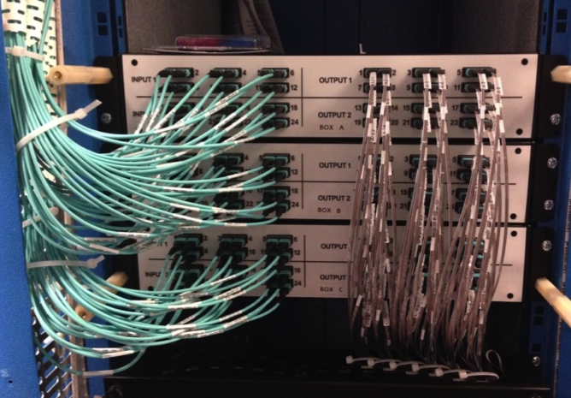
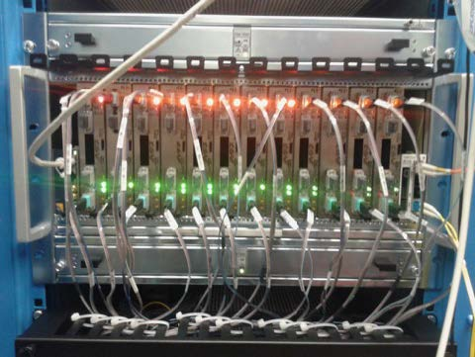
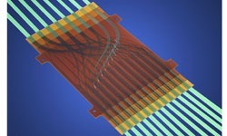
CMS Calorimeter Trigger Run-2
Installed and commissioned in 2015, fully operational in 2016
  Connections to CTP7 from Layer-1 patch panels completed in 2015
  Connections from Layer-1 to Layer-2 via compact patch panel
    3 “pizza box” sized patch panels instead of full 56U rack with LC connectors
  Layer 2 to demux to new μGT connected
Layer-1 CTP7
Layer-2 MP7
Layer-1 to Layer-2
Patch Panel
MOLEX
FlexPlane

Slide 41
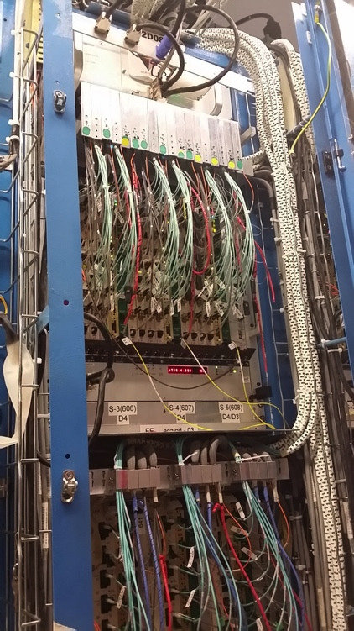
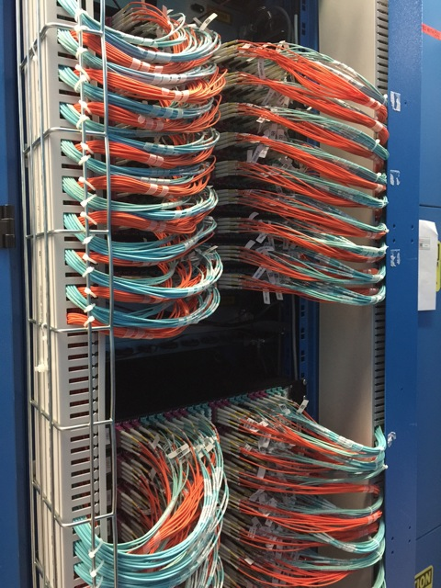
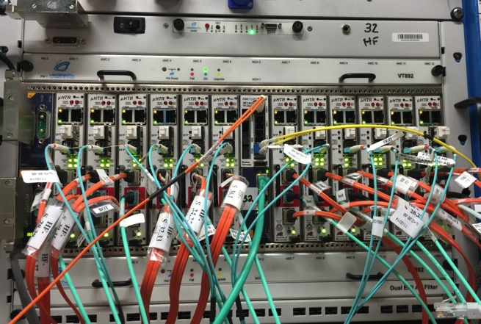
CMS Calorimeter Trigger for Run-2
Installed and commissioned in 2015, fully operational since 2016
  ECAL Back End (BE) has been converted to optical (from Cu) with Mezzanines
    2 x 4.8 Gbps links each, one for 2015 operation, one to Layer-1 Patch Panels
  HF and HCAL BE has been replaced with optical back end (μHTR)
    6.4 Gbps links, up to 6 per μHTR
  All optical connections to Layer-1 complete
    1152 fibers to 18 patch panels for conversion to MPO fiber ribbons
New HCAL and HF BE
ECAL
BE to Layer1
Patch Panels

Slide 42


Calorimeter Trigger Algorithms
Overall
  Use full calorimeter tower granularity
    Previously 14η x18φ now 56η x 72φ
    Better energy & position resolution
  Cluster dynamically
  Mitigate pileup
e/γ
  Cluster shape and electromagnetic energy fraction discriminates e/γ from jets
  Energy weighted position to potentially use for invariant mass triggers
Tau
  Clustering and position similar to e/γ, optimized for tau
  Merge neighboring clusters to recover multi-prong tau decays
Jet
  Sliding window, search for seed (central tower) energy above threshold
  Remove duplicates, sum 9 by 9 trigger towers for ~R=0.4 as used offline
2010 to 2015
2016 onwards

Slide 43
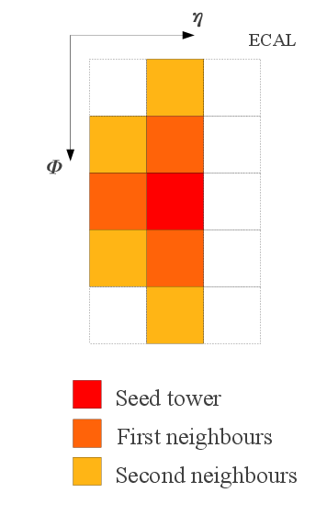
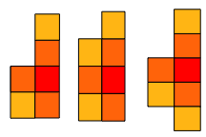

e/γ Algorithm
Dynamic Clustering
  Improved energy containment
  Showing electrons, photon conversions
  Minimize effect of pile-up
  Improved energy resolution
Cluster Shape Veto
  Discriminate using cluster shape and electromagnetic energy fraction between e/γ and jets
Calibration
  e/γ cluster energy calibrated as a function of ET, η and cluster shape
Energy Weighted Position
  Potential use in correlating objects e.g. invariant mass
Cluster Building
Cluster Shapes
Jet like
e/γ like

Slide 44

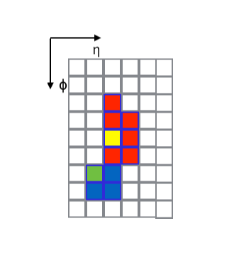
Tau Algorthm
Clustering, shape, and position
  Very similar to e/γ — optimised for τ
Merging
  Merge neighbouring clusters (~15% of clusters)
  Recover multi-prong τ decays
Calibration
  τ cluster energy calibrated as function of ET, η, merging and EM fraction
Isolation
  Very similar to e/γ — optimised for tau including merging as input – two working points

Slide 45

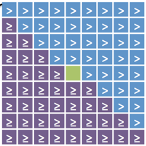
Jet Algorithm
Input Granularity
  Access to higher granularity inputs than Run I
Sliding window jet algorithm
  Search for seed energy above threshold
  Apply veto mask to remove duplicates
  Sum 9x9 trigger towers to approximate R=0.4 used offline
Pile-Up Subtraction
  Consider four areas around jet window
  Subtract sum of energy in lowest three from jet energy
Calibration
  Correct jet energies as a function of jet ET and η
Pile-up Subtraction Areas
Seed Tower
Veto Mask

Slide 46
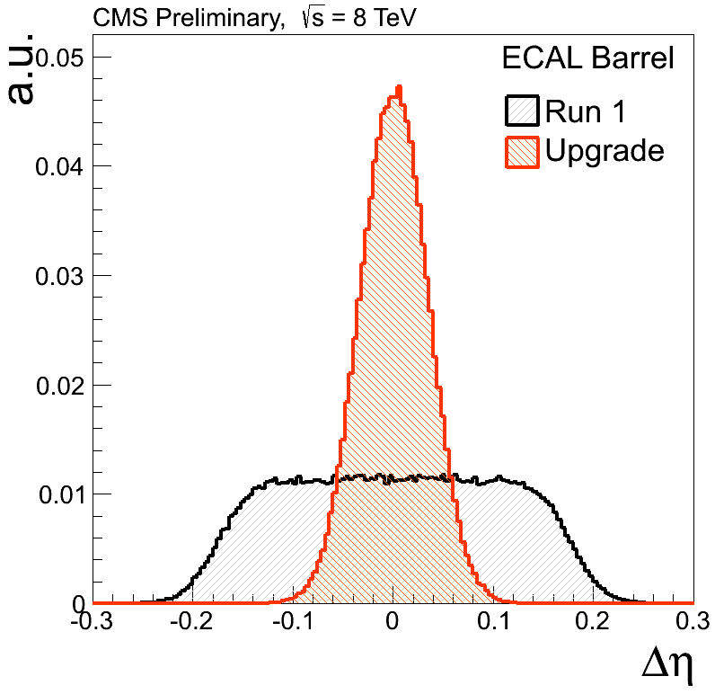



e/γ Performance
Efficiency for single e/γ with E_{T} > L1 threshold vs offline E_{T}
  Tag and probe method with Z→ee dataset
  As LHC conditions change, isolation adapted
  Isolated e/γ reduces rate with modest reduction in efficiency
    Combined with higher-threshold non-iso triggers
Non-Isolated e/γ
Isolated e/γ
Better Position
Resolution

Slide 47


Tau Performance
Efficiency for a single tau for E_{T}> L1 threshold vs offline tau p_{T}
  Tag and probe for Z→μτ
  Adapt isolation as LHC conditions change
  Isolated reduces rate with modest impact on efficiency
    Can be combined with higher-threshold relaxed tau trigger
Relaxed tau
Isolated tau

Slide 48



Jet Performance
Level-1 jets are matched to offline jets
(ΔR < 0.25)
  Single muon data sample (unbiased)
  Sharp turn on for different L1 Jet E_{T} (upper left)
  No pile up dependence (upper right)
  Good resolution (right)

Slide 49
Design Considerations – Phase 2
Start with a tiled multi-layer architecture where:
  Regional Layer partitions the detector and forms regional clusters, local cluster–track matching ...
  Global Layer identifies and creates detector-wide triggerable objects (e.g. electrons, jets, MET, …)
  Possibility to expand by adding additional layers or more cards to a certain layer.
Use high-end Xilinx FPGAs
  Example: Xilinx Ultrascale Plus VU9P FPGA
  >2.5 M logic cells, >100 28-Gbps links, >75 Mb BRAM, … etc.
  Support services using ZYNQ SOC with embedded unix, etc
  Modern support tools for high-level synthesis, etc
Infrastructure based on ATCA
  Industry standard
  What are the specific requirements on this part of the WBS, how do they drive the design. Can include physics motivation if not already discussed in L2 talk (or if more details are needed), add another slide as needed.
  You should refer to your requirements document

Slide 50
Calo & Corr Trigger Deliverables
Endcap Calorimeters
Barrel Calorimeters
Outer Tracker
Detector
Endcap Muon
System
Barrel Muon
System
Pixel Tracker
DTC: Outer Tracker BE
MIP Timing Detector
CE BE
EB/HB/HF BE
EMU BE
BMU BE
Barrel Calo
Trigger RCT
Track
Trigger
Endcap Muon
Track Finder
Barrel Muon
Track Finder
24 Boards
13 boards
6 boards
162
boards
Barrel Calo
Trigger GCT
9 + 1 Boards
Wisconsin :
Calo RCT/GCT & Correlator Layer-1
Correlator Trigger Layer-1
36 + 6 Boards
7.5 kHz
To Offline
BE+L1 System:
40,000 kHz event data
processing
750 kHz To HLT
DAQ/HLT System
Event Builder
HLT
Storage Manager
Correlator / Global Trigger Layer-2
5-10 Boards

Slide 51
Calorimeter Trigger Subdivisions
L1 Calorimeter Trigger
  Input from Barrel ECAL crystals and HCAL towers + HGCAL clusters
  Output energies, locations of clusters and candidate e/γ, τ, jets, and energy sums to track correlator and global trigger
Regional
Calorimeter
Trigger
Global
Calorimeter
Trigger
24x
9+1 x
Ratios reflect ηxφ input regions to output regions
HGCAL
BE

Slide 52

APd1 + Control Boards
APd1 Rev A PCB
VU9P FPGA
ZYNQ-IPMC (ATCA IPMI controller)
ELM1 (ZYNQ-based embedded Linux endpoint)
ESM (GbE switch)
19 28G Firefly positions loaded
(76 links)
High efficiency heatsinks
Front-panel inputs

Slide 53

APd1 with LLUT and RTM mated
Additional 6 28G Firefly positions on RTM (24 links) (total=100)

Slide 54

APd1 in ATCA Crate
APd1 in center position
“Home-made” panel
19× 28G Fireflly modules (76 Tx and Rx channels) to frontpanel in 10 MTP positions
Switchable frontpanel JTAG and console ports
  Frontpanel switch allows frontpanel access to IPMC, ELM or main board JTAG chain, and IPMC or ELM consoles
Frontpanel USB and SFP ports for additional development flexibility

Slide 55


Slide 56


Slide 57

APx – Firmware/Software
ELM:
Control endpoint,
providing complete
board overhead
functionality
Processing FPGA:
I/O
data processor
DAQ

Slide 58

APx Firmware Shell

Slide 59


APx-FS Resource Utilization
VU9P build
100x 25G GTY links w/ support infra
Central AXI infra with MGT-based Chip2chip core
APd1 VU9P FPGA floorplan

Slide 60
Multi-Card HLS Demonstrators
Gen-0 (in operation at UW and CERN)
  CTP7-based (3 cards, 96 total active links @ 10.0G available)
  HLS interface grafted onto Phase 1 8b10b link infrastructure
  64-bit link interfaces
Gen-1 (in operation at UW)
  APd1 single card setup
  Iridis-style 64b66b transport
  Early APx shell functionality
    Asynchronous processing clock
Gen-2 (underway)
  Multicard test setup
  Iridis-style signaling and APx shell environment
  Common emulated TCDS timebase in ATCA/MicroTCA crates using CTP7

Slide 61
Gen-1 Demonstrator Firmware
Algorithm block interface standardized on AXI-stream for input and output data
  Build time configurable number of input and output links
  Designed such to allow direct instantiation of HLS IP block (option A)
  Also an option to include HDL wrapper inside the algo block (option B)
Option A
Option B
Algo Block
Algo Block
HLS
H
D
L
HLS
H
D
L

Slide 62
Concluding Thoughts
A team of engineers and physicists have tamed the LHC data deluge with intelligent use of communications technologies to enable fundamental physics discoveries.
Advances in telecommunications technologies are continually adapted to track increasing data streams.
Students and postdocs are getting good training, especially in operations sand firmware, for potential careers in both academia and industry.

