Slide 1
Welcome to the
Department of Physics
Professor Sridhara Dasu, Department Chair

Slide 2
Congratulations!
Prospective
Graduate Students for 2021
91 Offers Made
Out of 600+ Applicants
59 women
31 men
63 Experiment
9 Theory
10 Both
9 Undecided
22 International
69 Domestic

Slide 3
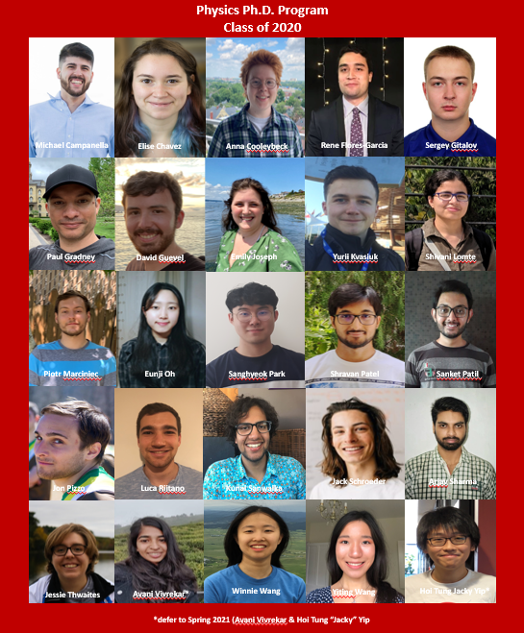
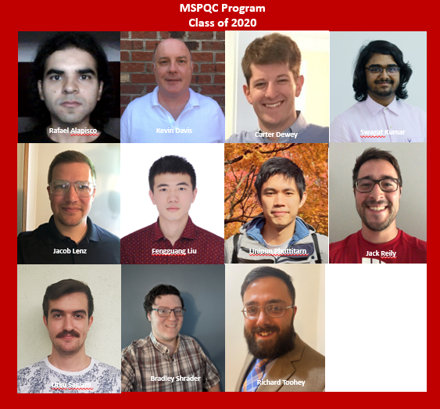
Your Predecessors from 2020

Slide 4
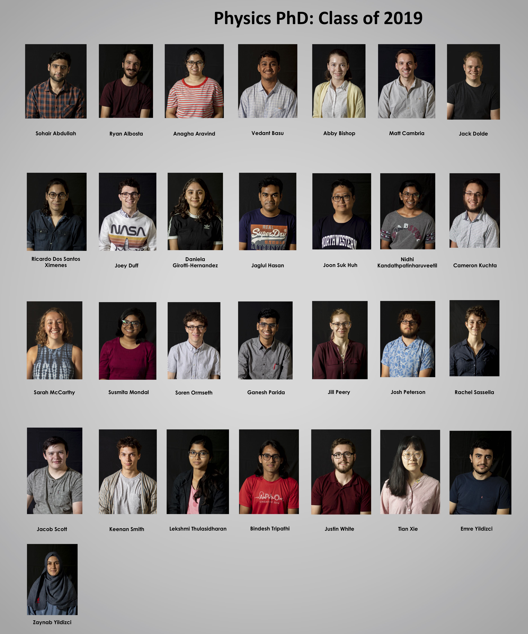
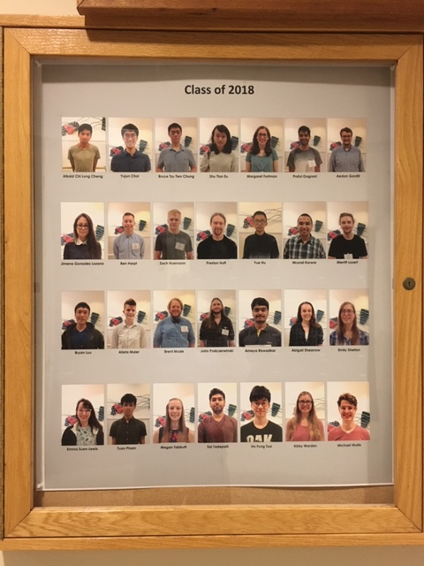
More of Your Predecessors

Slide 5
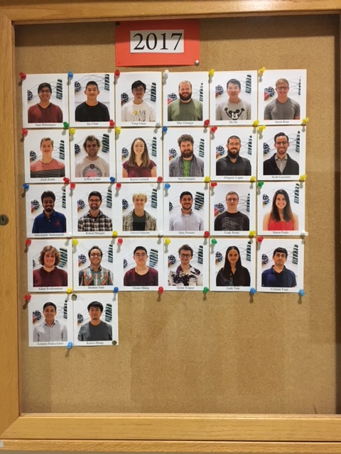
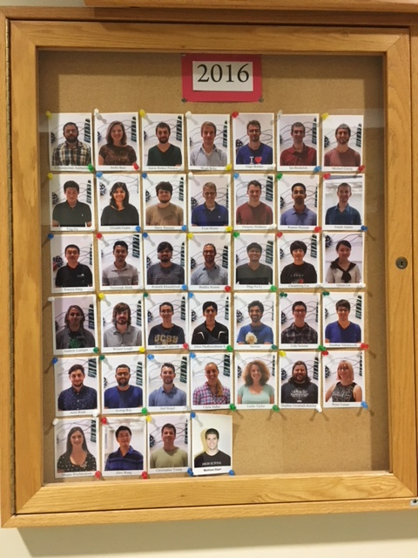
Even More of Your Predecessors

Slide 6
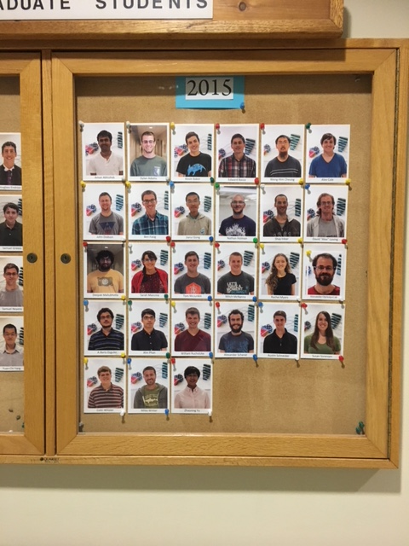
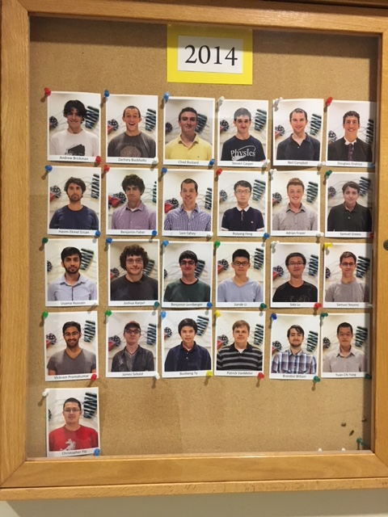
We're a Big Department!

Slide 7
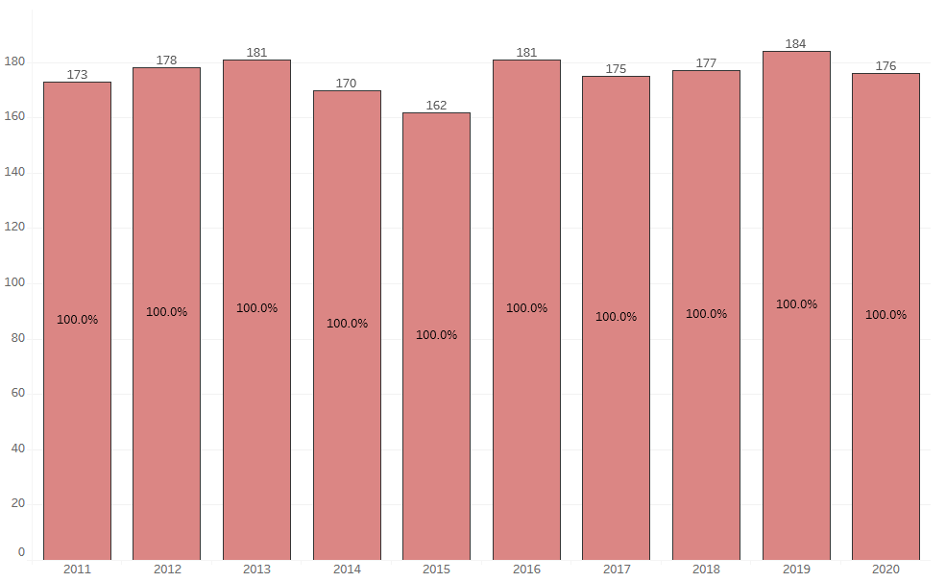
Physics Graduate Students
# of Grad Students
Year

Slide 8
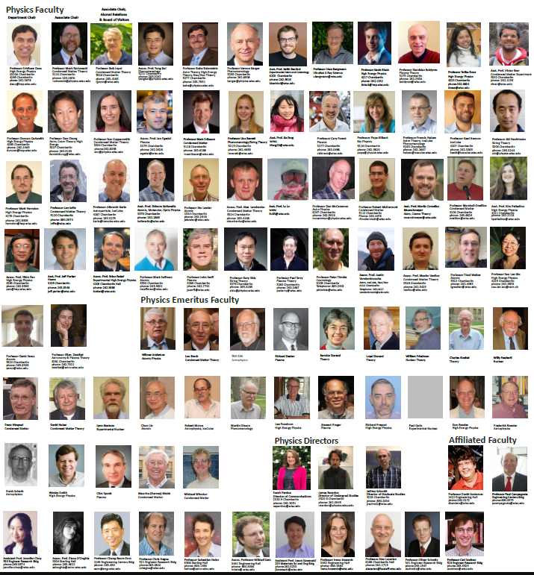
We are a big group of people!
Notes:
Is this accurate?

Slide 9
People Count!
Role | Count
Non-major UG Students Served (<300-level) | 2867
Physics Majors (Including AMEP, AP, double majors) | ~175
Graduate Students | ~186
Non-faculty Research Staff | ~95
Faculty | 50
Non-faculty Teaching Staff | 11
Technical Staff | 11
Administrative Staff | 9
Emeritus Faculty | 26
Affiliated Faculty | 10
Total (Excluding Service course UGs) | ~3400 (~500)
Notes:
Is this accurate?

Slide 10
Department of Physics (2020-21)
Chair
(Dasu)
Assoc. Chair
(Rzchowski)
Department
Administrator
(Lefkow)
Climate & Diversity
Faculty Recognition, Salaries
New Staff, Promotions & Mentoring
Strategic Planning
Curriculum
Colloquium
Facilities
(Space, Library
Computing, …)
Outreach, Museum
& Events
Student Awards
Non-faculty Recognition, Salaries
Dept. Finances
Assoc. Chair
Alumni Affairs
(Joynt)
Physics Council
Director of Computing (Bradley)
Physics Learning Center
(Nossal)
Director of Communications (Perdue)
Physics Centers
WIPAC (VCRGE center)
WiPPL
WQI
Graduate Student Organizations
PGSC
GMaWiP
Nominations
Notes:
Is this accurate?

Slide 11
Physics Teaching Organization
Assoc. Chair (Rzchowski)
Admin Support
(Holland, Kennedy - Grad)
(Tredinnick - UG)
Director of
UG Program
(Reardon)
Service Courses
Physics Majors
Teaching Facilities
Course Coordination (Thurs, Mohammadi)
TA Training & Operations (Reardon)
Active Learning (Spike)
Laboratories (Unks)
Lecture Demos (Narf)
Electronics Shop (Gates)
UG Advisors
(McCammon, Egedal, Yavuz)
AMEP Advisors (Forest, McDermott, Yavuz)
Physics Club Advisor (McCammon)
Laboratories Committee
Service Courses Committee
Director of
Grad Program (Schmidt)
Advising on
Course Plan
Interfacing with Grad Mentor Committees
Qual Exam Preparation
Grad Mentor Committees
Garage Physics
(Carlsmith)
Prelim Exam Committee
Committees
UG Program Committee
Grad Program Committee
Grad Admissions Committee
Qual Exam Committee
Notes:
Is this accurate?

Slide 12
Physics Administration & Services
Department
Administrator
(Lefkow)
UG Student Services Coord (Tredinnick)
Travel
(Bannon, Kinzley)
Purchasing (Austin)
Research Program
(Kmiec)
Grad Student Services Coord (Holland)
Payroll & HR (Hering)
Instrument Shop (Dummer)
Foster
Gerber
Pape
Yaeger
Accountant (Miner)
Student Services Coord (Kennedy)
Director of Computing
(Bradley)
Physics Librarian
(Warwick)
System Admin (Seys)
Librarian
(Croushore)
Notes:
Is this accurate?

Slide 13
Physics Learning & Physics Earning ☺
Director of Physics Learning
(Nossal)
PLC Staff (Hooper)
PLC Staff (Huesmann)
PLC Staff
(Moore)
PLC Staff (Schenker)
PLC Staff (Trestrail)
Admin Support
(Department Staff)
Assoc. Chair
Alumni Affairs
(Joynt)
Board of Visitors
This is a very important effort which funds student scholarships,
visiting speaker funds, outreach
and lately new faculty!
Notes:
Is this accurate?

Slide 14
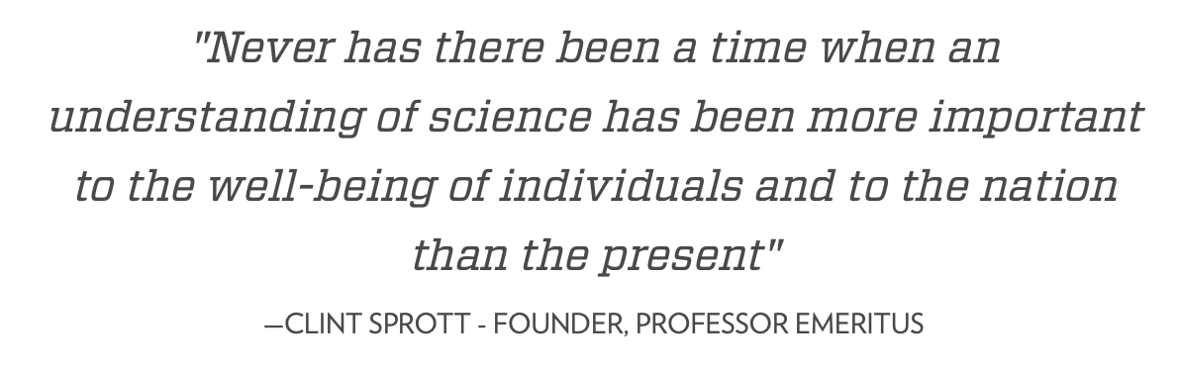
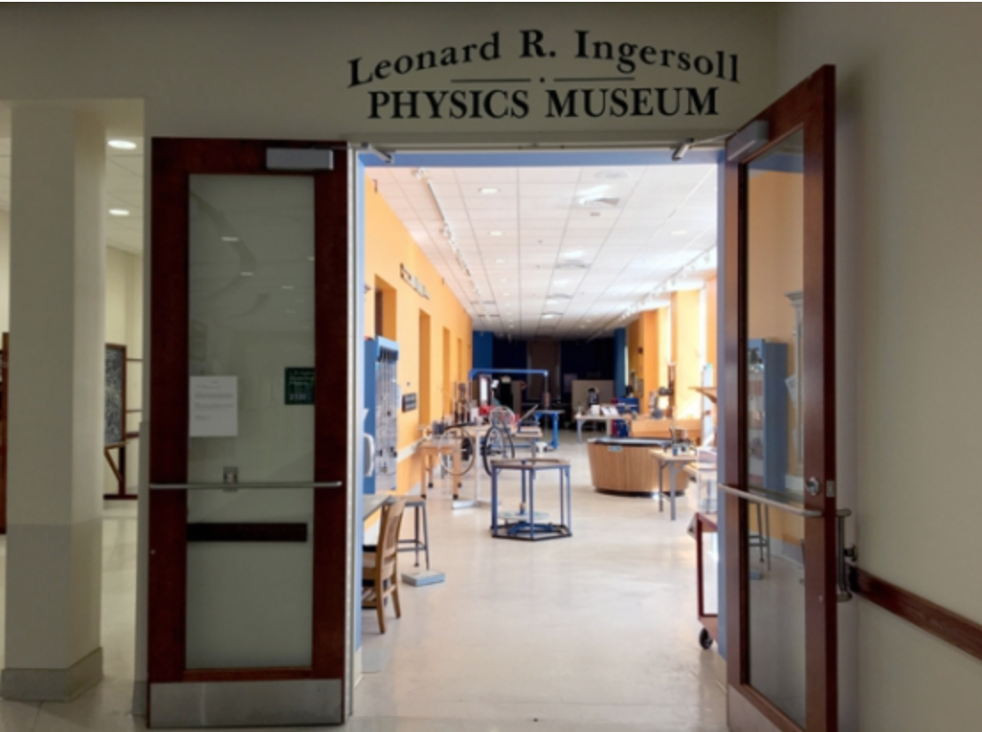
Outreach
Mallory Conlon,
Quantum Science Outreach Program Coordinator

Slide 15
Funded Research Areas & Faculty
Astro-particle / Neutrino-astrophysics (WIPAC)
  Halzen, Hanson, Karle, Vanderbroucke, Lu, Fang
Astrophysics & Cosmology (Cosmo)
  McCammon, Timbie, Bechtol
AMO and Quantum Computing with Neutral Atoms (AMO)
  Saffman, Walker, Yavuz, Lawler, Kolkowitz
X-Ray Physics – Material Science – Bio-materials (Bio)
  Gilbert, Bergmann
Condensed Matter, Quantum Computing & Nanostructure Experiment (CMP-E)
  Brar, Erikkson, McDermott, Rzchowski
Condensed Matter, Quantum Computing Theory (CMP-T)
  Levchenko, Joynt, Vavilov
High Energy Physics Experiment (HEP-E)
  Black, Bose, Dasu, Herndon, Rebel, Wu
Nuclear, Particle, Astro-particle, Cosmology & String Theory (NPACS-T)
  Bai, Balantekin, Barger, Chung, Everett, Hashimoto, Shiu, Munchmeyer
Wisconsin Plasma Physics Laboratory, Plasma-astrophysics (WiPPL)
  Boldyrev, Egedal, Forest, Sarff, Terry, Zweibel, Parker

Slide 16
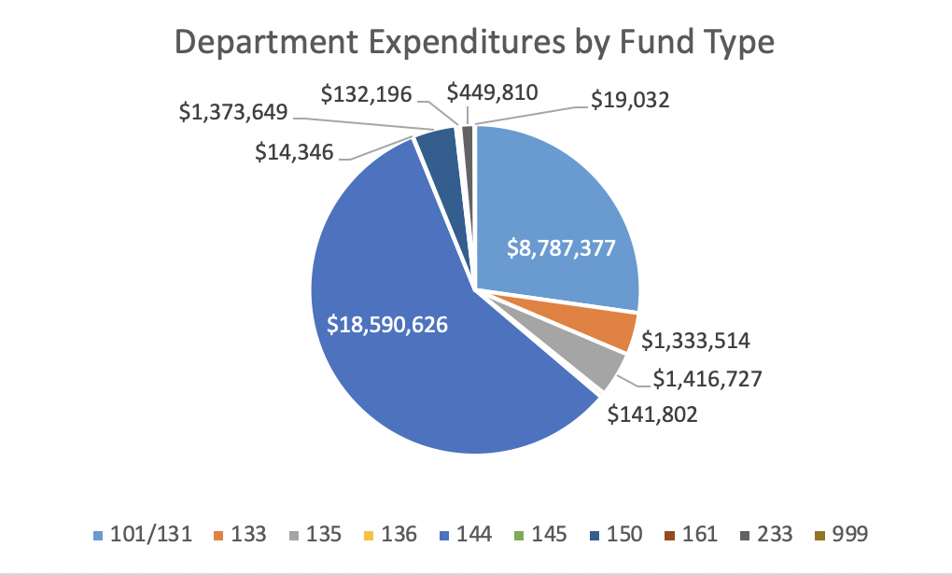
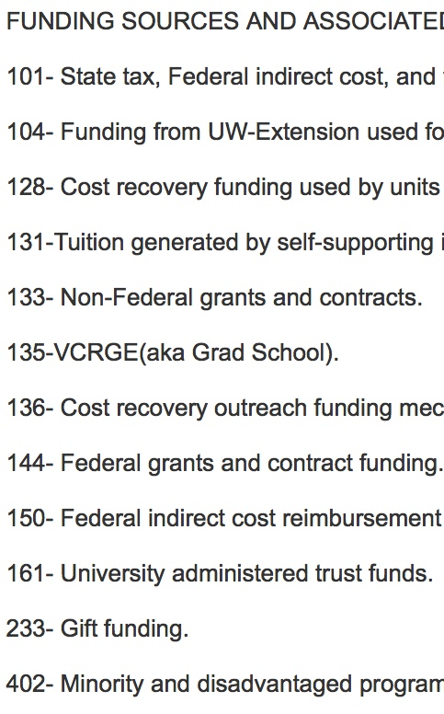
$32.2M Expenditure Pie
UW Base Support
Extramural Research Funds

Slide 17
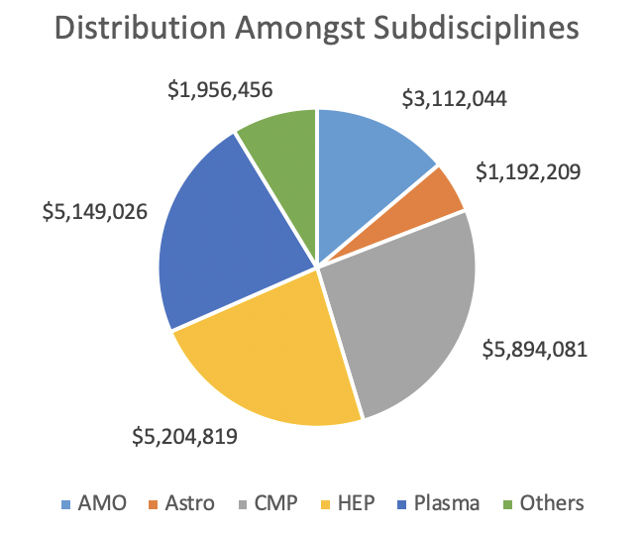
Research Areas: Expenditure
Reasonably well balanced across various research areas
Astro does not include the big enchilada – WIPAC, which is managed separately

Slide 18
80% of our effort is due to research funding

Slide 19
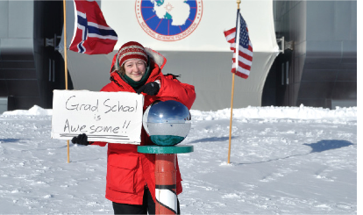
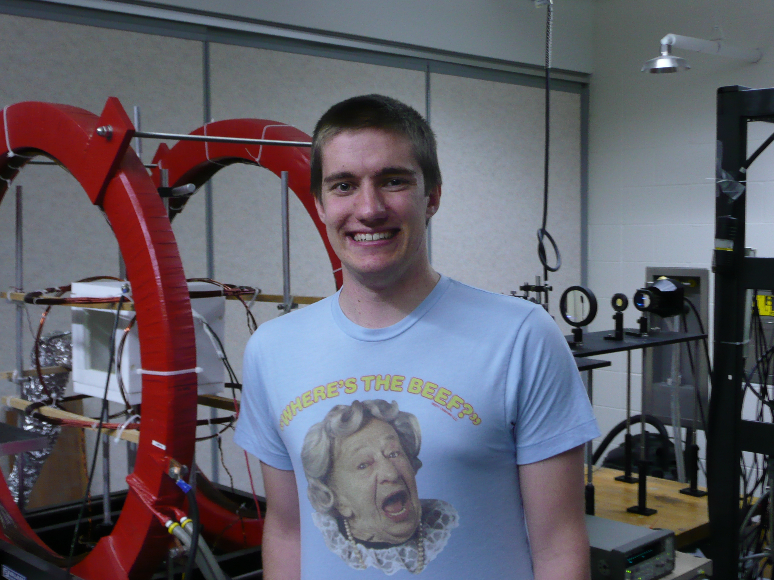
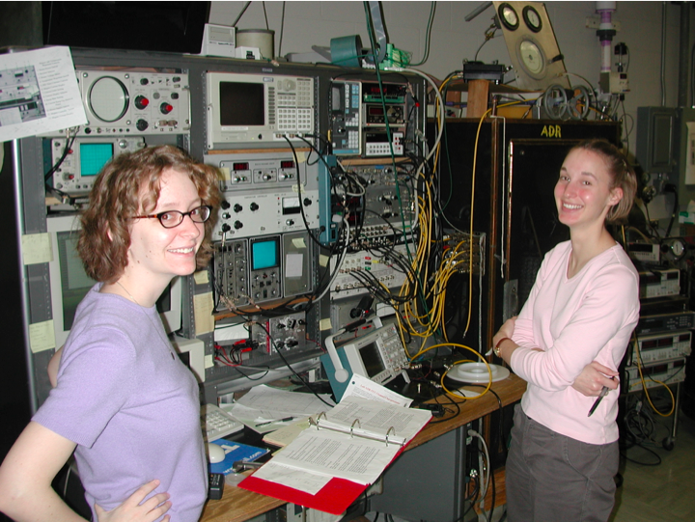
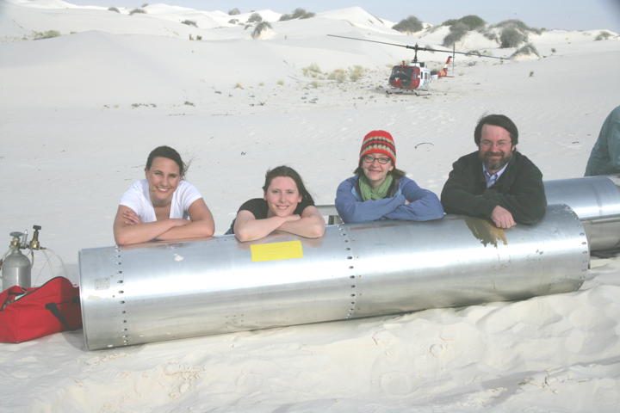
… Training Next Gen of Scientists

Slide 20
COVID-19
Operations
Safety
Classes & Teaching
  The university is planning for a resumption of primarily in-person instruction for the fall semester 2021
  https://covidresponse.wisc.edu/
Testing
  Will continue into the fall semester
  Safer Badger
  https://saferbadgers.wisc.edu/
Vaccine
  Everyone in the campus community who wishes to get a COVID-19 vaccine will have been able to do so by the beginning of the fall 2021 semester

Slide 22
Dr. Jeff Schmidt
Director of Graduate Studies (DGS)
Qualifying exam
Core coursework
Minor requirement
Timeline

Slide 23

Physics Ph.D. Program Requirements
Program Handbook: 51 credits total https://www.physics.wisc.edu/graduate/current-phd-students/phd-handbook/
Qualifying Exam
  Assess understanding of core physics topics at the undergraduate level
  4 sections: Classical Mechanics, Quantum Mechanics, Electricity & Magnetism, Statistical Mechanics/Thermodynamics
  4 consecutive attempts
  Exam held: day before classes each semester (September/January)
  Fall 2021 exam date: Tuesday, September 7th, 2021
  Qual prep held during new student orientation
Core Courses (3 credits each)
  711: Dynamics (fall)
  715: Statistical Mechanics (spring)
  721: Electrodynamics (fall)
  731: Quantum Mechanics (fall)
  732: Quantum Mechanics (spring)

Slide 24
Physics Ph.D. Program Requirements
Minor Requirement (9-15 credits)
  External department: typically 9-15 credits of coursework in a specific department (Math, Astronomy, Computer Science, etc.)
  Distributed: 9 credits of coursework in one or more department, must include 3 credits of Physics
Acquire a research advisor (additional research credits)
  Typically students have joined a research group by the summer after the first year
  Department of Physics faculty http://www.physics.wisc.edu/people/faculty
  Department of Physics affiliated faculty http://www.physics.wisc.edu/people/affiliated
Preliminary Exam
  Completed by the end of the third year
Thesis Defense

Slide 25
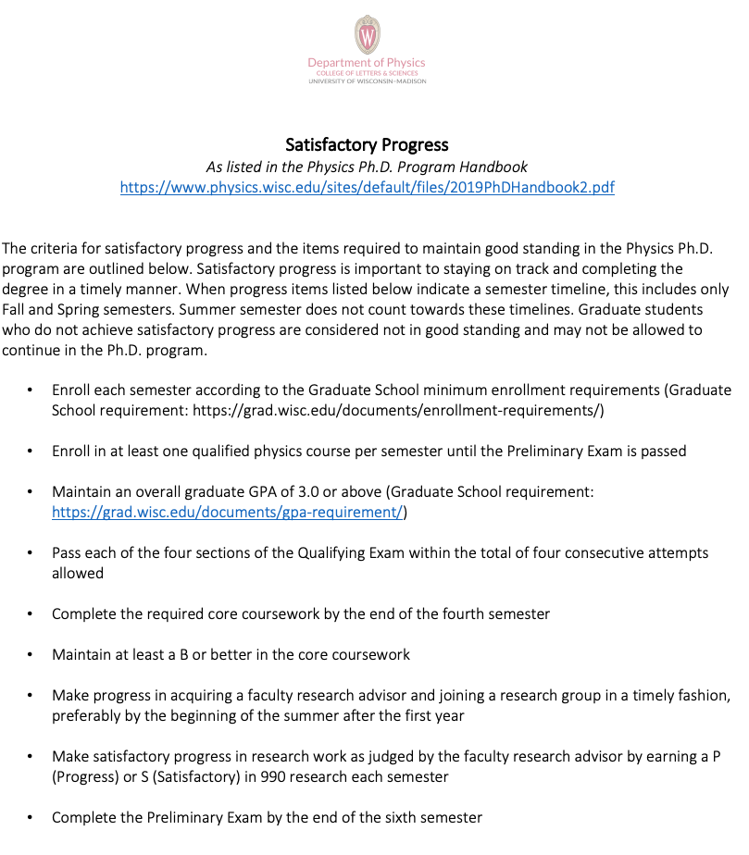

Slide 26
Friday Logistics
Michelle Holland, Graduate Program Coordinator

Slide 27
Friday Schedule
https://www.physics.wisc.edu/grad-recruitment-2021/
10:00-10:45am Research Area Discussions with Faculty
10:45-11:00am BREAK
11:00-11:45am Current Student Panel Discussion
11:45am-12:30pm Research Area Discussions with Current Students
12:30-1:00pm LUNCH BREAK
12:30-3:30pm Lounges Open
  Current grad student lounge open
  Grad coordinator lounge open
1:00-3:30pm Faculty Appointments
  Email at 12:00pm with zoom links
3:30-4:30pm Great Ideas Seminar
4:30-5:00pm Faculty Appointments
5:00-5:45pm Closing Ceremony
6:00pm DINNER BREAK
7:00pm Evening Social Activity (optional)

Slide 28
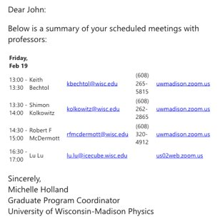
Faculty Appointment Email: 12pm

Slide 29

Next session will begin at 10:00am (CST)
Research Area Discussion with Faculty
Join one or mix and mingle among various zoom rooms

Slide 30
Next session begins at 11:00am (CST)
Panel discussion with current students
Abigail Shearrow, Current Student Host

Slide 31
Abigail Shearrow, Current Student
Panel Discussion Host

Slide 32
Panel Discussion
Moderator
  Abigail Shearrow, Current Student
Format
  Any questions for panelists can be put in the chat box
  Moderator will read them in the order they were submitted
Introductions
  Name, year, research area/group

Slide 33
Next session begins at 11:45am (CST)
Research Area Discussions with Current Students
Join one or mix and mingle among various zoom rooms

Slide 34
Next session begins at 1:00pm (CST)
12:30-3:30pm Lounges Open: Current Grad Student & Program Coordinators
1:00-3:30pm Faculty Appointments (schedule will be emailed at 12:00pm with zoom links)
3:30-4:30pm Great Ideas Seminar
4:30-5:00pm Faculty Appointments

Slide 35
Next session begins at 5:00pm
Closing Ceremony

Slide 36

Highlights
What was your favorite part of the virtual visit?
Students? Faculty? Department? UW-Madison? City of Madison?

Slide 37

Ask Us Anything!
What questions do you still have at this point?

Slide 38
Writing Prompts & Action Items
What factors are most important to me in selecting a graduate school?
What is the most appealing aspect about Physics at UW-Madison?
Are there things you need to follow up on after your visit?
Are there questions you have after your visit?
What are your next steps?

Slide 39
Next Steps
Evaluation of virtual visit coming next week
Submit official transcript to the UW-Madison Graduate School to finalize admissions process
April 15th decision deadline to Accept or Reject offer of admission to Physics Ph.D. program at UW-Madison
Housing information sent in late April/early May
Summer start option for international students doing ITA training
Summer start possible for anyone who is offered an RA

Slide 40
Department of Physics Contacts
Michelle Holland, Graduate Program Coordinator
Jackson Kennedy, Graduate Program Coordinator
Recruitment Committee
  Name, email
Jeff Schmidt, Director of Graduate Studies

Slide 41

Thank you!!
Thank you to all of you for visiting from around the world!
Thank you to all of the amazing current student volunteers for their help putting this virtual visit together!

Slide 42
Next session will begin at 7:00pm
Dinner break at 6:00pm
Virtual Escape Room at 7:00pm

