Slide 1
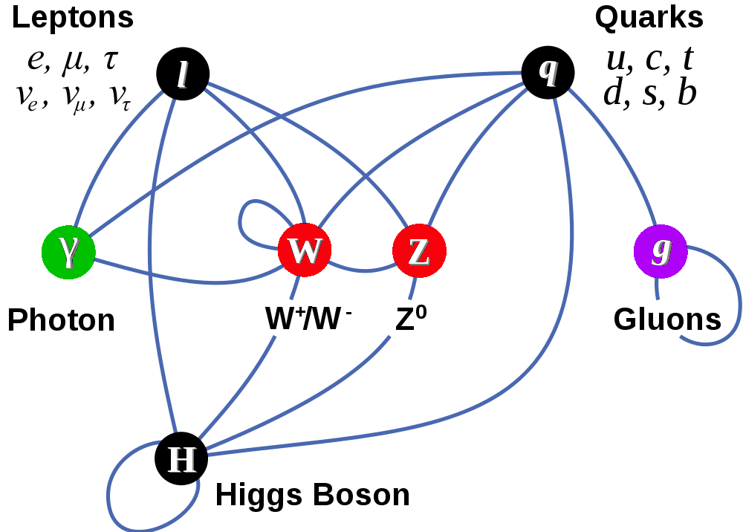
Physics 535 : Electroweak Interactions
Matter Particles (fermions)
Interactions by exchange of vector bosons
Scalar boson – remnant of mass giver

Slide 2
Charged Particle / Anti-particle – Photon Interaction
The interaction term is
Obtained by demanding local gauge invariance
Conserved current coupled to the photon field
This is a virtual photon – energy momentum can be not conserved for short time (Heisenberg)

Slide 3
True or False?
The three neutrinos, $ν_{e},$ $ν_{μ} and$ $ν_{τ}$ form an SU_{left}(2) triplet: True or False ?
The three quarks, u$,$ d $and$ s form an SU_{flavor}(2) triplet: True or False ?
The three quarks, u$,$ d $and$ s form an SU_{color}(3) triplet: True or False ?
The three weak currents $J_{CC}^{μ+},J_{NC}^{μ0}$ and $J_{CC}^{μ−}$form an SU_{left}(2) triplet: True or False ?

Slide 4
Four Fermion Interaction
n
p
What interaction can describe this decay?
How about – charged currents?
Discovery of beta+ decays – hermitian conjugate
Works Surprisingly well!
But, not perfectly, both ΔJ=0 and 1 seen
This implied potential other forms of interaction
e–

Slide 5
Question?
Which of the following covariant quantities could be used exclusively to describe weak interactions, which violate parity?
$\overline{ψ}ψ$
$\overline{ψ}γ^{5}ψ$
$\overline{ψ}γ^{μ}ψ$
$\overline{ψ}γ^{μ}γ^{5}ψ$
$\overline{ψ}σ^{μυ}ψ \text{where} σ^{μν}=\frac{i}{2}\left(γ^{μ}γ^{ν}−{γ^{ν}γ}^{μ}\right)$

Slide 6
Pseudoscalars and Axial Vectors
What is the correct interaction?
Weak interactions found to be violating parity

Slide 7
Discovery of Maximal P Violation
Resulted in identification of interaction as V-A!
Universal coupling – same for all leptons
μ
e–

Slide 8
Question?
Which type of current term would you include in your Lagrangian if you were to describe the decay, $μ→eγ$ – BTW, this process is not yet observed but there are experimental searches afoot?
A flavor changing charge current term
A flavor changing neutral current term
A pair of flavor conserving currents
A flavor conserving tensor interaction term

Slide 9
Neutral Currents

Slide 10
Neutral Currents

Slide 11
Charged and Neutral Currents
Study of interference effects can allow separation of charged and neutral current process details → sensitive probe of weak interaction dynamics, although rates of interaction are very small.
Availability of high-energy muon-neutrino sources at accelerators (FNAL and CERN) allowed easier discovery in ν_{μ}e– scattering.

Slide 12
Quark Charged Current

Slide 13
Quark Weak Currents

Slide 14
Intermediate Vector Bosons
Introducing:
→

Slide 15
Quark Weak Isospin Doublets

Slide 16
GIM Mechanism

Slide 17
Weak Neutral Currents

Slide 18
Electro-Weak Theory

Slide 19
EWK Particle Content

Slide 20
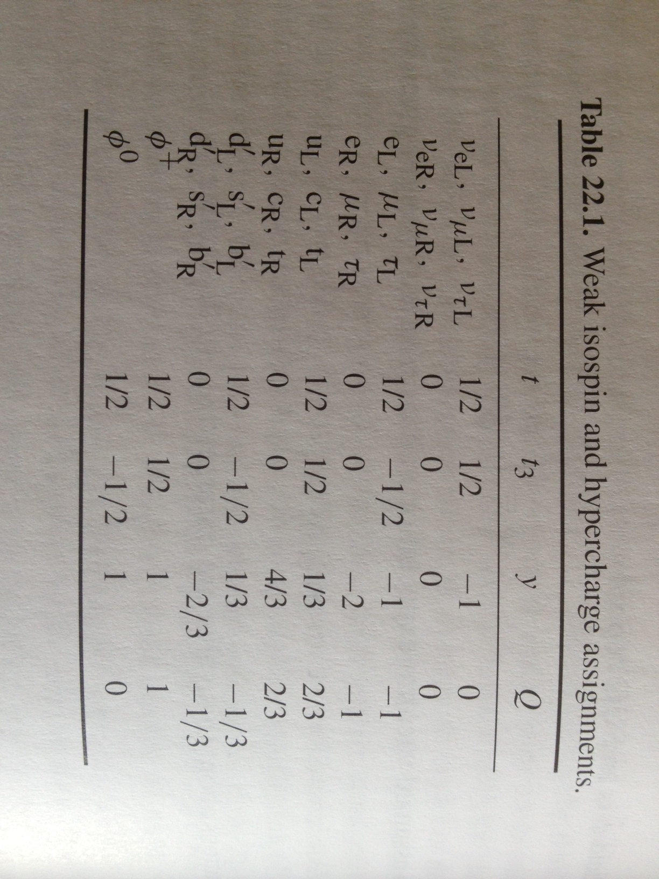
Weak Isospin & Hypercharge

Slide 21
The EWK Lagrangian (massless)
For Fermionic matter fields use Dirac Lagrangian:
$ℒ_{Dirac}=i\overline{ψ}γ^{μ}∂_{μ}ψ$
For gauge fields SU_{L}(2) and U_{Y}(1):
Weak isospin bosons are in triplet so they interact with
each other, unlike the singlet gauge boson of U_{Y}(1)
Stress energy tensor has additional cross product term

Slide 22
4-Fermion vs Vector Boson Model
Model with W/Z boson exchange mimicking the electrodynamics was introduced using the Gauge Principle as our guide – but gauge invariance breaks with mass terms.

Slide 23
Goldstone Model

Slide 24
Spontaneous Symmetry Breaking

Slide 25
Different Degrees of Freedom!

Slide 26
EWK Lagrangian

Slide 27
Spontaneous Symmetry Breaking

Slide 28
Z and Photon

Slide 29
Leptonic Part of L

Slide 30
Quark Part of L

Slide 31
Yukawa Couplings

Slide 32
Chirality of Spinors & Weak Interactions
Chirality for a Dirac fermion ψ is defined through the operator γ⁵, which has eigenvalues ±1.
Any Dirac field can thus be projected into its left- or right-handed component by acting with the projection operators ½(1 − γ⁵) or ½(1 + γ⁵) on ψ.
The chirality operator is equivalent to helicity for massless fields only
The coupling of the charged weak interaction to fermions is proportional to the ½(1 − γ⁵) , which is responsible for this interaction's parity violation.
The coupling of the neutral weak interaction to fermions has both left and right-handed parts (it has both W⁰ and B⁰ contributions).

Slide 33
Axial and Vector Couplings

Slide 34
EWK Vertices
Calculations of tree-level decay widths and cross sections proceed essentially the same as the QED case, except now with the complication of γ₅ thrown in.
I will simply state the results in the following slides

Slide 35
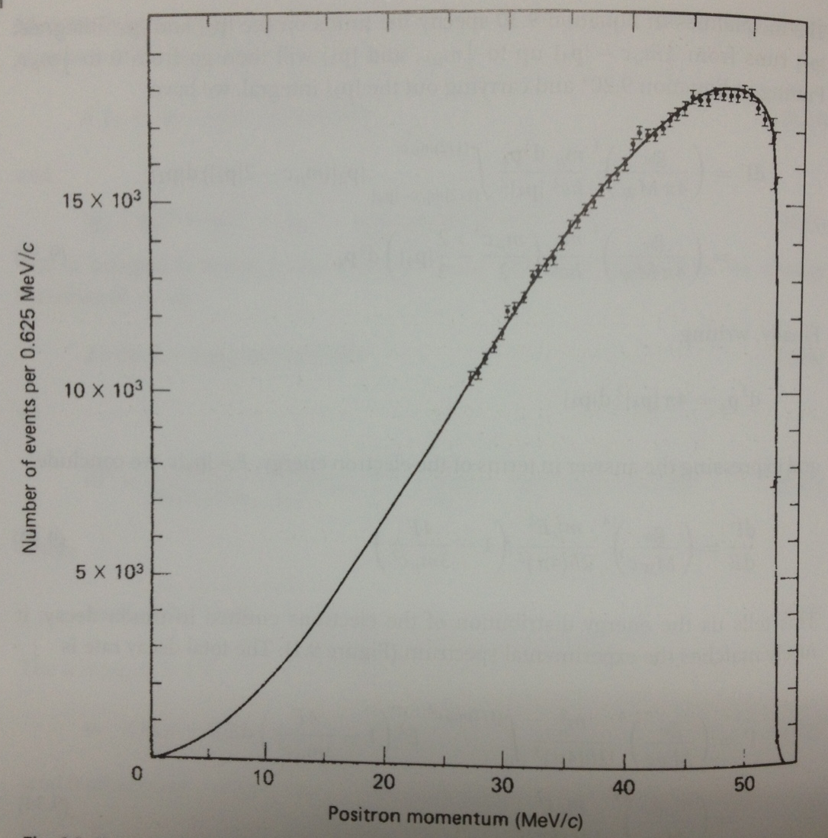
EWK Results: Muon Decay

Slide 36
EWK Results: Beta Decay
True lifetime is 15m as opposed to 22m=1318s

Slide 37
EWK Results: Pion Decay

Slide 38
Questions?
How many degrees of freedom are in the SM Higgs Field?
0
1
2
3
4
What is the weak isospin of the SM Higgs Field?
0
0.5
1
2

Slide 39
EWK Results: W & Z Decay

Slide 40
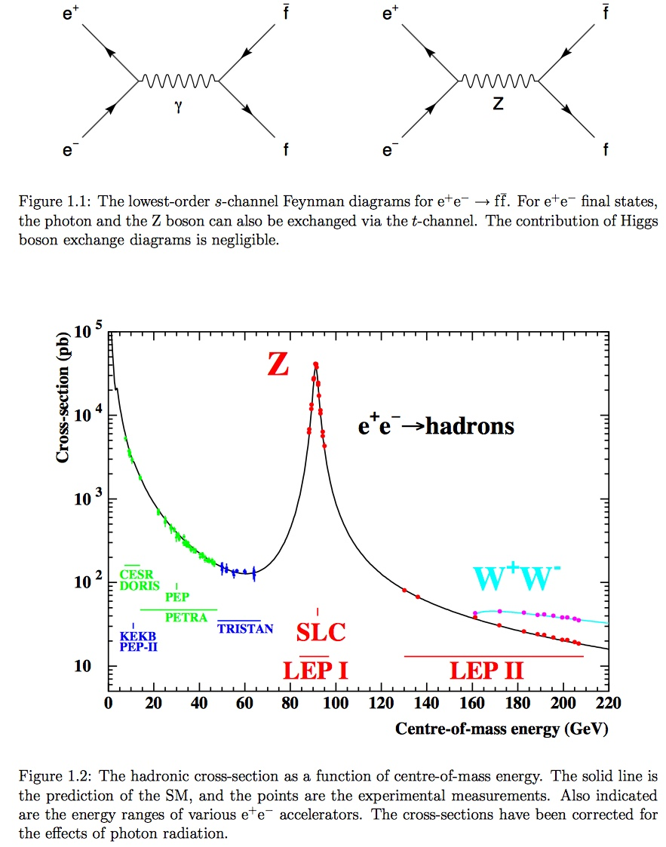
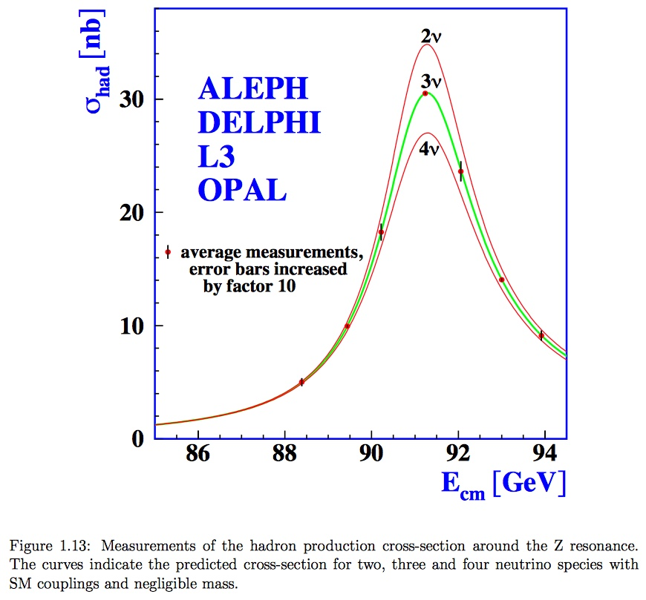
LEP Data
https://arxiv.org/pdf/hep-ex/0509008.pdf

Slide 41
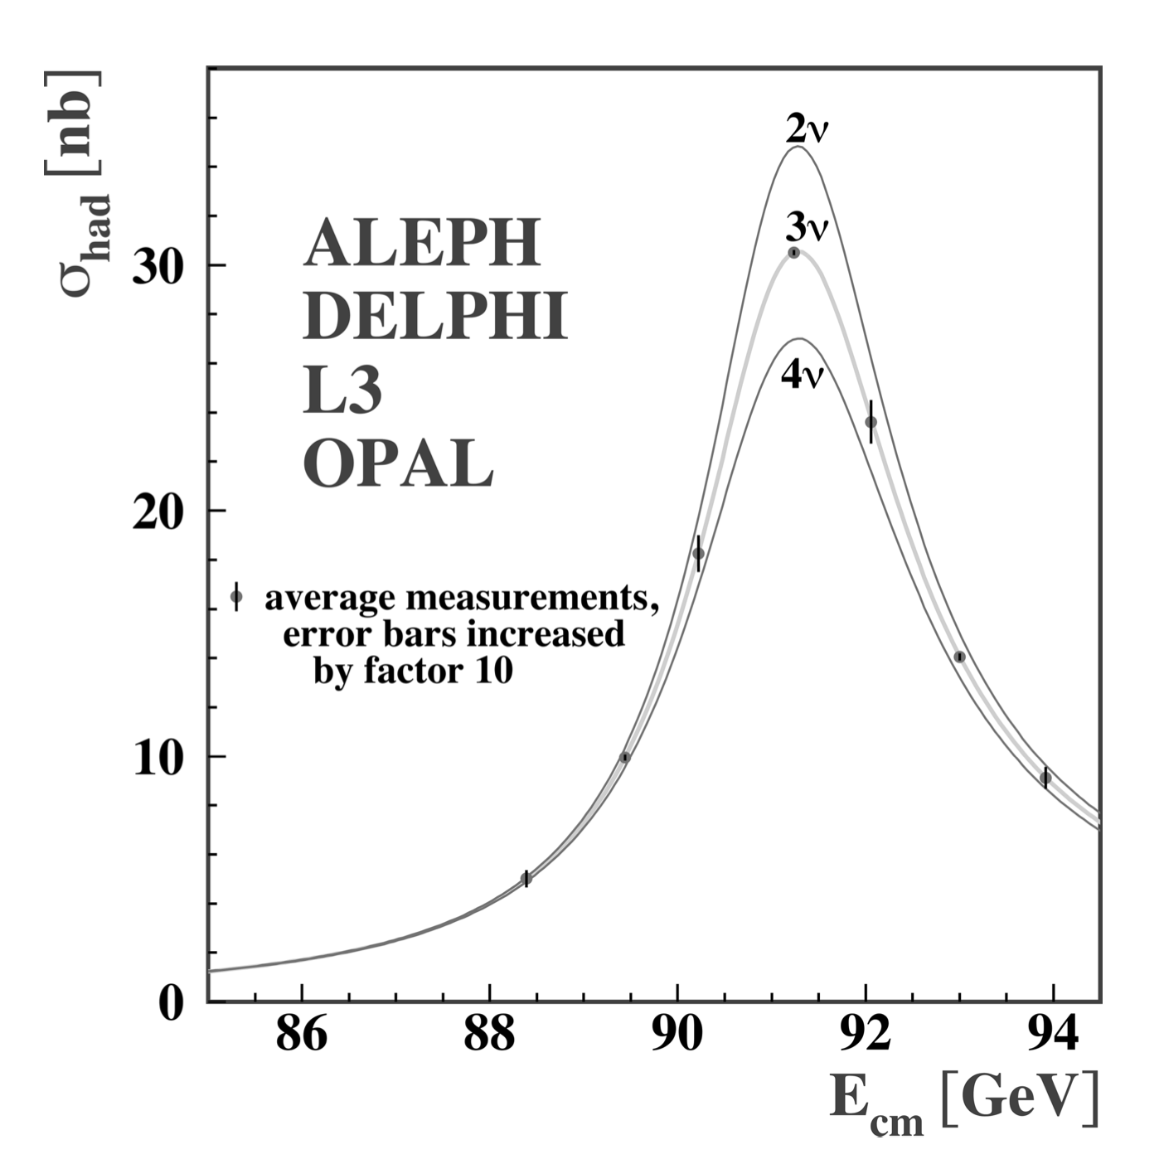
Z-line shape
There are only three neutrino flavors that couple to Z (with neutrino mass less than M_{Z}/2)
https://cds.cern.ch/record/2217139/files/9789814733519_0008.pdf

Slide 42
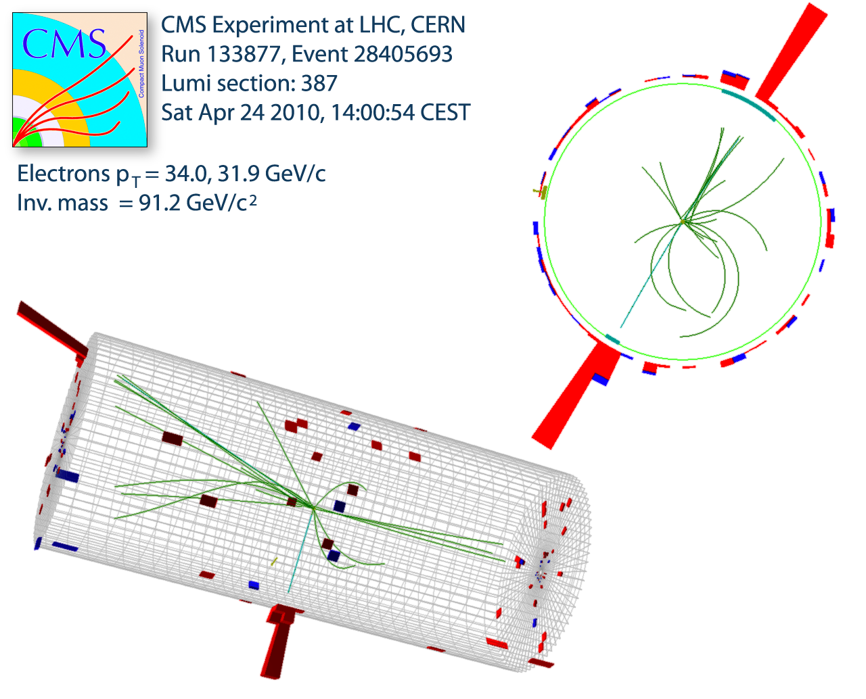
Example Event of Z Boson Decay
Z interacts with electrons and positrons
Event vertex (collision point) is measured using tracks
Note there are several low momentum tracks (underlying event)
Electron (–) and Positron (+)
Momentum (P_{x}, P_{y}, P_{z})
measured in tracker
Energy (E) measured in the calorimeter

Slide 43
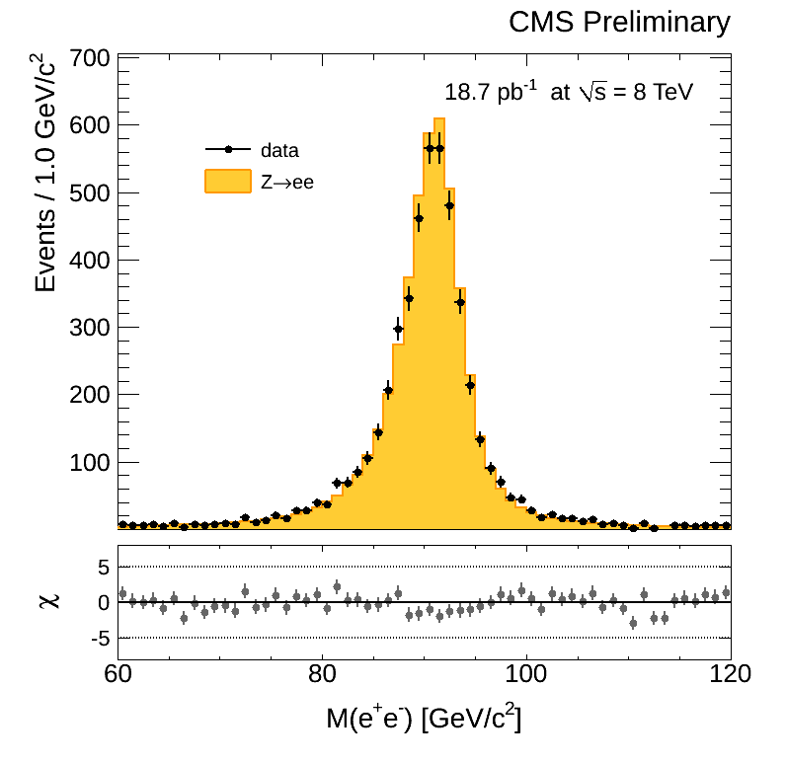
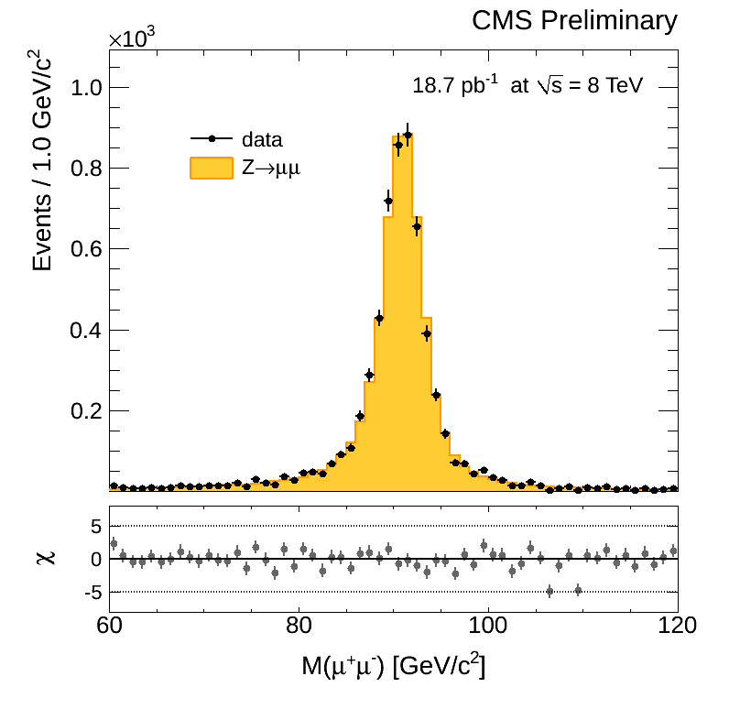
The Z Boson Invariant Mass Peak
Particles decaying close to the interaction point
Histogram of “invariant mass” of the original heavy particle shows a sharp peak at the mass of the Z (91 GeV)
ATLAS & CMS see 20M events second – about 10/s are Z events
Mass of Electron-Positron Pair
Mass of Muon⁺-Muon– Pair

Slide 44
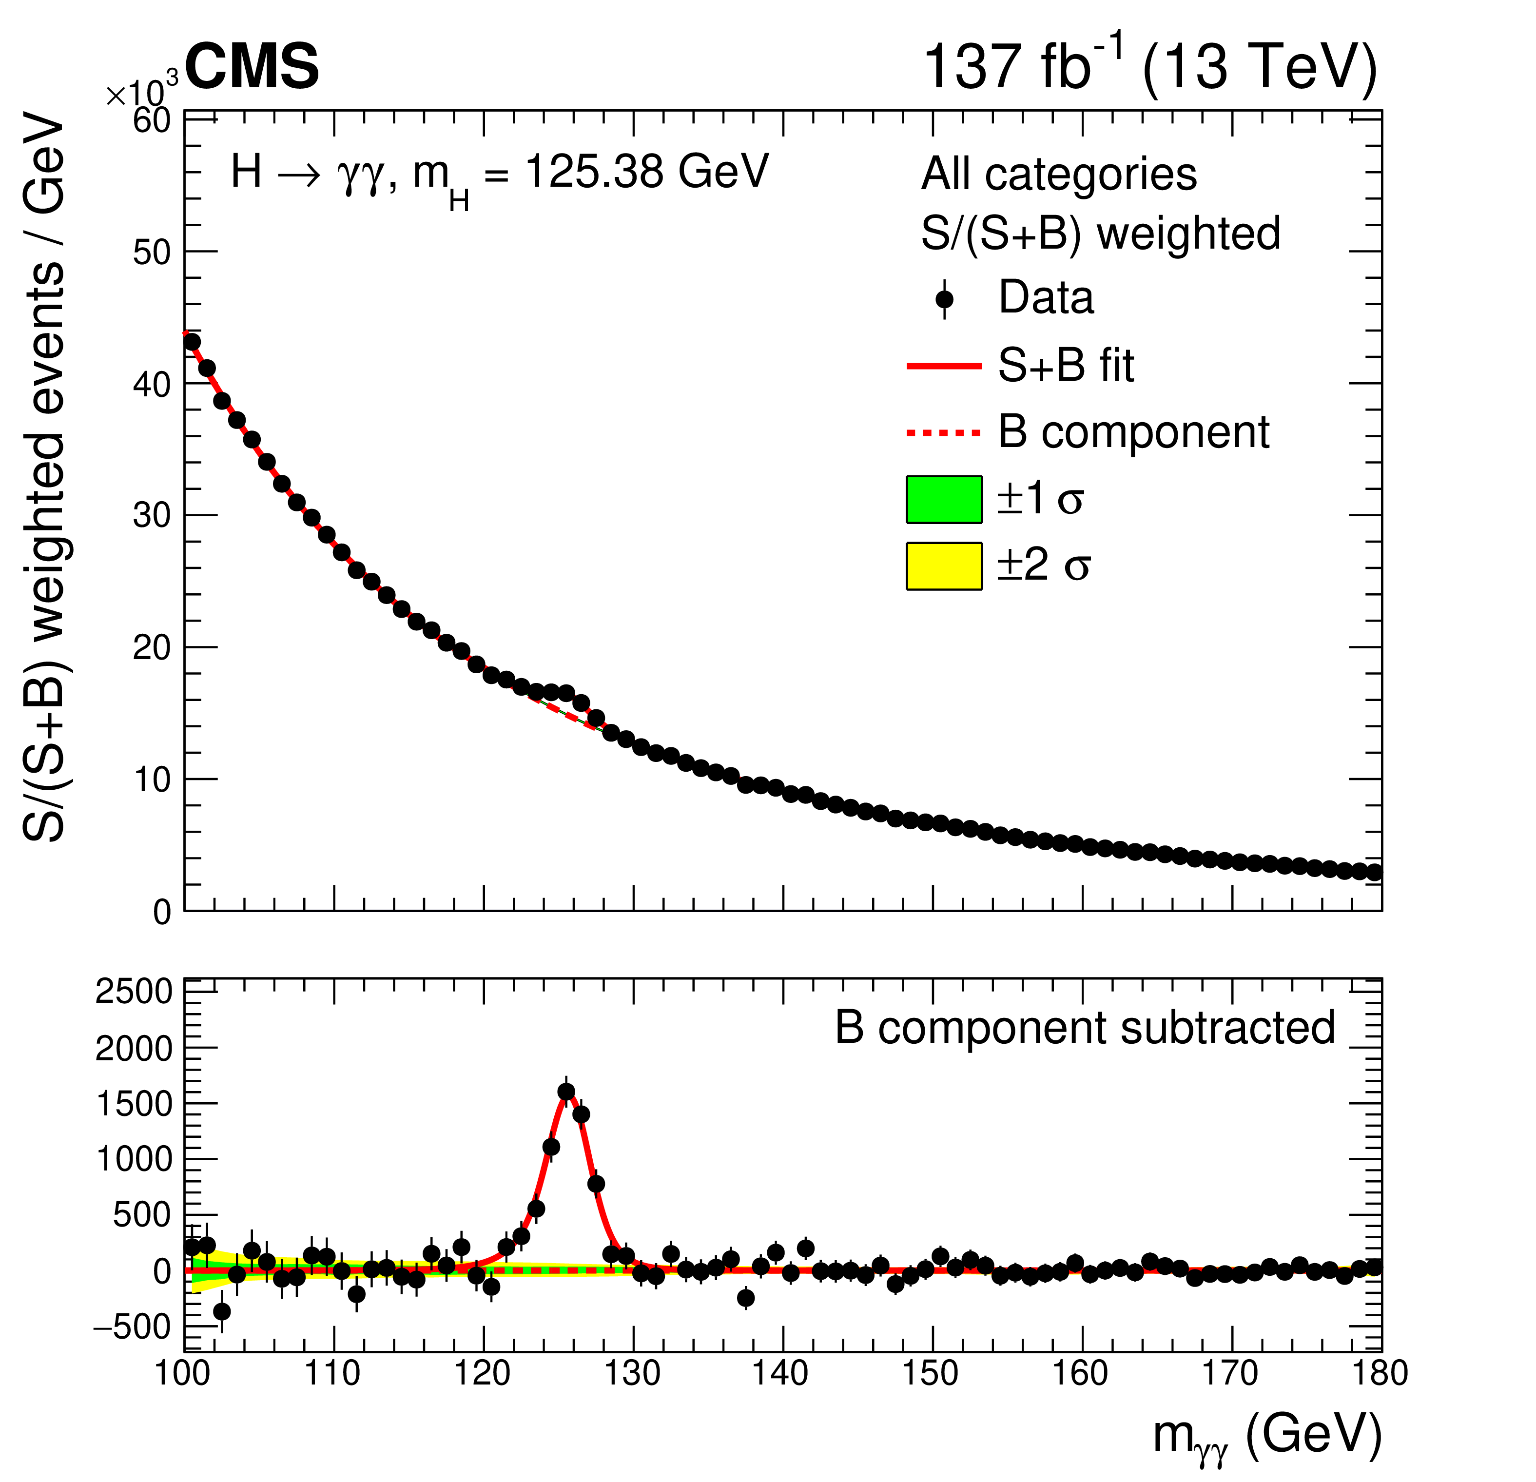
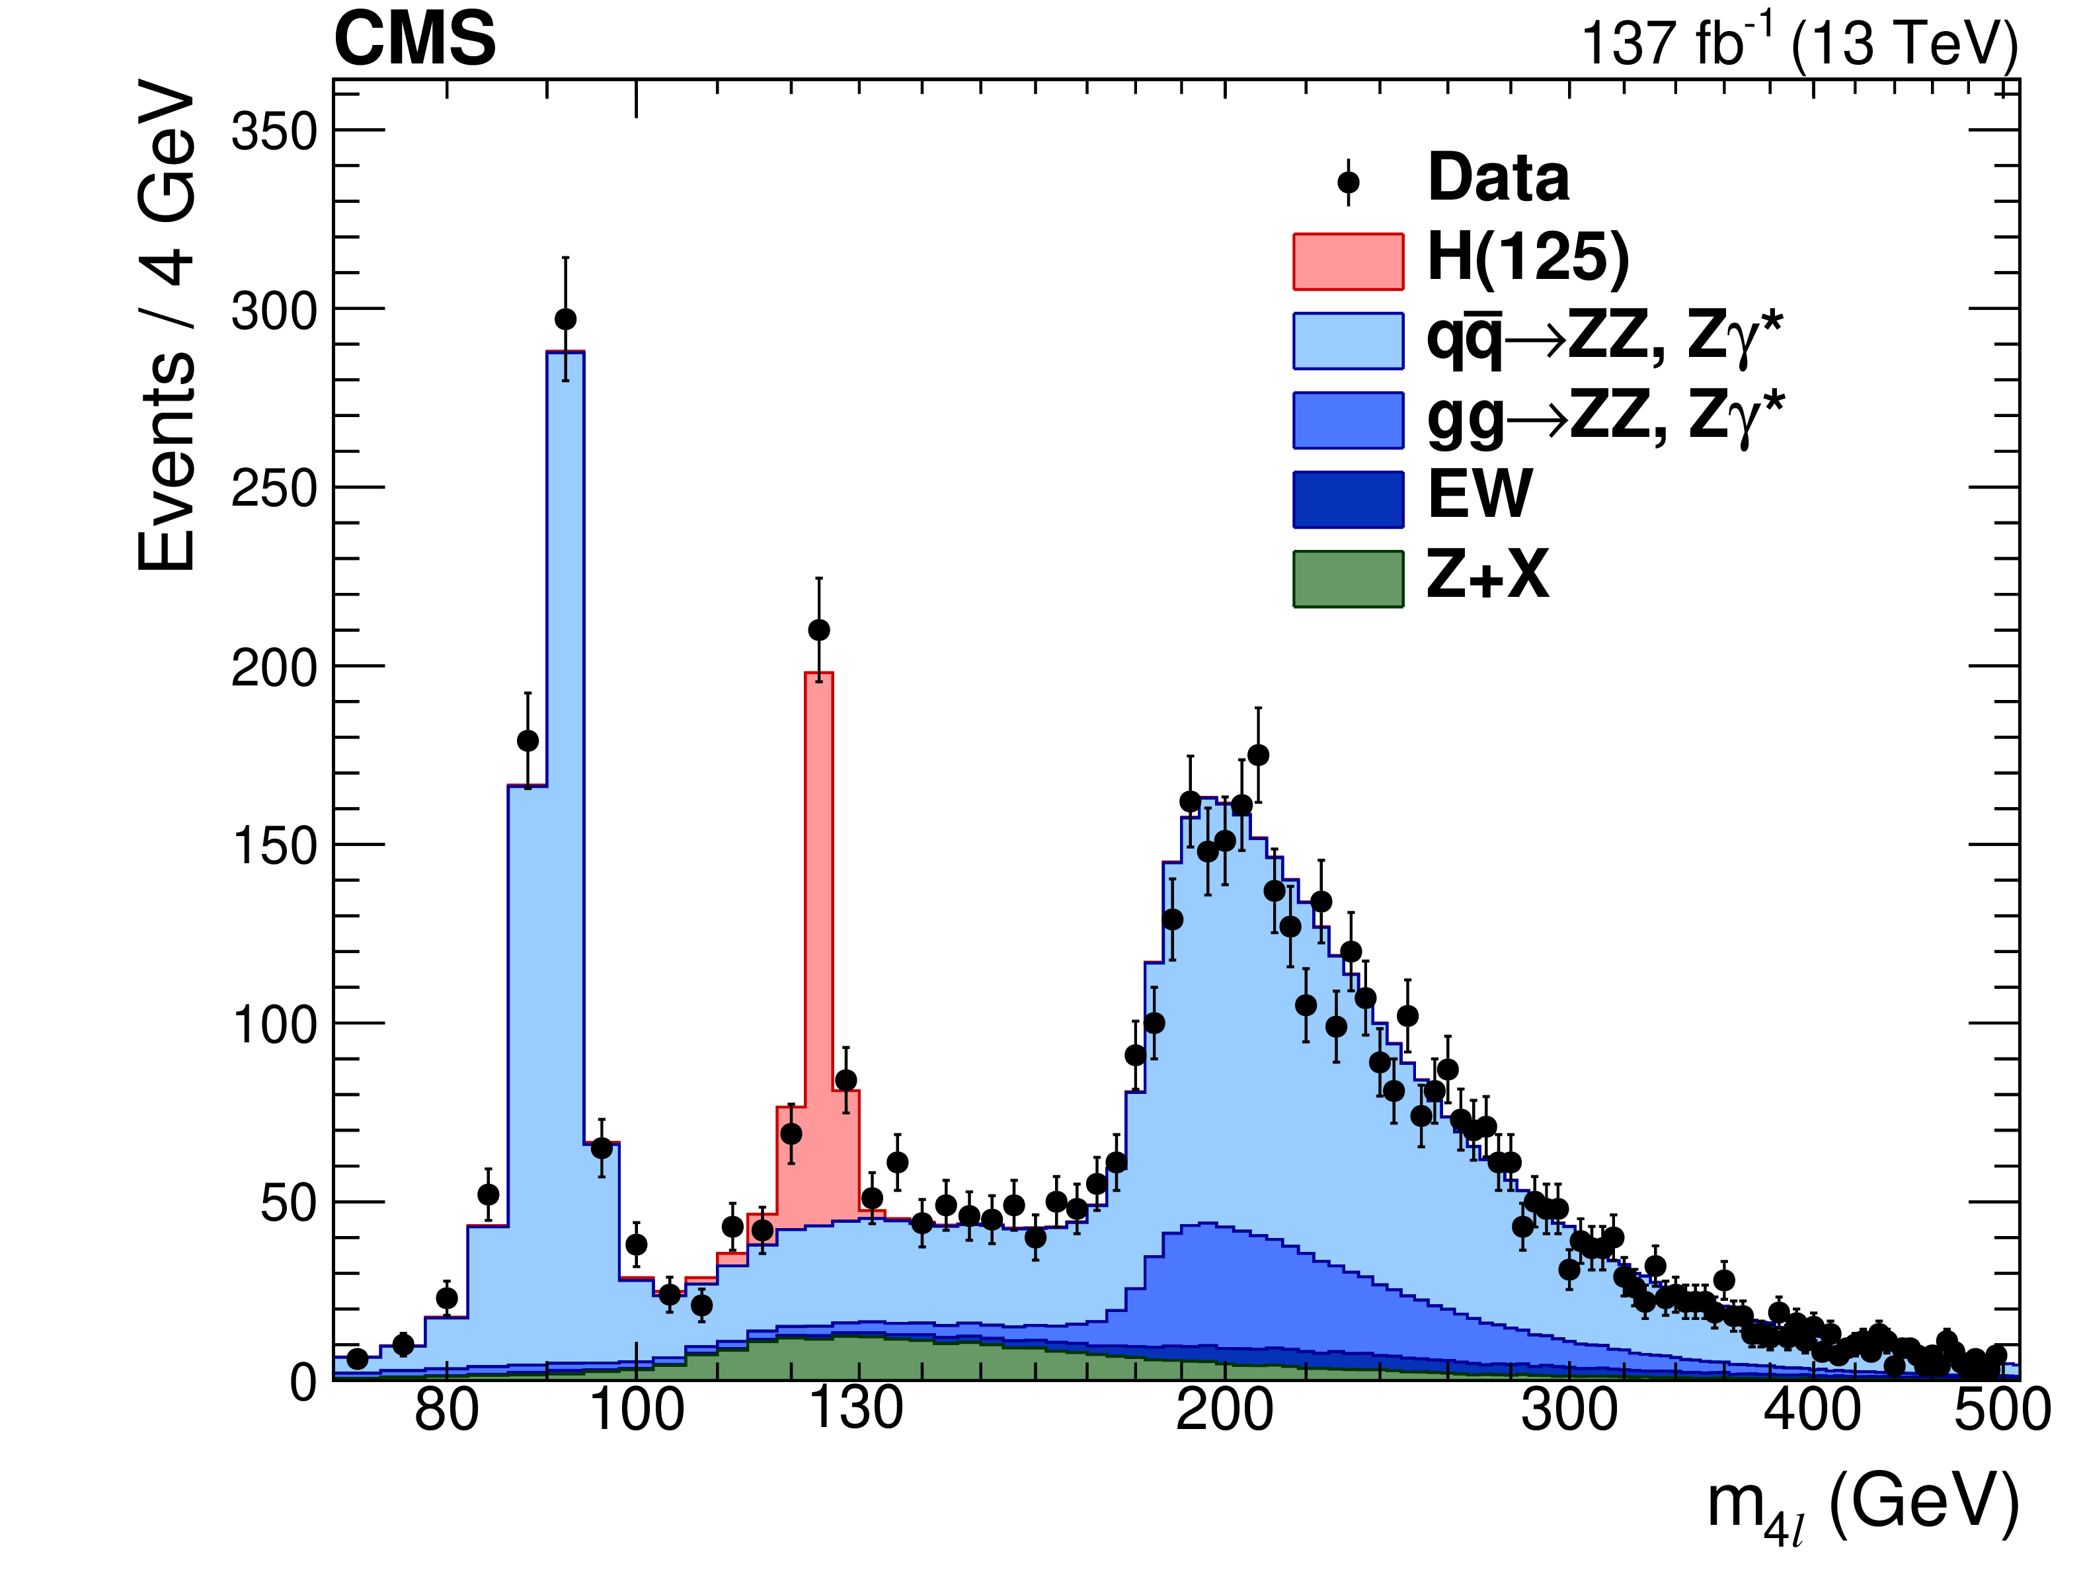
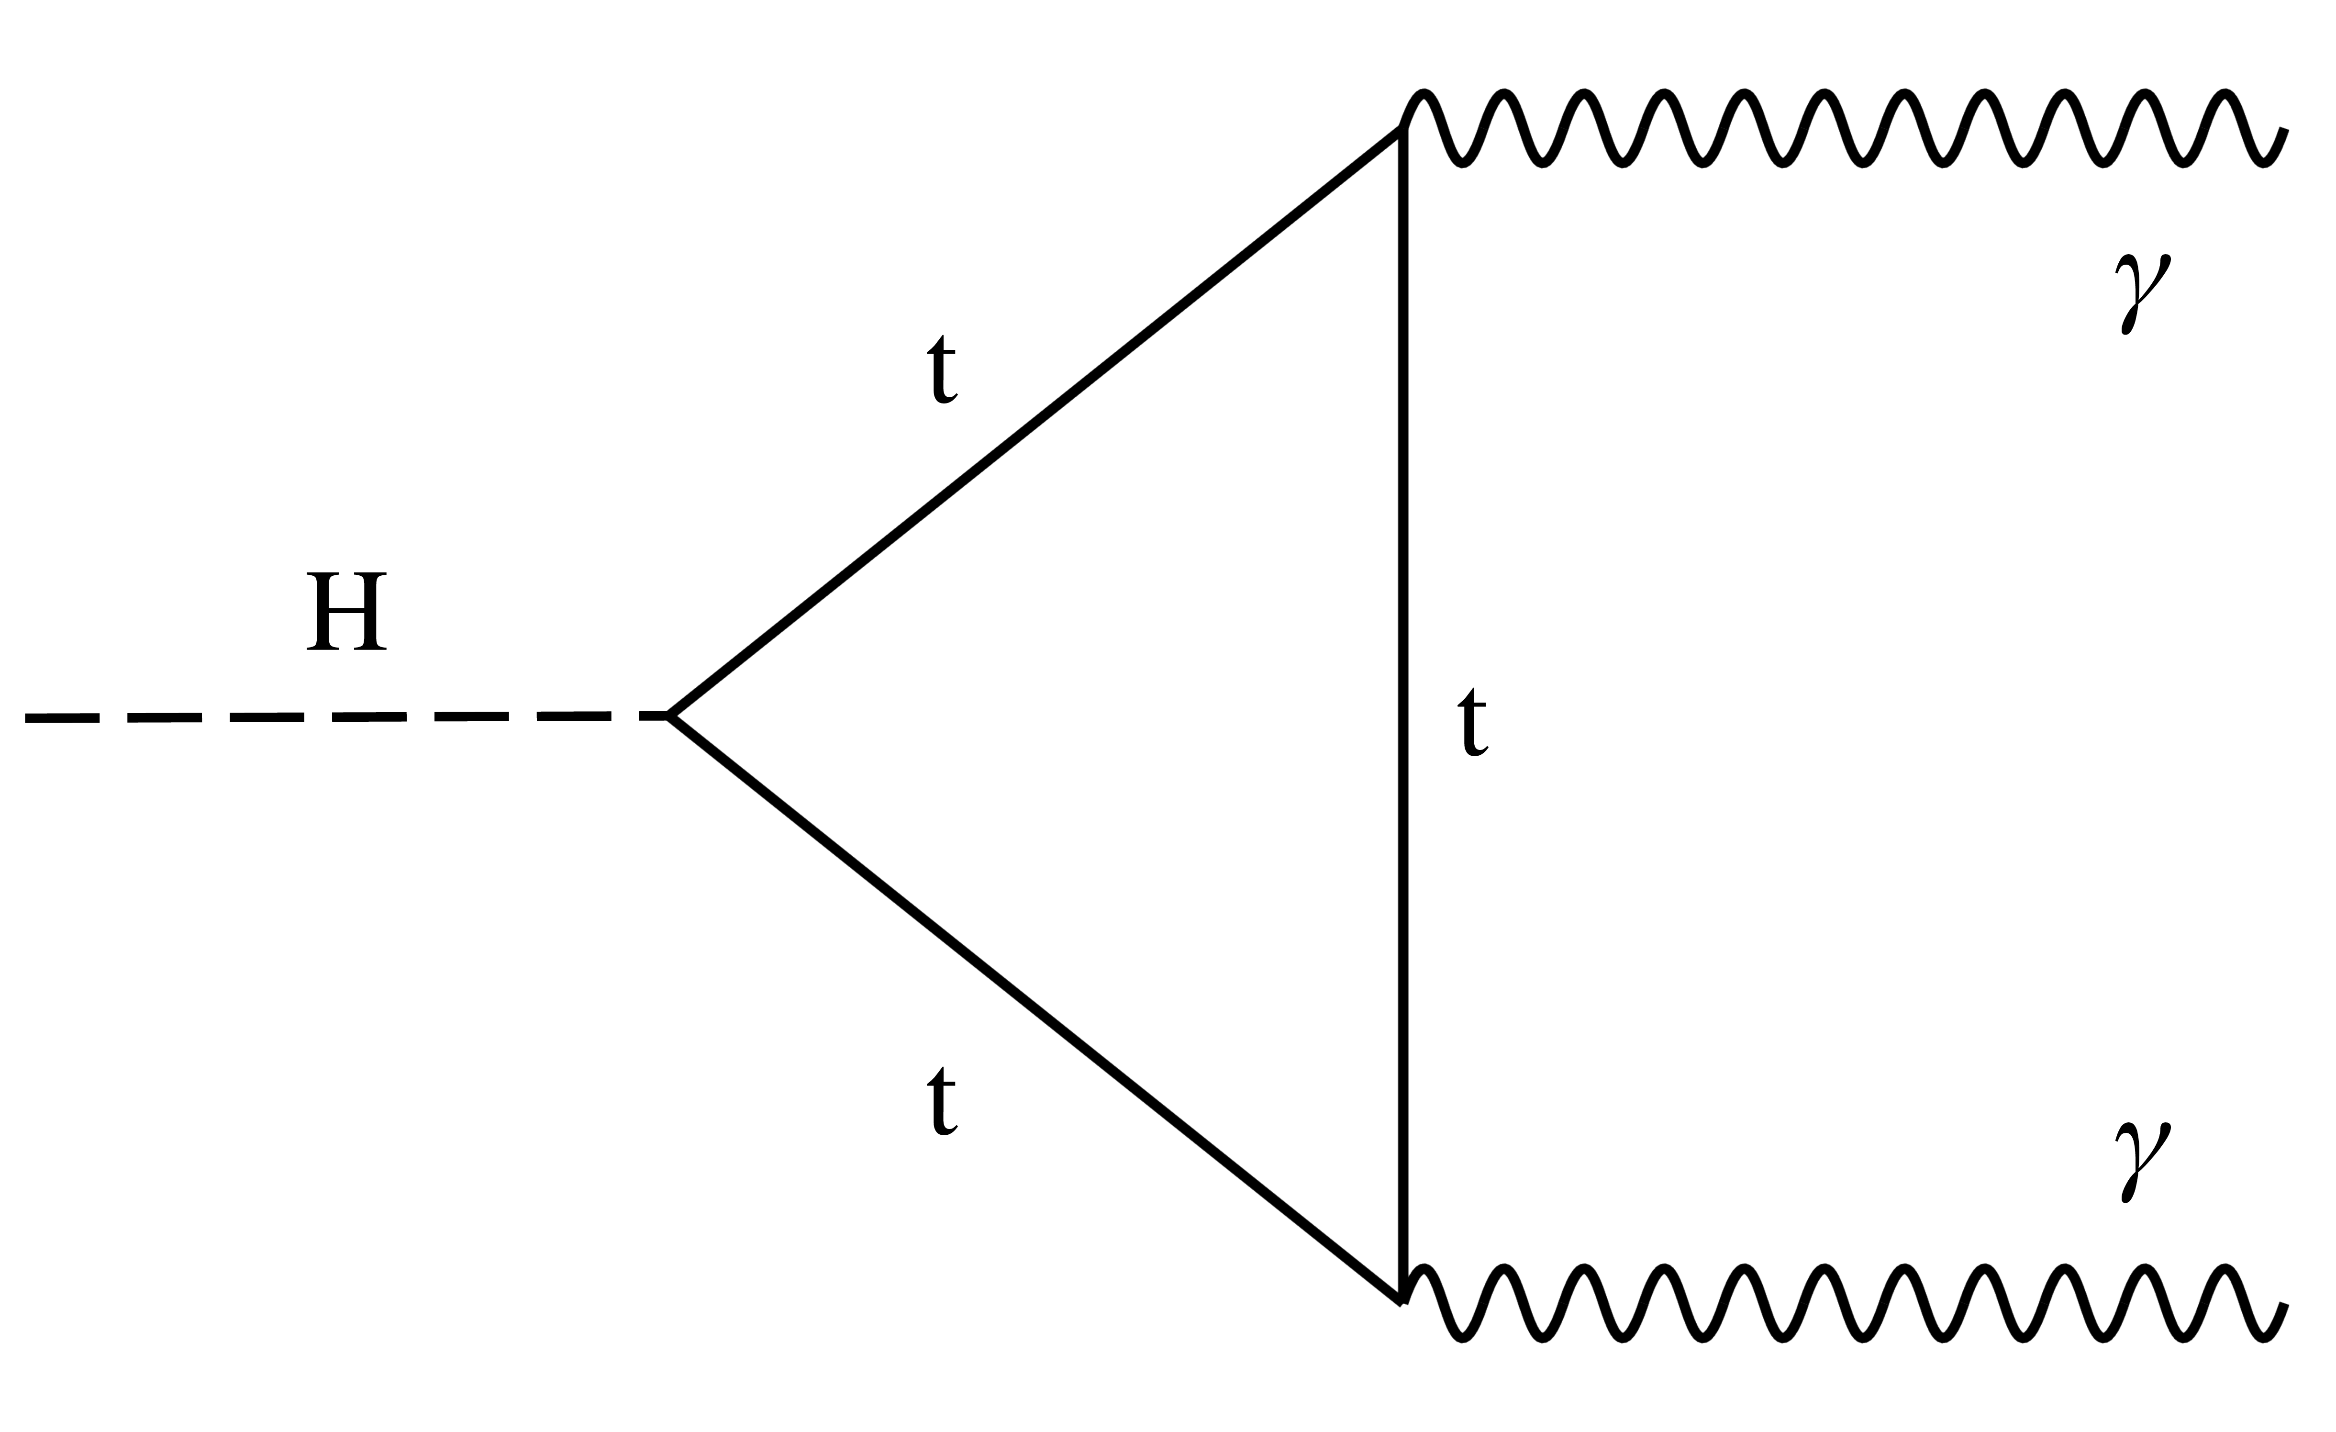
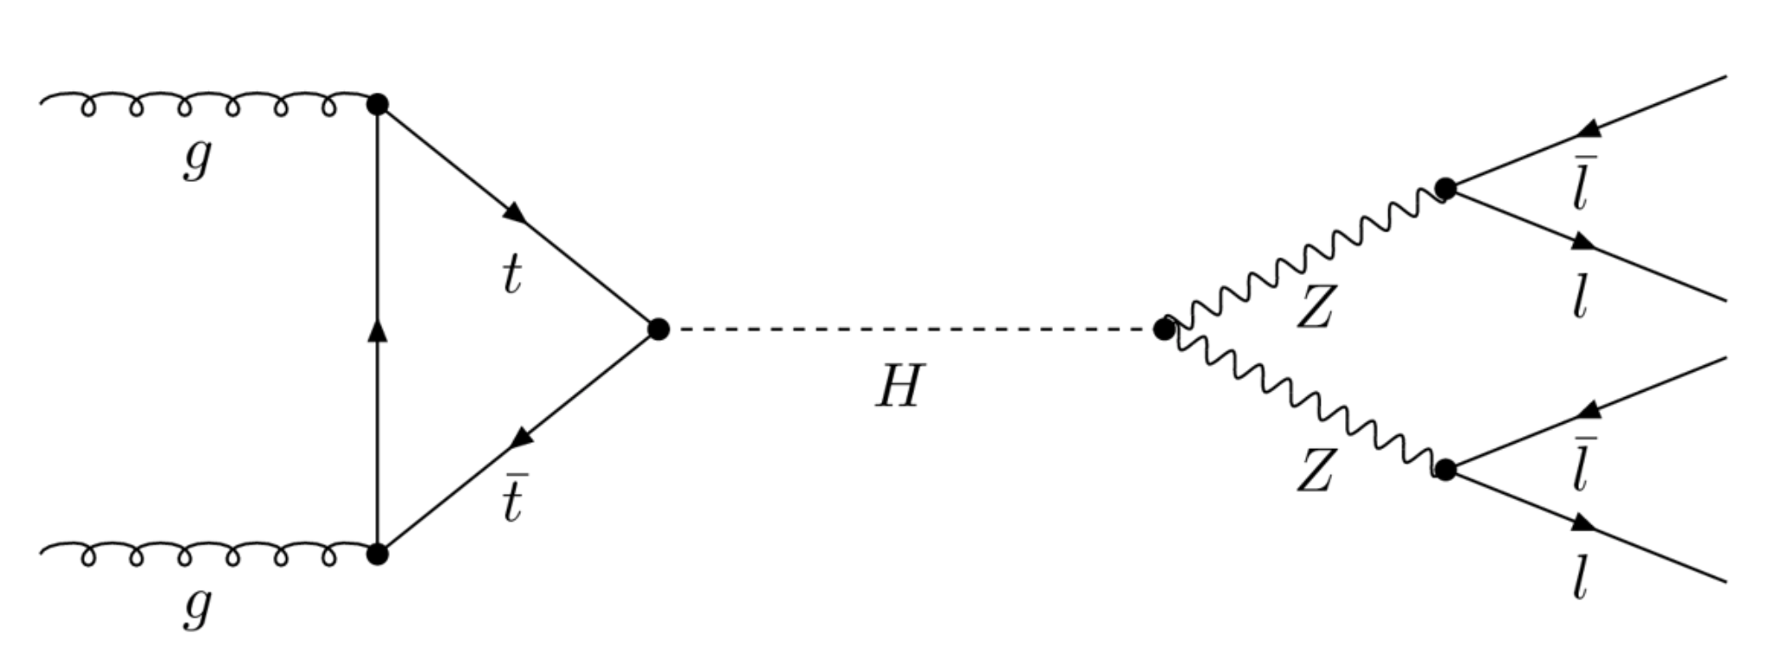
Higgs Discovered in July 2012 Full Run-2 (2016-18) Results
Our Higgs boson data sets are enabling detailed studies of the SM
2020 : h(125) detailed studies in four-lepton golden channel
Differential distributions, Production modes, Higgs P_{T} spectrum
2020 : h(125) detailed studies in diphoton channel
Simplified Template Cross Sections (STXS); BSM sensitivity

Slide 45
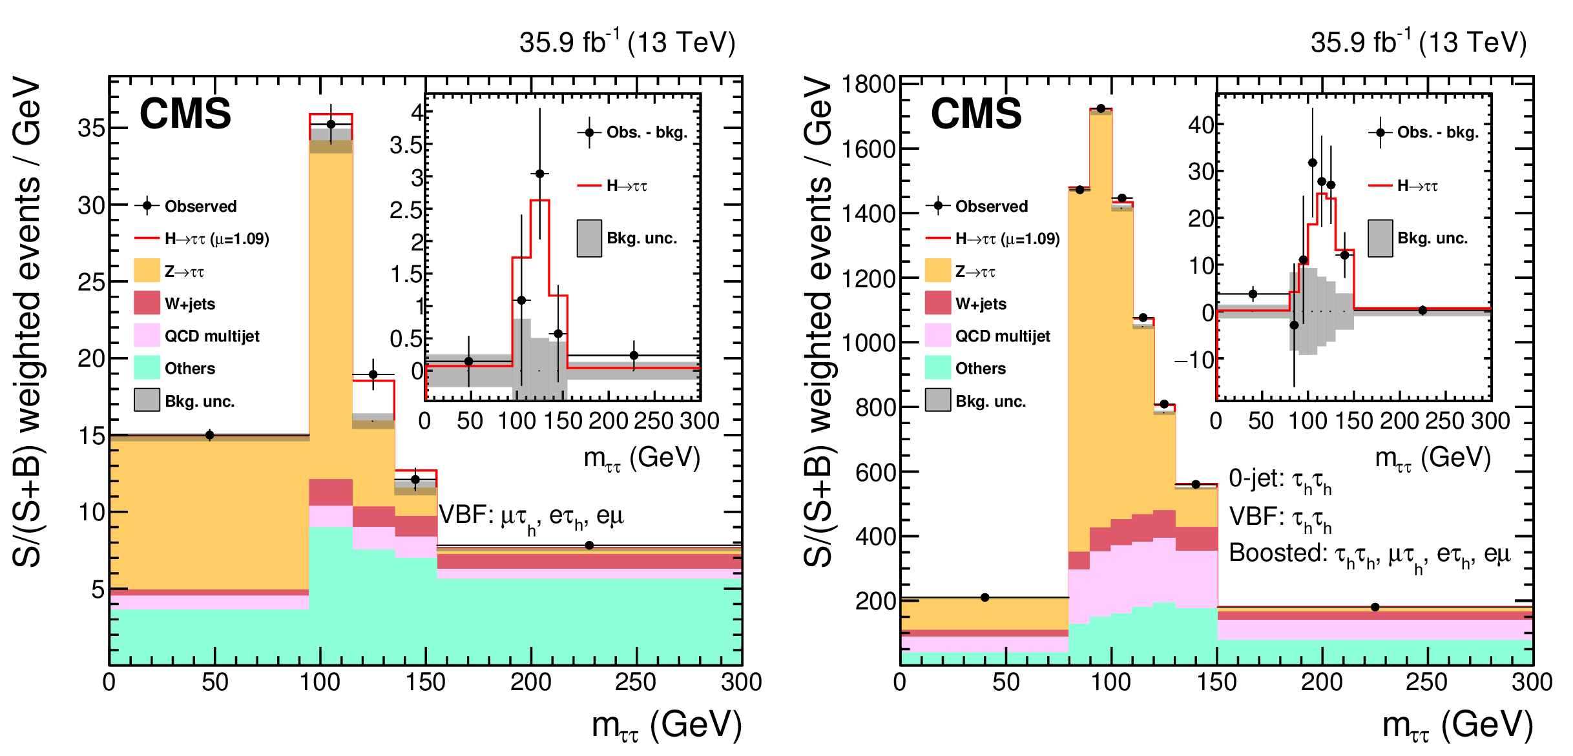
Higgs Yukawa Couplings – τ lepton

Slide 46
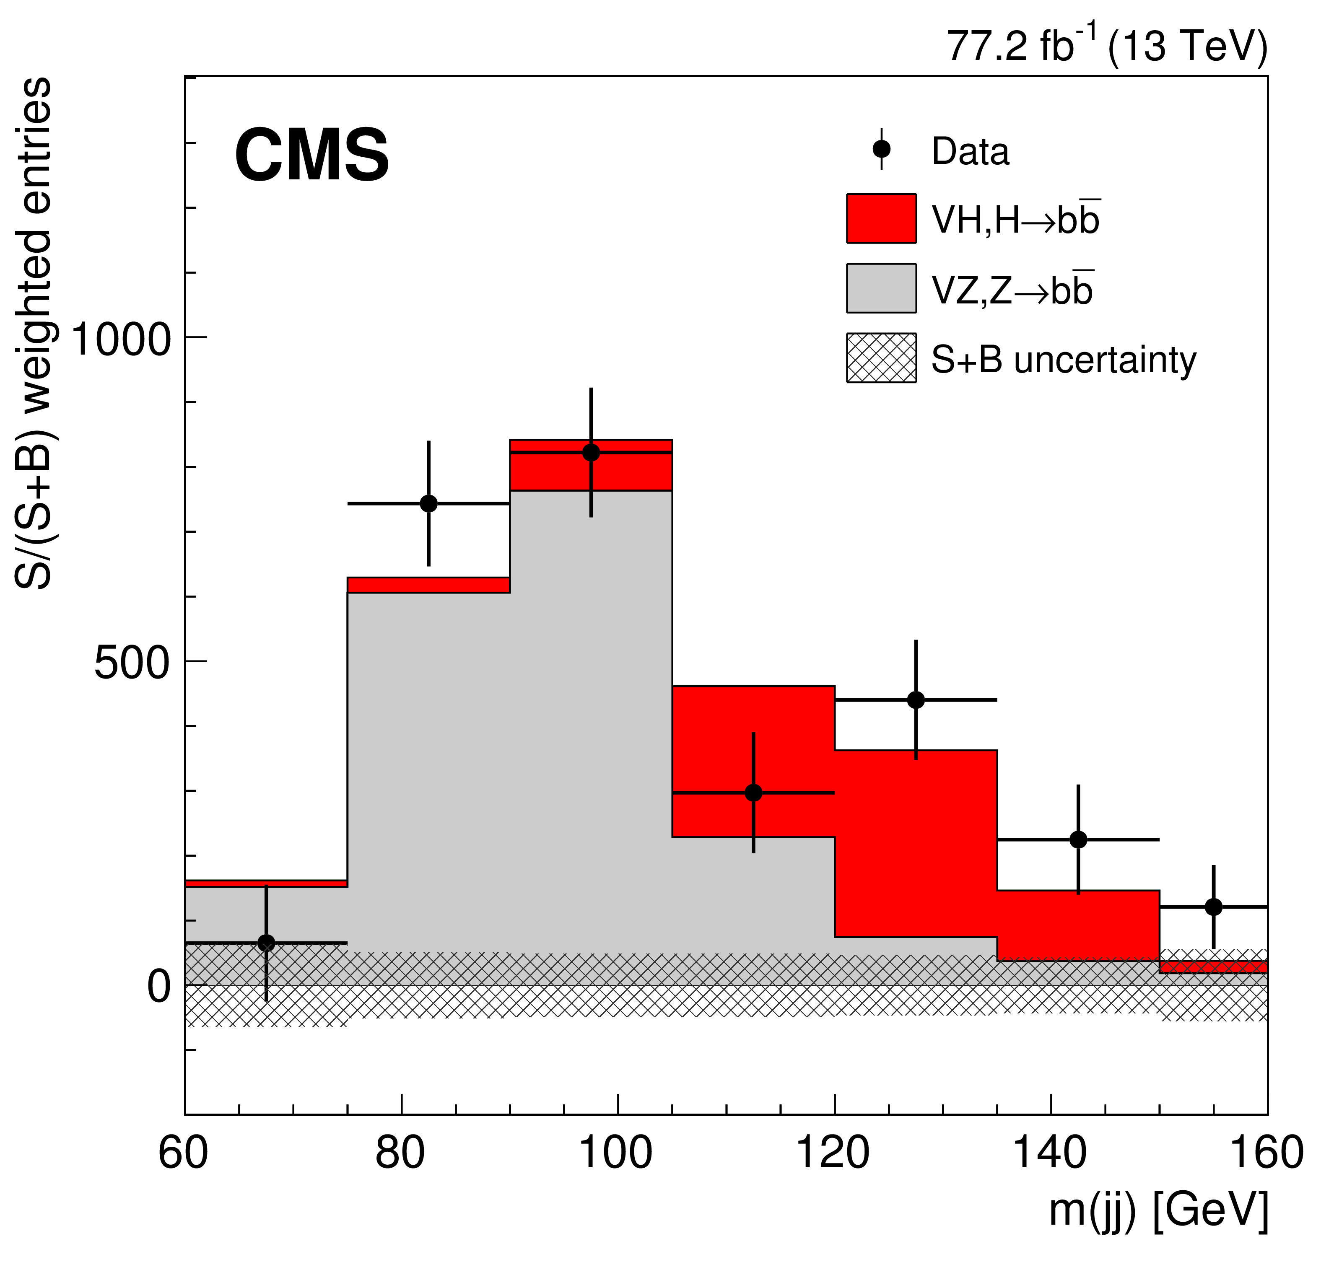
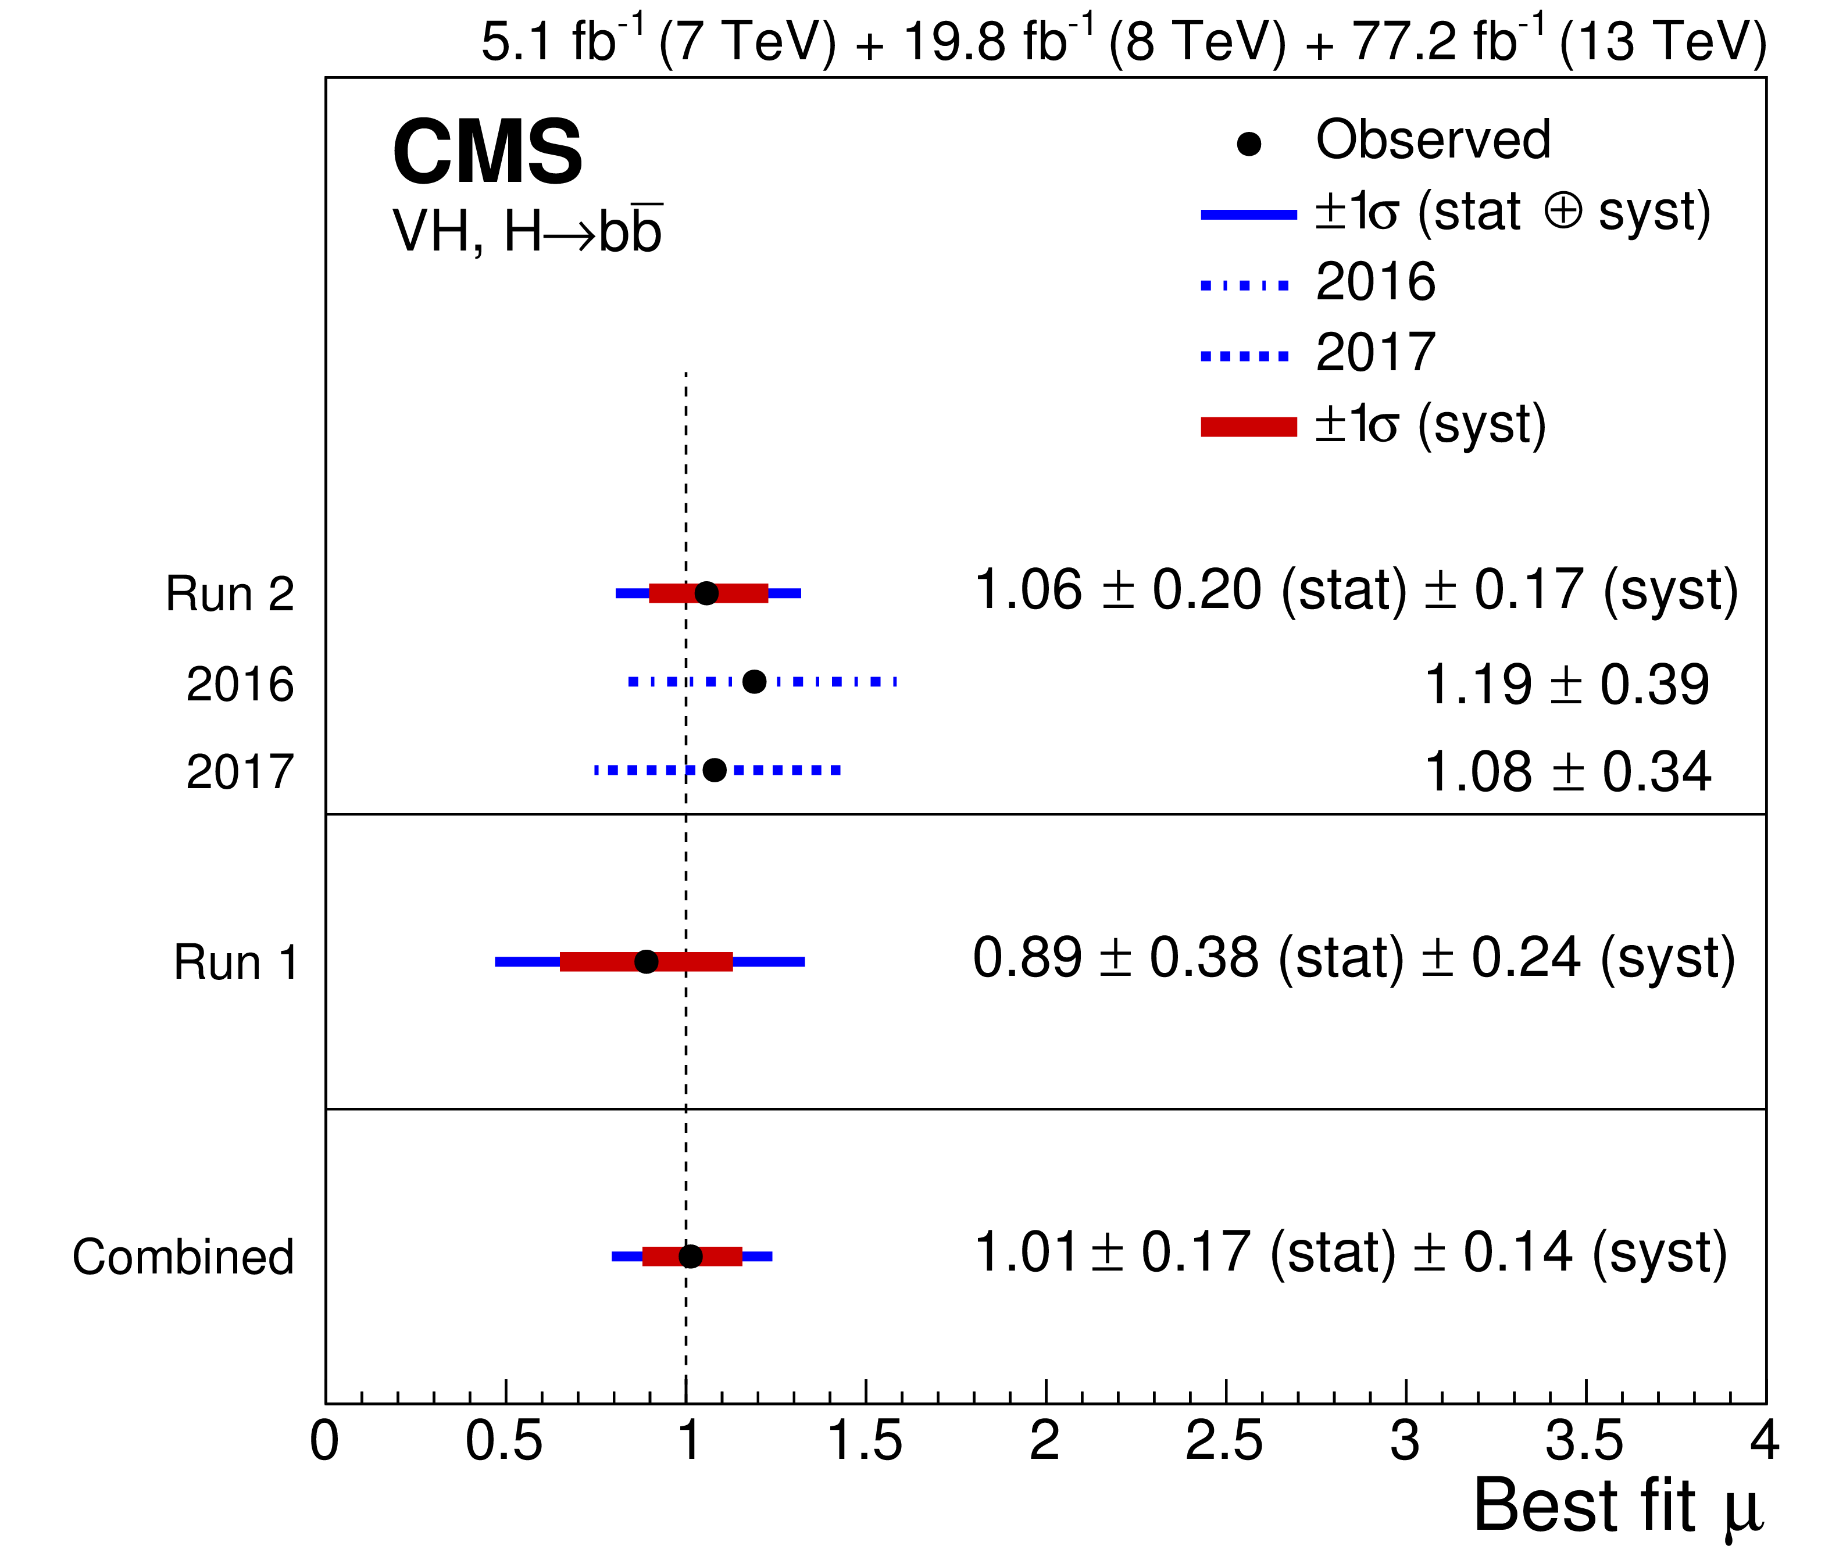
Higgs Yukawa Couplings – b quark

Slide 47
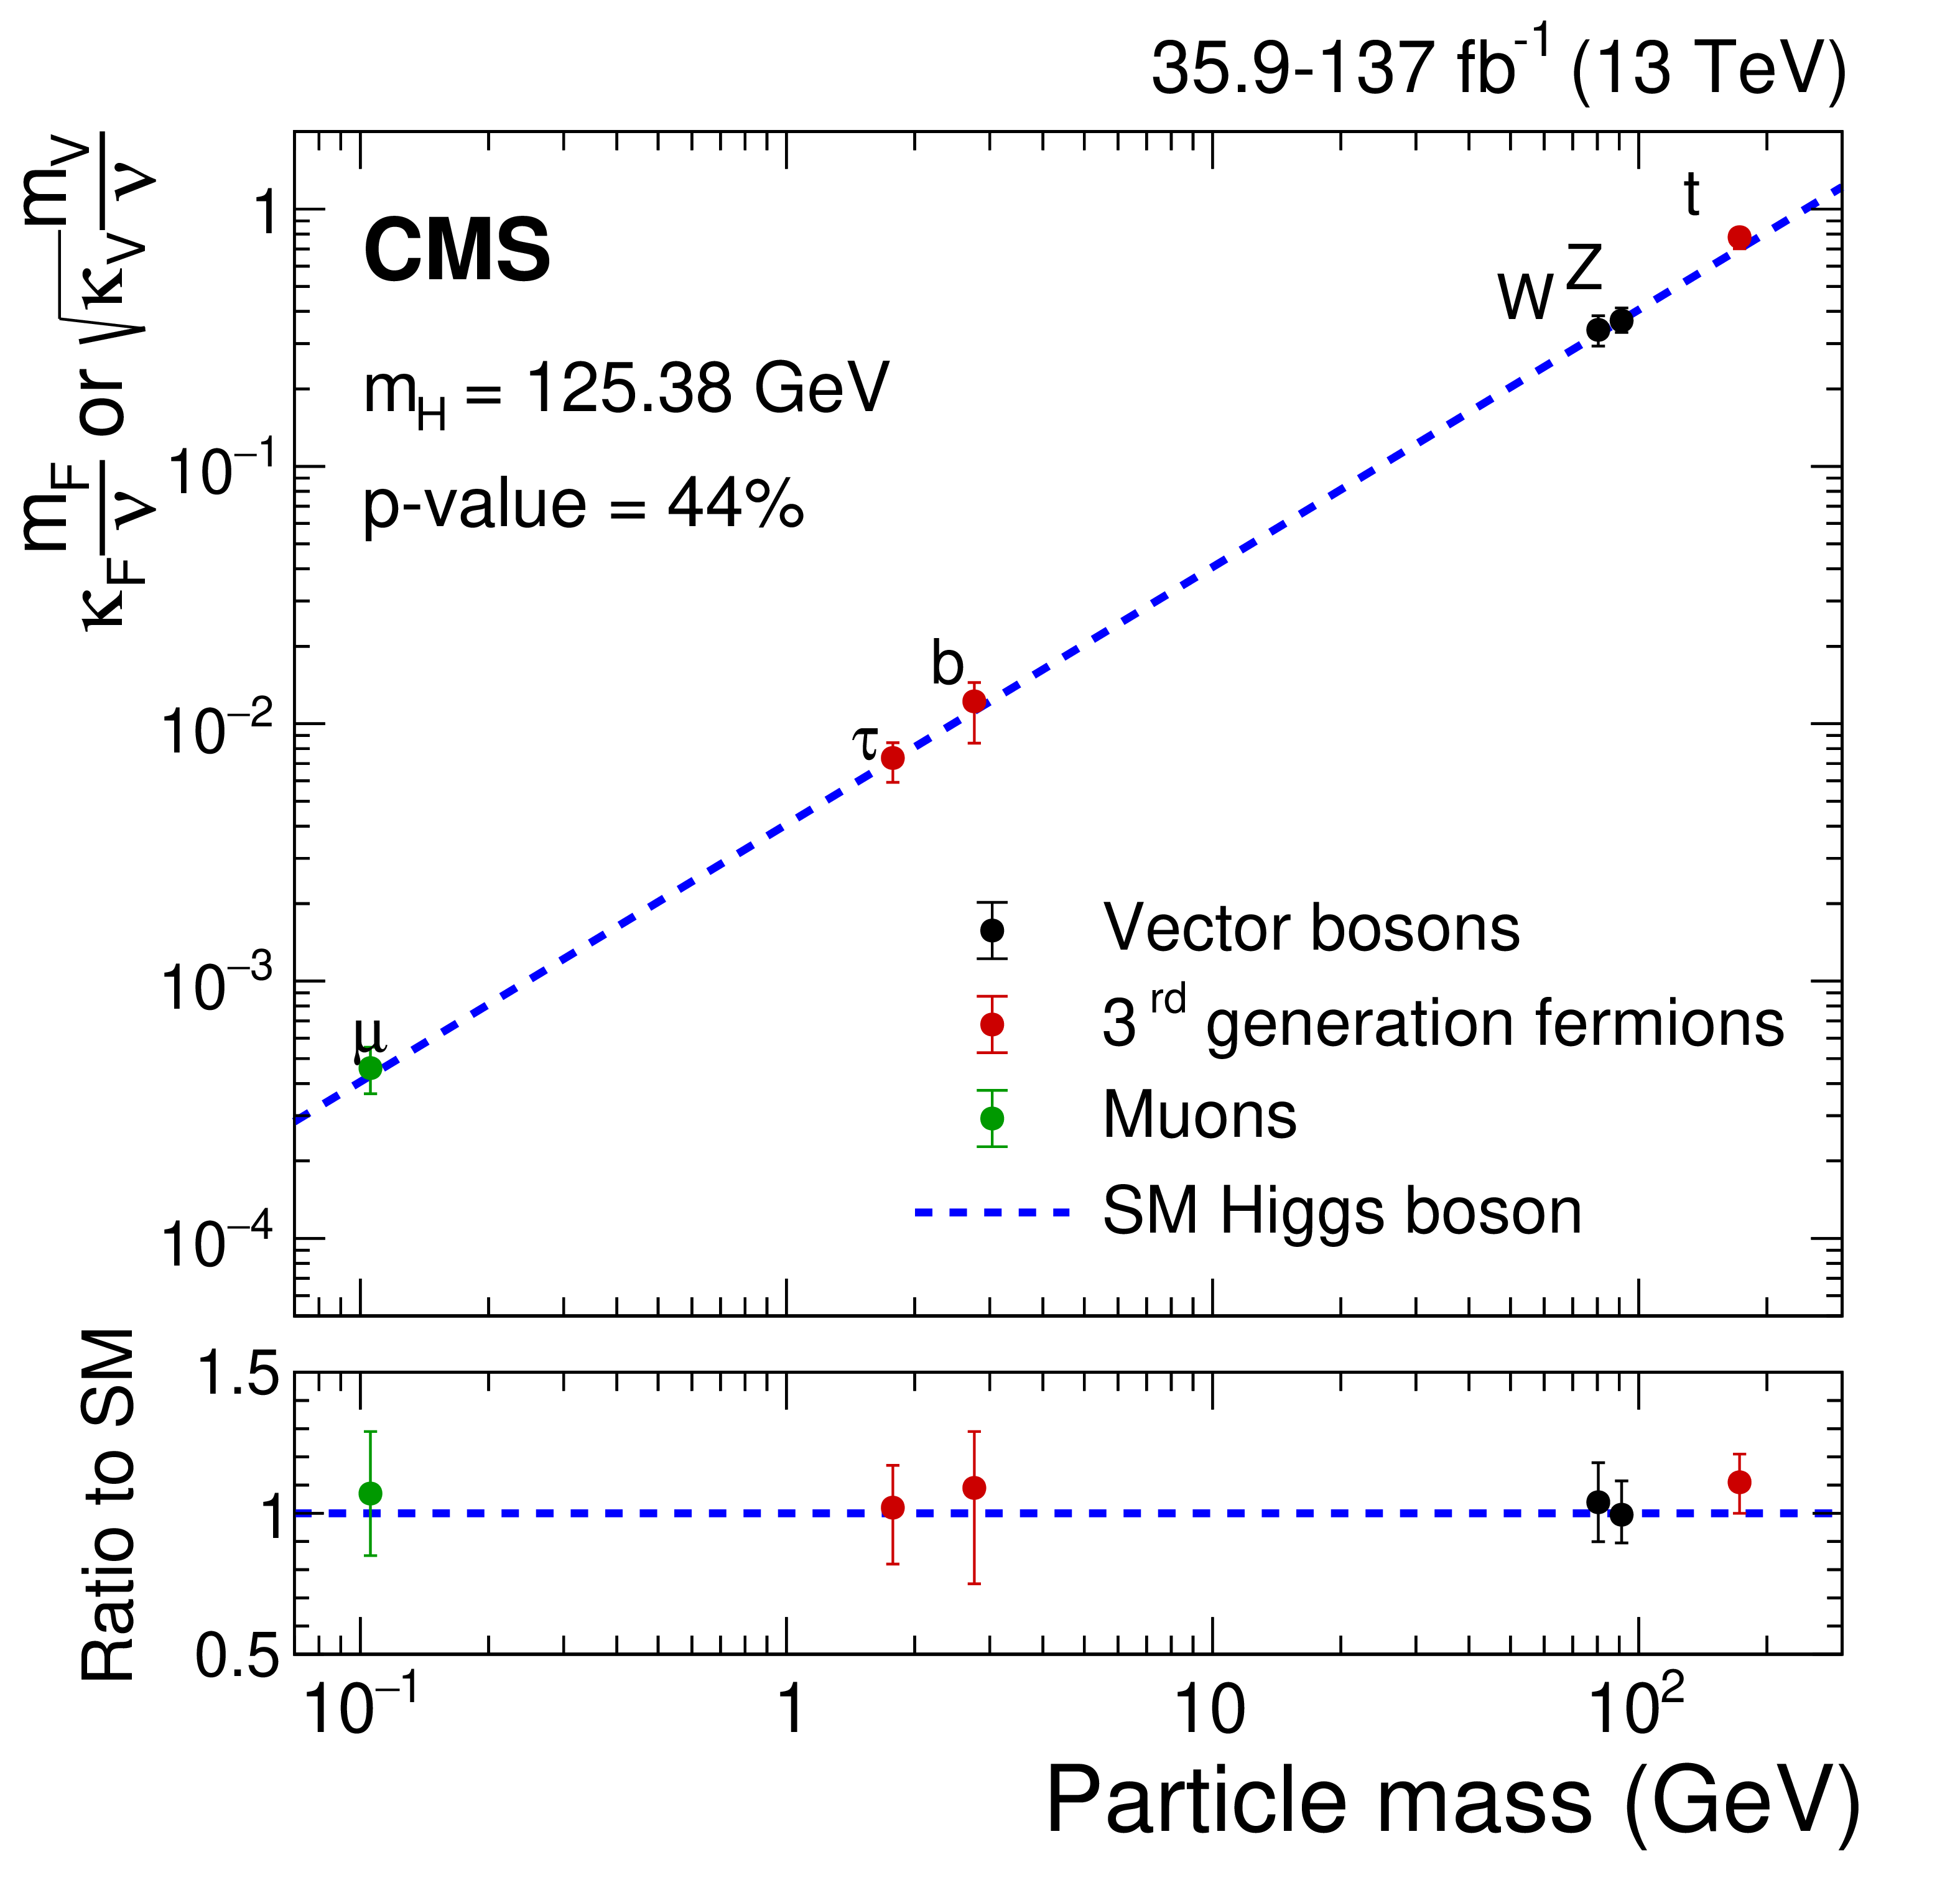
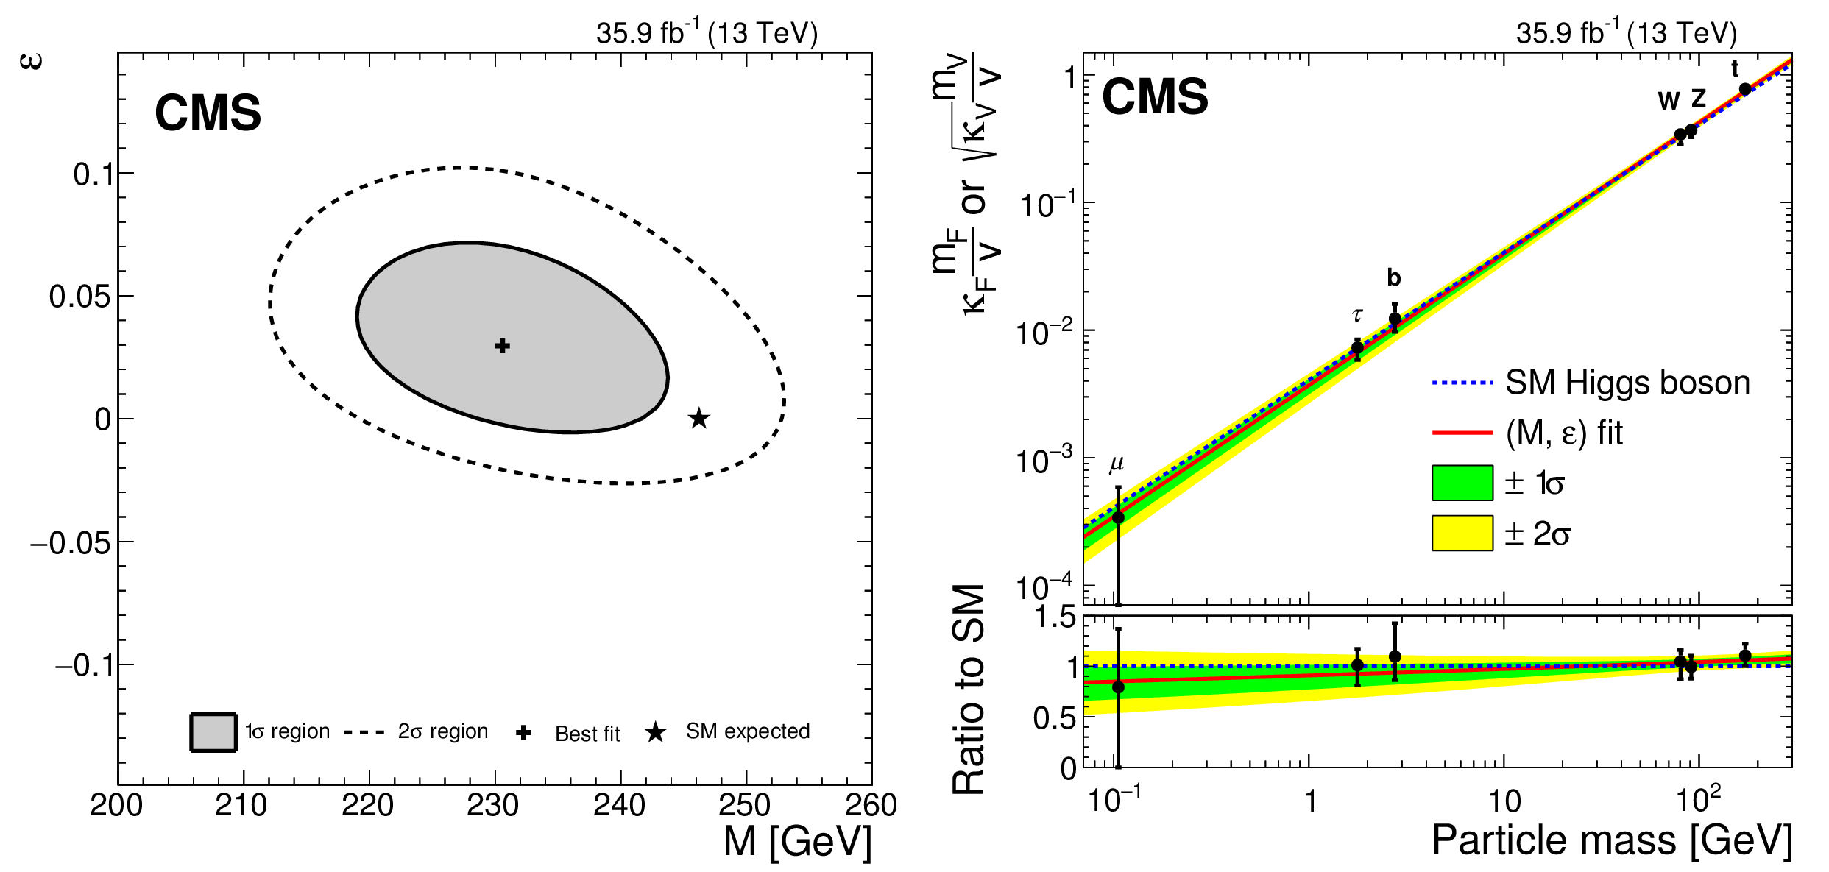
2018 Status : Higgs Couplings
Our discovery of a Higgs boson completes the Standard Model
2018 : h(125) continues to look like The SM Higgs Boson
Deviations from fermionic & vector coupling SM expectations quantified
2021: Many channels updated to full Run-2 data of 137 fb^{–1}
Further constraints with Run-2 before Run-3 data-doubling begins
Deviation from SM EWK
κ_{F} = v m^{ε}_{f} / M^{1+ε}
κ_{V} = v m^{2ε}_{V}/M^{1+2ε}
Electroweak Scale

Slide 48
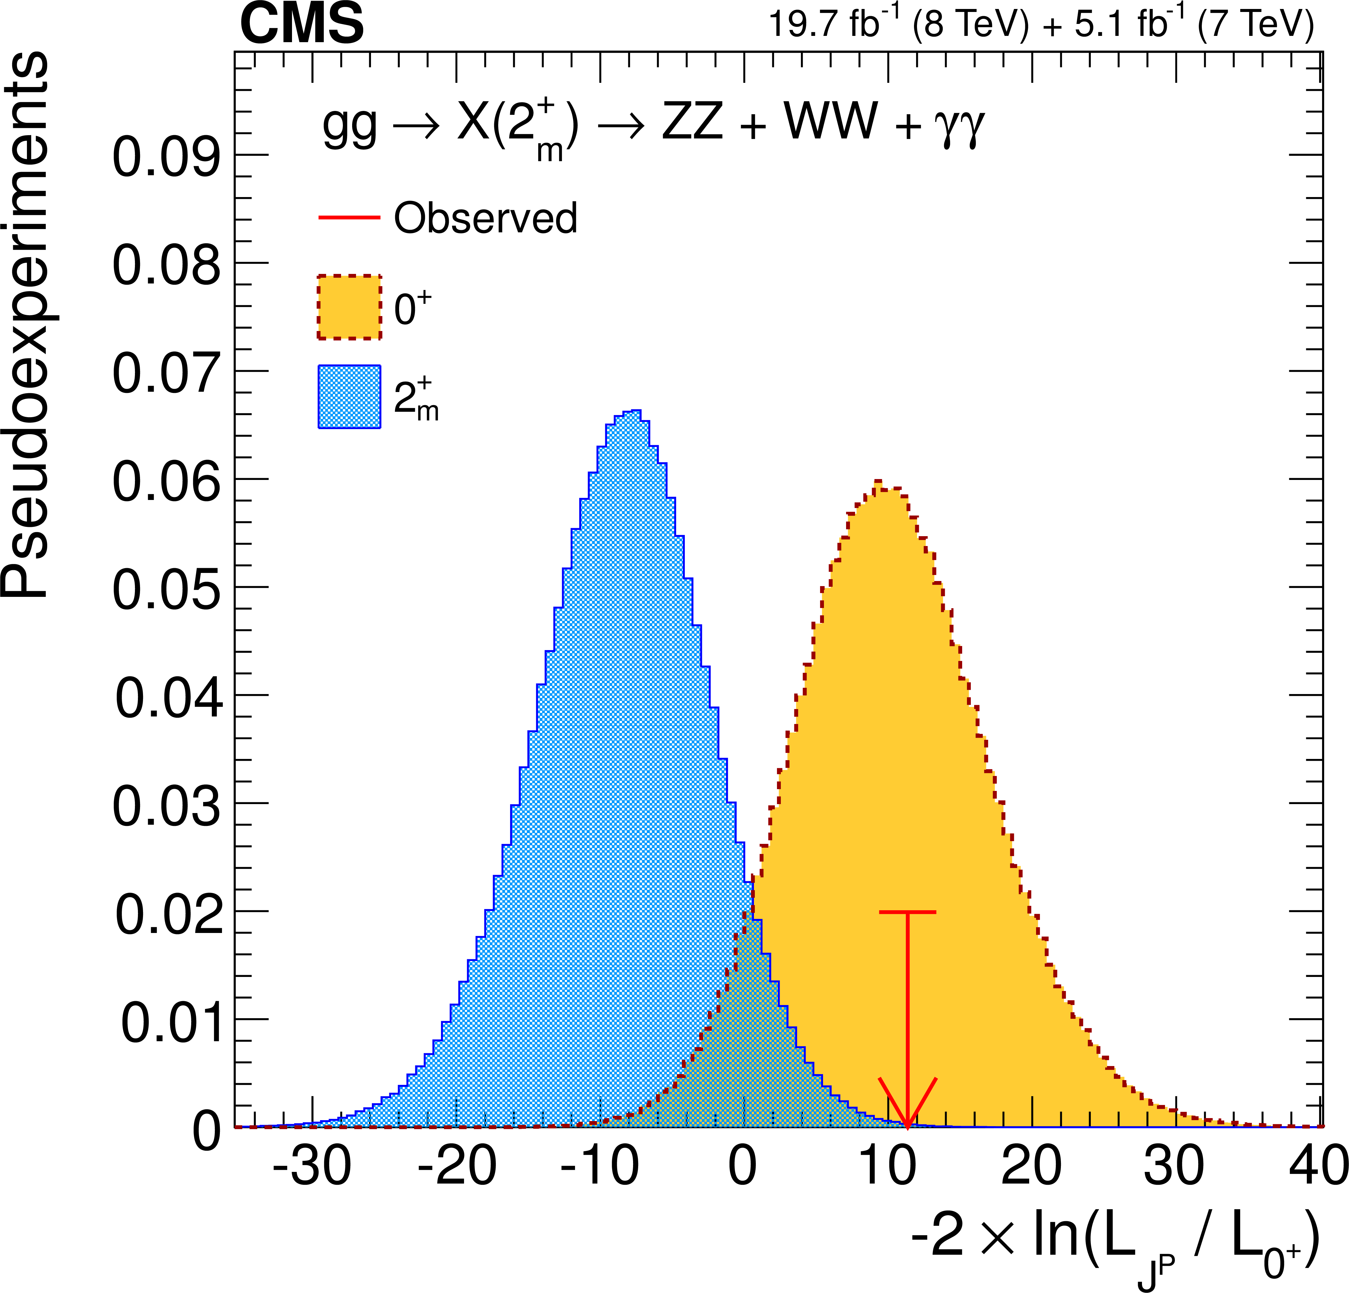
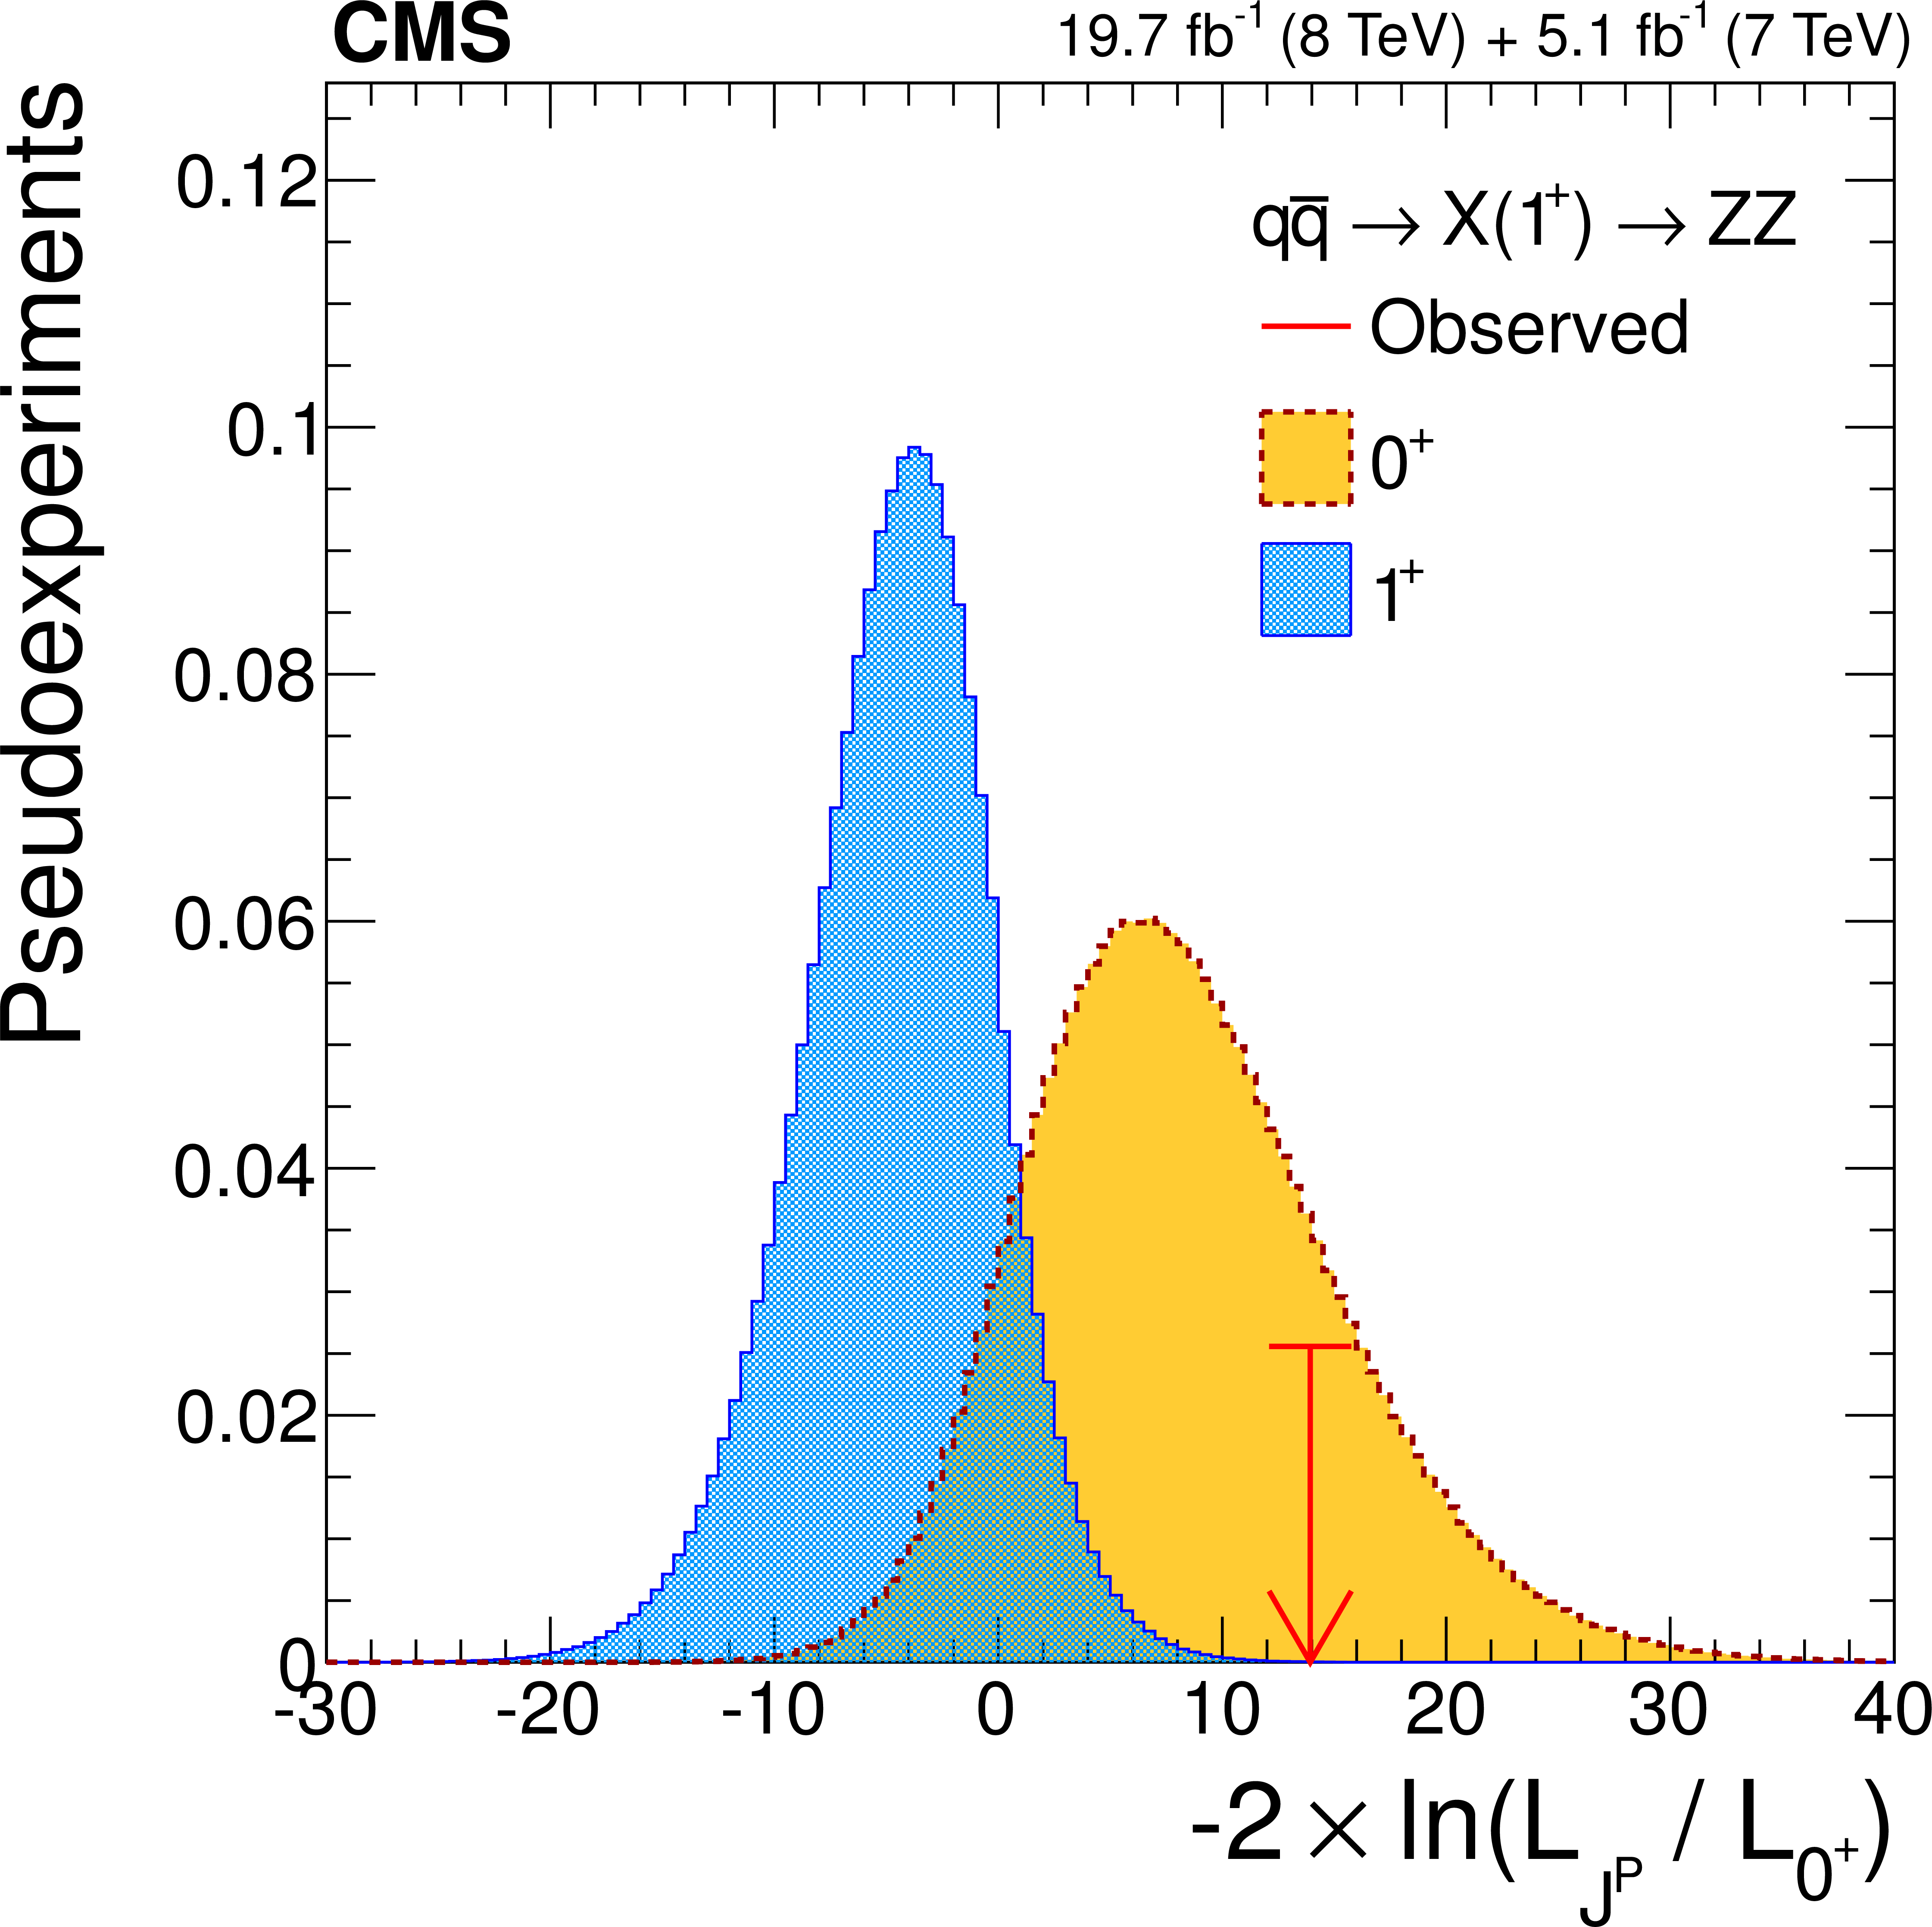
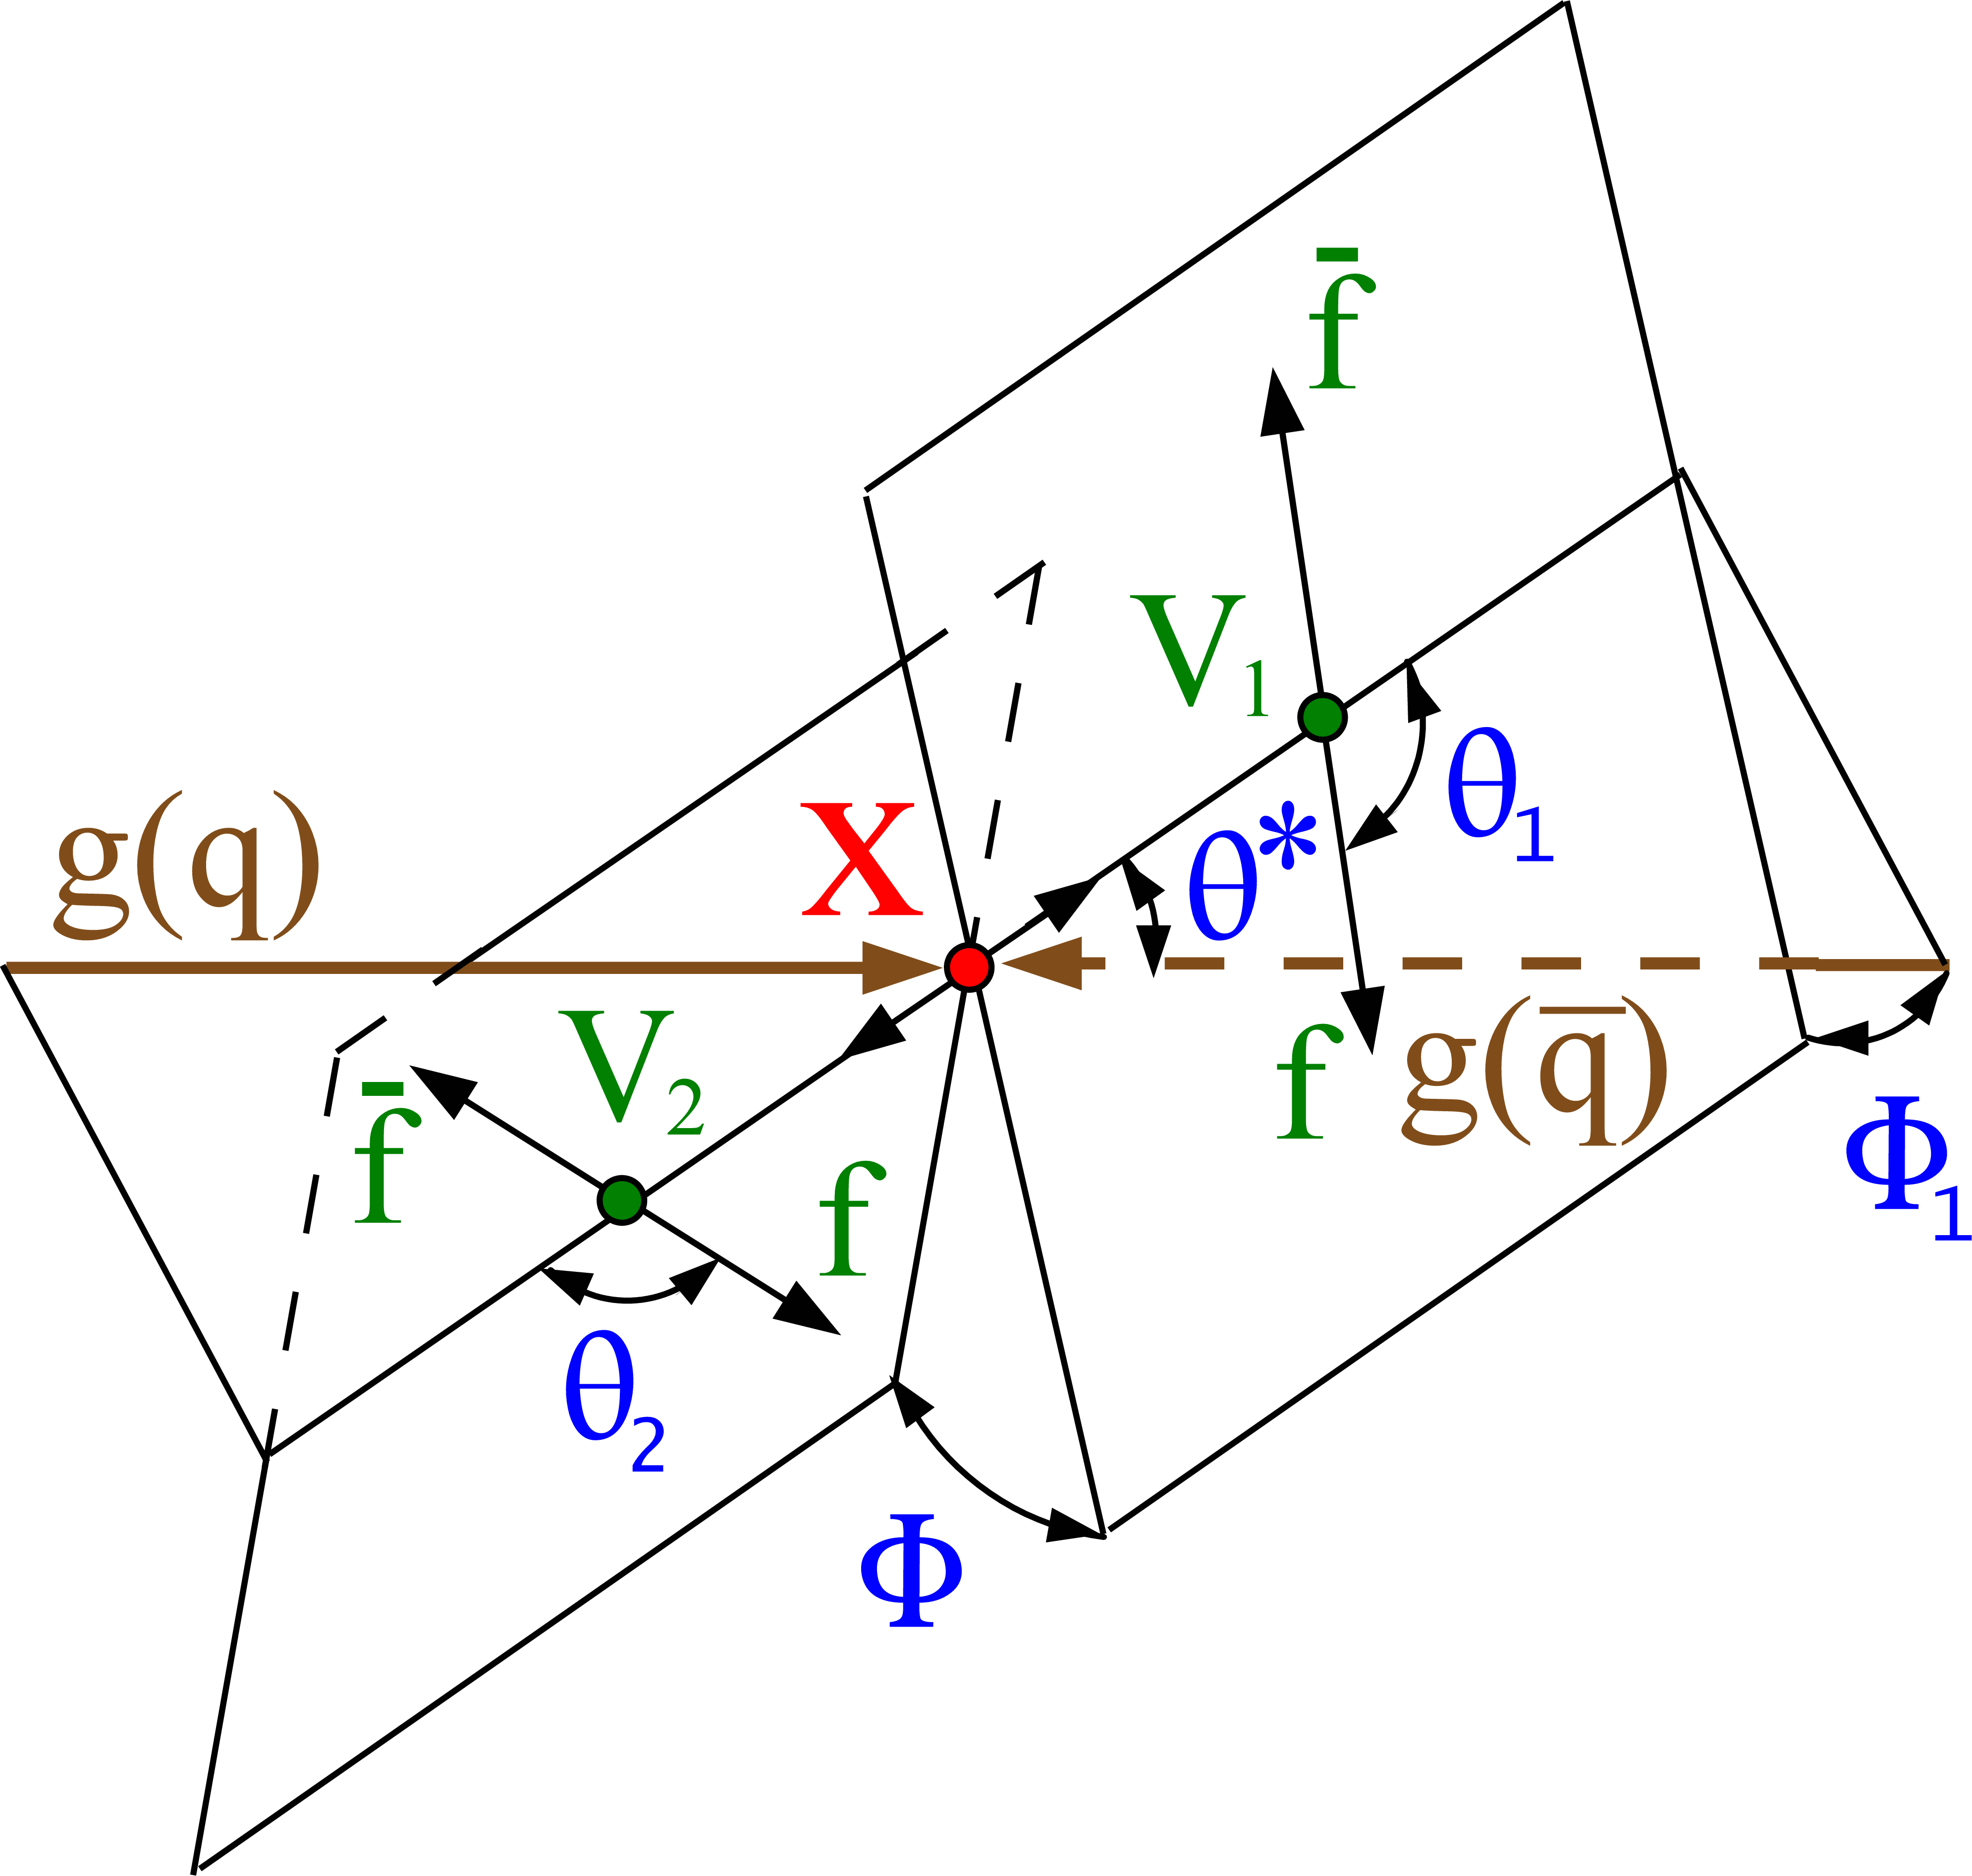
Spin – Parity Measurement
From early Run-1 data : H(125 GeV) to 4-leptons
A complex multi-variate fit to the distributions of angles in 4-lepton channel was made for different spin assumptions.

Slide 49
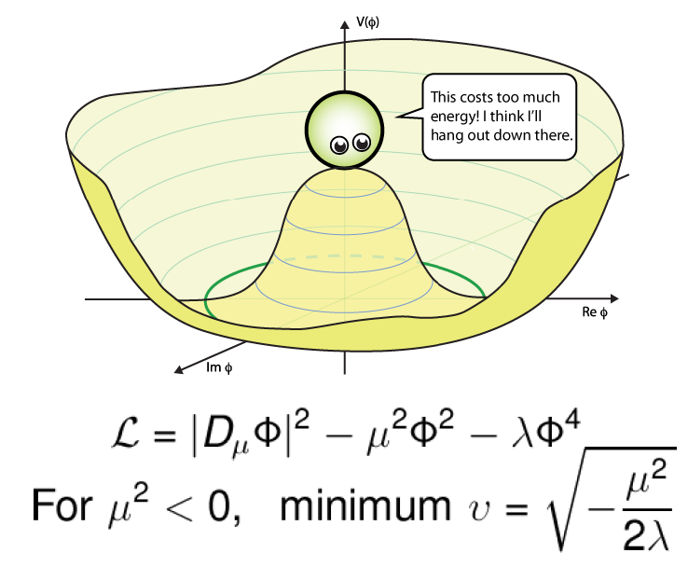
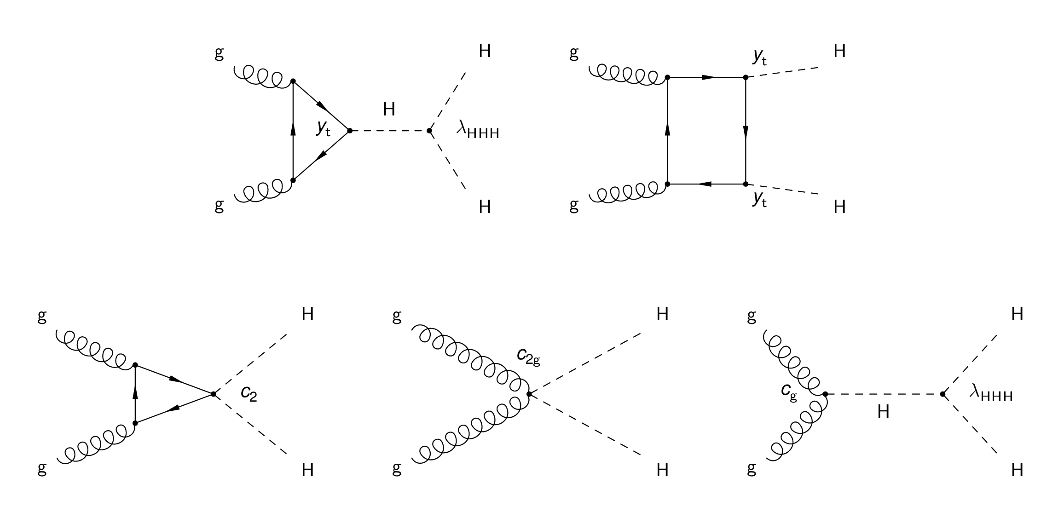
Verification of the Mexican Hat Potential!
Double Higgs production modes
potential new physics

Slide 50
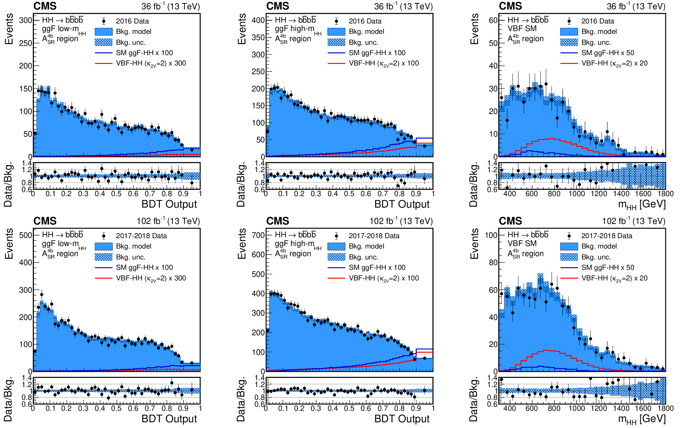
Verification of the Mexican Hat Potential!
Lots more data needed – 100 → 3000 fb^{–1}

Slide 51
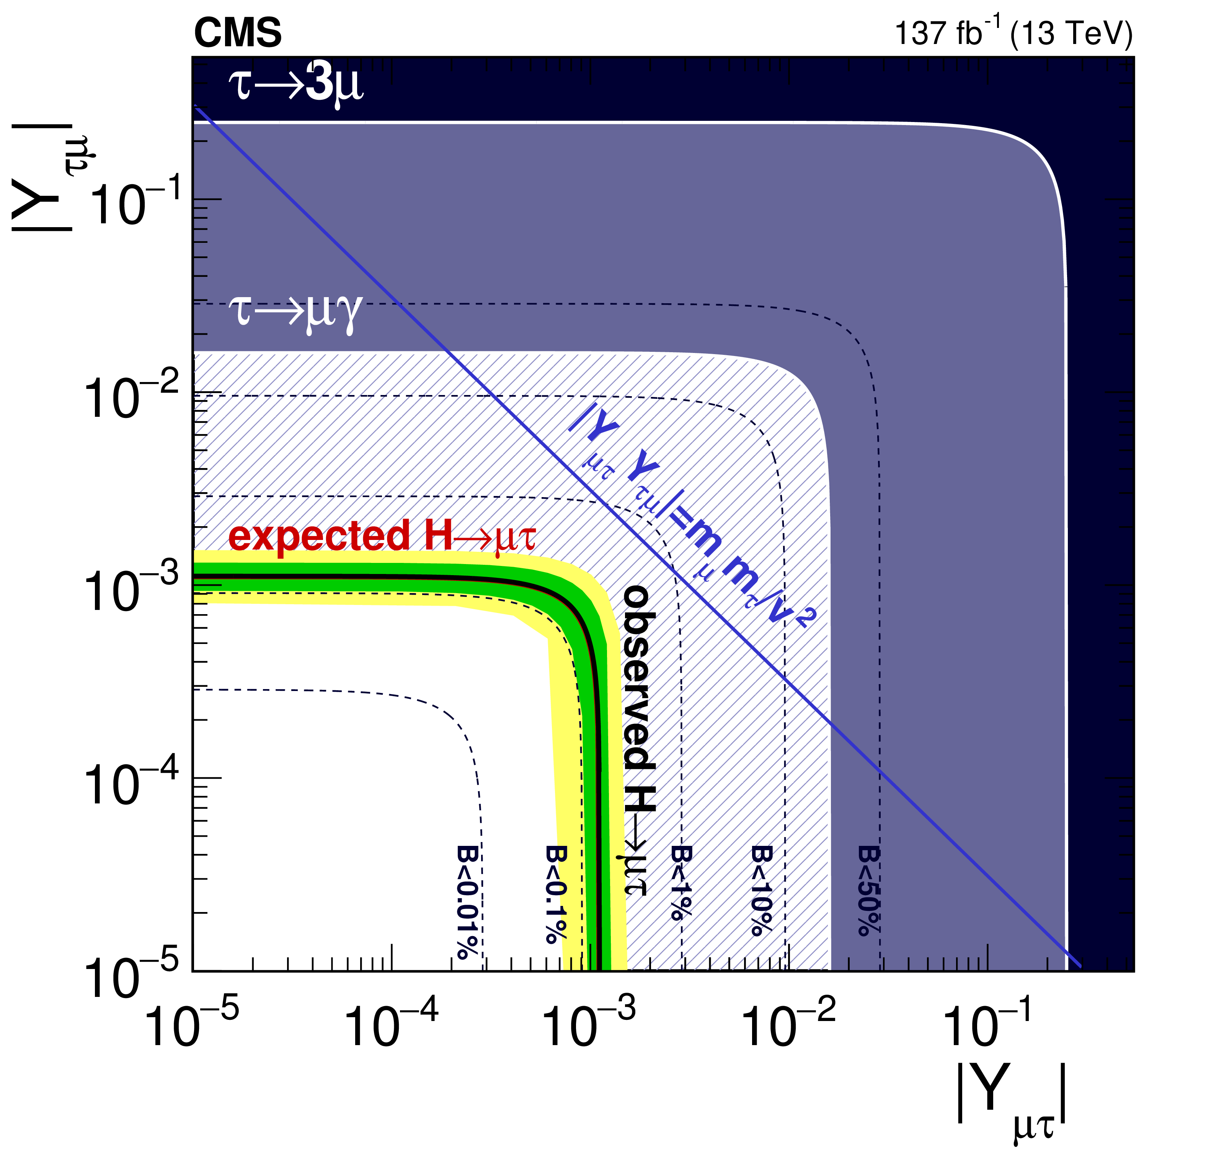
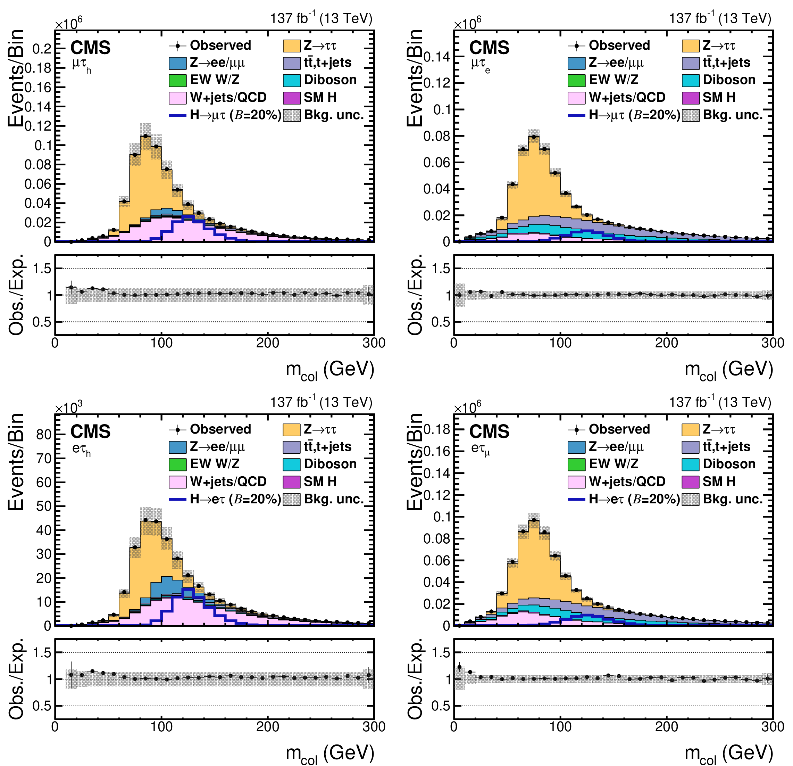
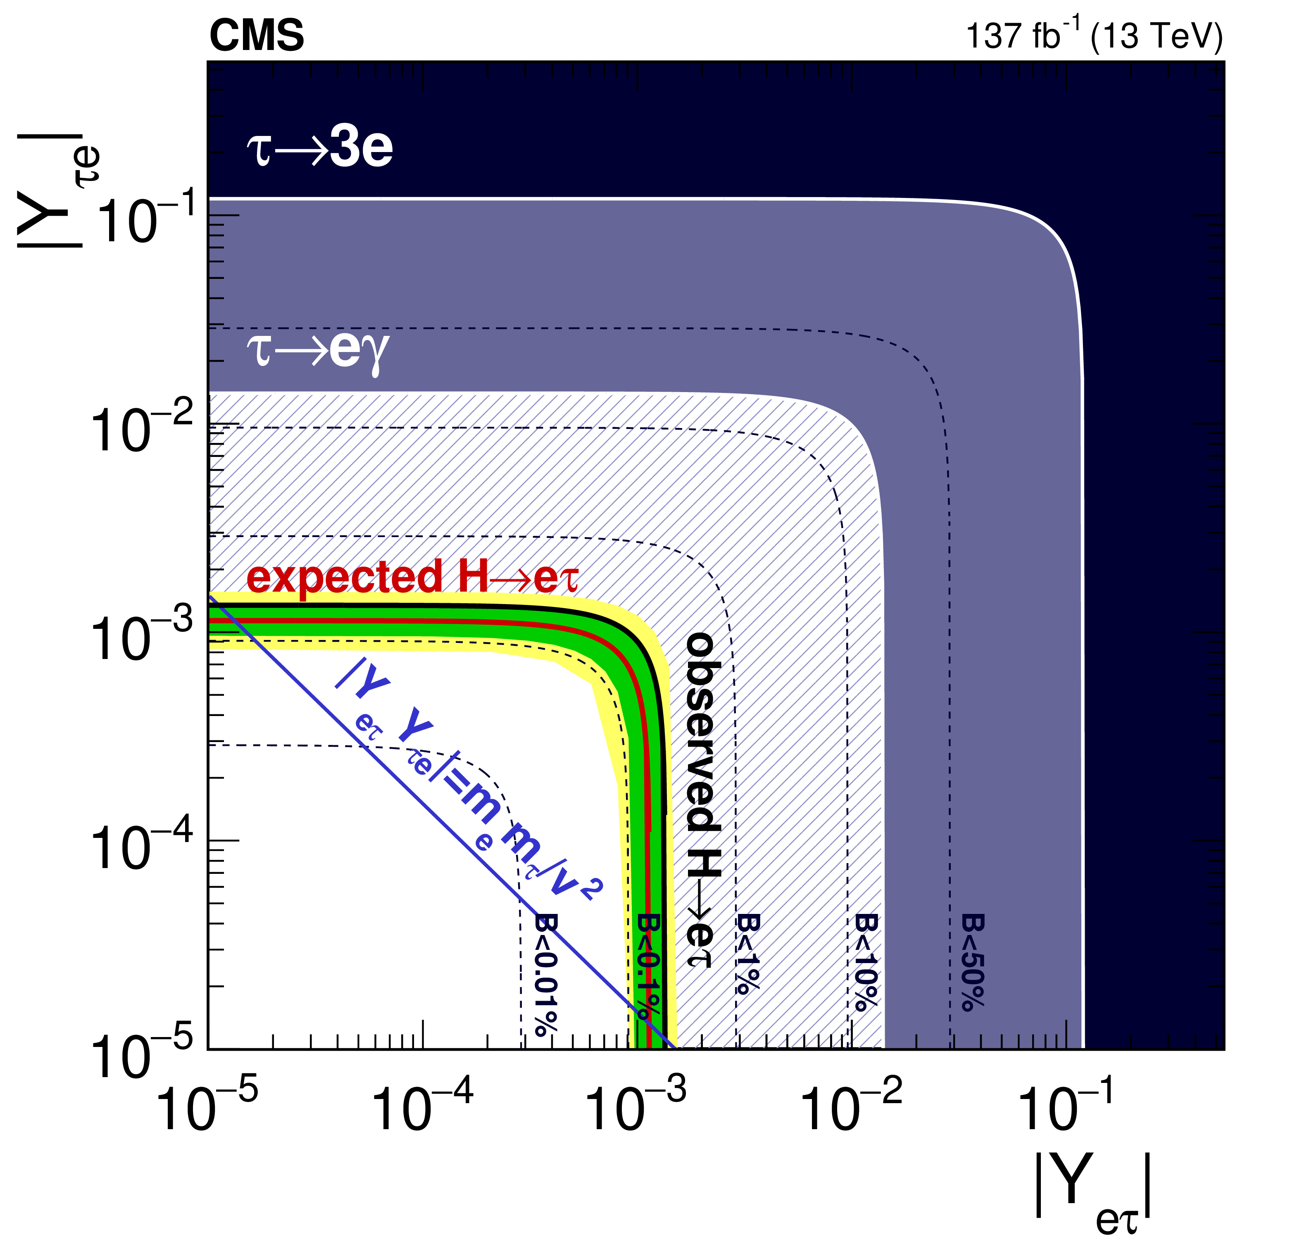
Lepton Flavor Violation? Non-diagonal Yukawa Couplings
Decays to μτ, eτ … None seen …

Slide 52
Neutrino Mixing

Slide 53
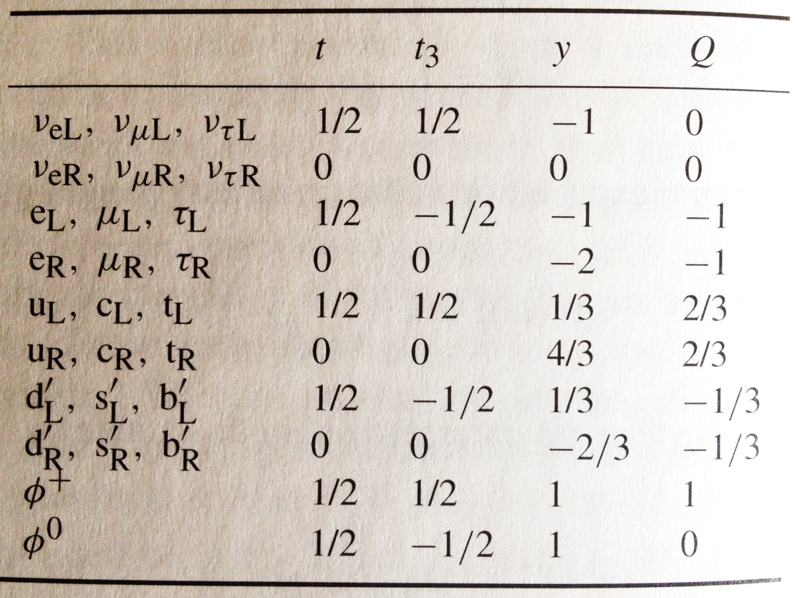
Neutrino Masses – Beyond SM
In principle all we need to do is to introduce right-handed neutrinos with no EWK quantum numbers and use the Dirac mass term as we do for all other fermions in the SM.
However, the Yukawa coupling will be ridiculously small.
Not a “natural” choice.
Therefore, the fact that neutrinos are known to mix is considered as “evidence” for beyond the SM physics.

