Slide 1
Physics 535
More on Spinors and Covariant Quantities
+
The Gauge Principle
Fermion-Photon Coupling

Slide 2
Question?
Klein-Gordon Equation :
can only describe massless particles
has only first derivatives of space and time
is a matrix equation of dimension 4
describes massless or massive spin-1/2 particles
can replace Schrodinger equation in consistently describing single particle quantum mechanics that is relativistically invariant

Slide 3
Question?
Dirac Equation describes:
Spin-0 particles and anti-particles
Spin-1/2 particles only
Spin-1 particles
Particles of any spin
Particles and anti-particles of spin-1/2

Slide 4
Question?
Dirac Equation :
is a relativistic equation
has only first derivatives of space and time
is a matrix equation of dimension 4
describes massless or massive spin-1/2 particles
All of the above

Slide 5
Dirac Equation
A 4x4 matrix equation
is a “Dirac Spinor”
There are four $u_{α}\left(k\right), α=1, 2, 3, 4$

Slide 6
Stuckleberg – Feynman Idea
Negative energy solutions are negative energy particles propagating backwards in time
The negative energy solutions can be interpreted as oppositely charged particles propagating forward in time
Time dependence of $e^{−iEt}$= $e^{−i(−E)(−t)}$ remains unchanged
Anti-particle spinors instead of $u_{3} \text{and} u_{4}$
$$v_{1}\left(E,\vec{p}\right)e^{−i\left(\vec{p}∙\vec{x}−Et\right)}=u_{4}(−E,−\vec{p})e^{−i\left[−\vec{p}∙\vec{x}−(−E)t\right]}$$
$$v_{2}\left(E,\vec{p}\right)e^{−i\left(\vec{p}∙\vec{x}−Et\right)}=u_{3}(−E,−\vec{p})e^{−i\left[−\vec{p}∙\vec{x}−(−E)t\right]}$$

Slide 7
Dirac Spinors
The four solutions
Momentum space Dirac equations

Slide 8
Question?
Is the four component Dirac Field $ψ$ a vector?
Yes
No
How do we tell if a four-component object is a vector?
By checking its transformation properties under Lorentz Transformation
By checking if the sum of electron and positron spins always adds up to spin=1 or not

Slide 9
Transformation of ψ
It takes some effort to establish above – look at solution to problem 7.11

Slide 10
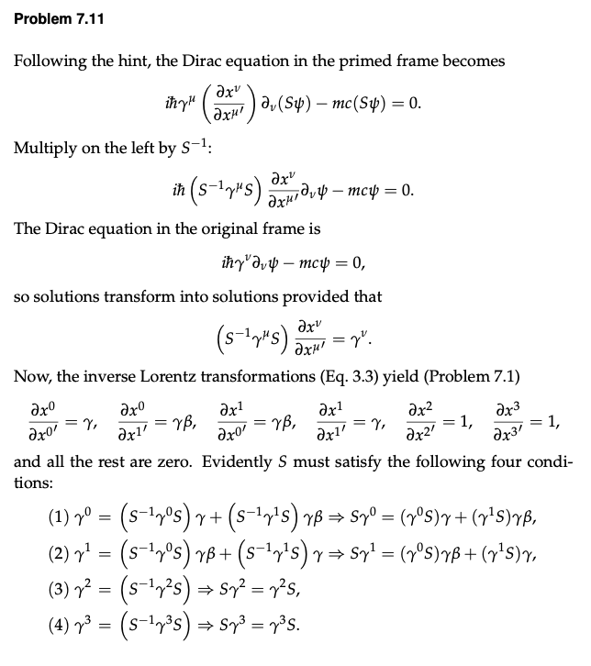
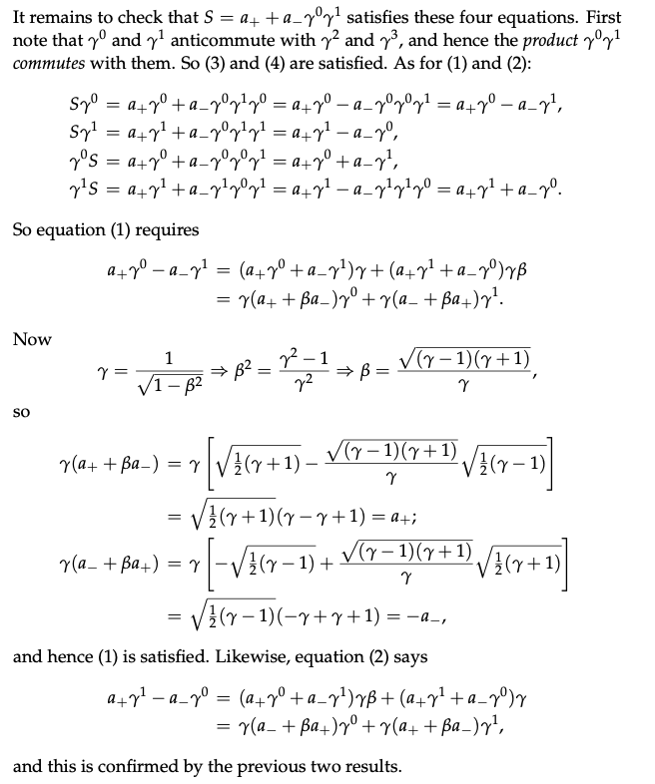
Transformation of $ψ$

Slide 11
Covariant quantities

Slide 12
Covariant Quantities: Scalar

Slide 13
Covariant Quantities: Pseudoscalar

Slide 14
Full set of Bilinear Covariants

Slide 15
EM Charged Particle Interaction
$$\vec{E}=−\vec{∇}V−\frac{∂\vec{A}}{∂t}$$
$$\vec{B}=\vec{∇}×\vec{A}$$

Slide 16
Gauge Transformation

Slide 17
Gauge Transformation Verification
So, the equation is gauge covariant

Slide 18
Gauge Principle → Interactions
Global gauge invariance led to conserved current
Demanding local invariance results in interaction!

Slide 19
Complex Scalar QED

Slide 20
Four Fermion Current-Current Interaction
n
p
What interaction can describe this decay?
How about – charged currents?
Discovery of beta+ decays – hermitian conjugate
Works Surprisingly well!
But, not perfectly, both ΔJ=0 and 1 seen
This implied potential other forms of interaction
e–

Slide 21
Pseudoscalars and Axial Vectors
What is the correct interaction?
Weak interactions found to be violating parity

Slide 22
Discovery of Maximal P Violation
Resulted in identification of interaction as V-A!
Universal coupling – same for all leptons
μ
e–

Slide 23
Quark Charged Current

Slide 24
Neutral Currents

