Slide 1
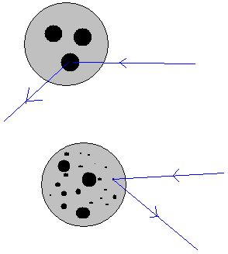
Physics 535 : Understanding the Proton
Parton Distributions – Use in pp Collisions
Increasing Q²

Slide 2
QED Feynman Rules: External Lines
External fermion lines contribute the spinors
External photon lines contribute polarization vector

Slide 3
QED Feynman Rules: Propagators…

Slide 4
Practice Writing Matrix Elements
Electron-Anti-Fermion Scattering
Question 2: Which of the spinors does the matrix element involve?
$$a) u\left(p2\right)$$
$$b) \overline{u}\left(p2\right)$$
$$c) v\left(p2\right)$$
$$d) \overline{v}(p2)$$
Question 4: Which of the spinors does the matrix element involve?
$$a) u\left(p4\right)$$
$$b) \overline{u}\left(p4\right)$$
$$c) v\left(p4\right)$$
$$d) \overline{v}(p4)$$
e– p₂
f– p₄
q
Question 1: Which of the spinors does the matrix element involve?
$$a) u\left(p1\right)$$
$$b) \overline{u}\left(p1\right)$$
$$c) v\left(p1\right)$$
$$d) \overline{v}(p1)$$
Question 3: Which of the spinors does the matrix element involve?
$$a) u\left(p3\right)$$
$$b) \overline{u}\left(p3\right)$$
$$c) v\left(p3\right)$$
$$d) \overline{v}(p3)$$
e—, p₁
f—, p₃
Question 5: Current term for electrons is $q_{e}\overline{v}(p2)γ^{μ}u(p1)$?
$$a) True$$
$$b) False$$

Slide 5
Practice Writing Matrix Elements
Electron-Anti-Fermion Scattering
e– p₂
f– p₄
q
Fractional charge for quarks
Question 7: Propagator is $\frac{−ig_{μυ}}{q^{2}}$
$$a) True$$
$$b) False$$
e—, p₁
f—, p₃
Question 6: Current term for quarks is $q_{q}\overline{u}(p3)γ^{ν}v(p4)$?
$$a) True$$
$$b) False$$

Slide 6
Deep Inelastic Scattering
p, p
Unobserved hadrons
X, p’
q
e, k
e, k’

Slide 7
Discovery of ~Free Point Particles within Proton
This looks very different from eμ scattering
Proton has structure unlike μ, which is a point particle
There are higher mass resonances
The growth above W=3 GeV indicates more and more scattering sites as energy is increased

Slide 8
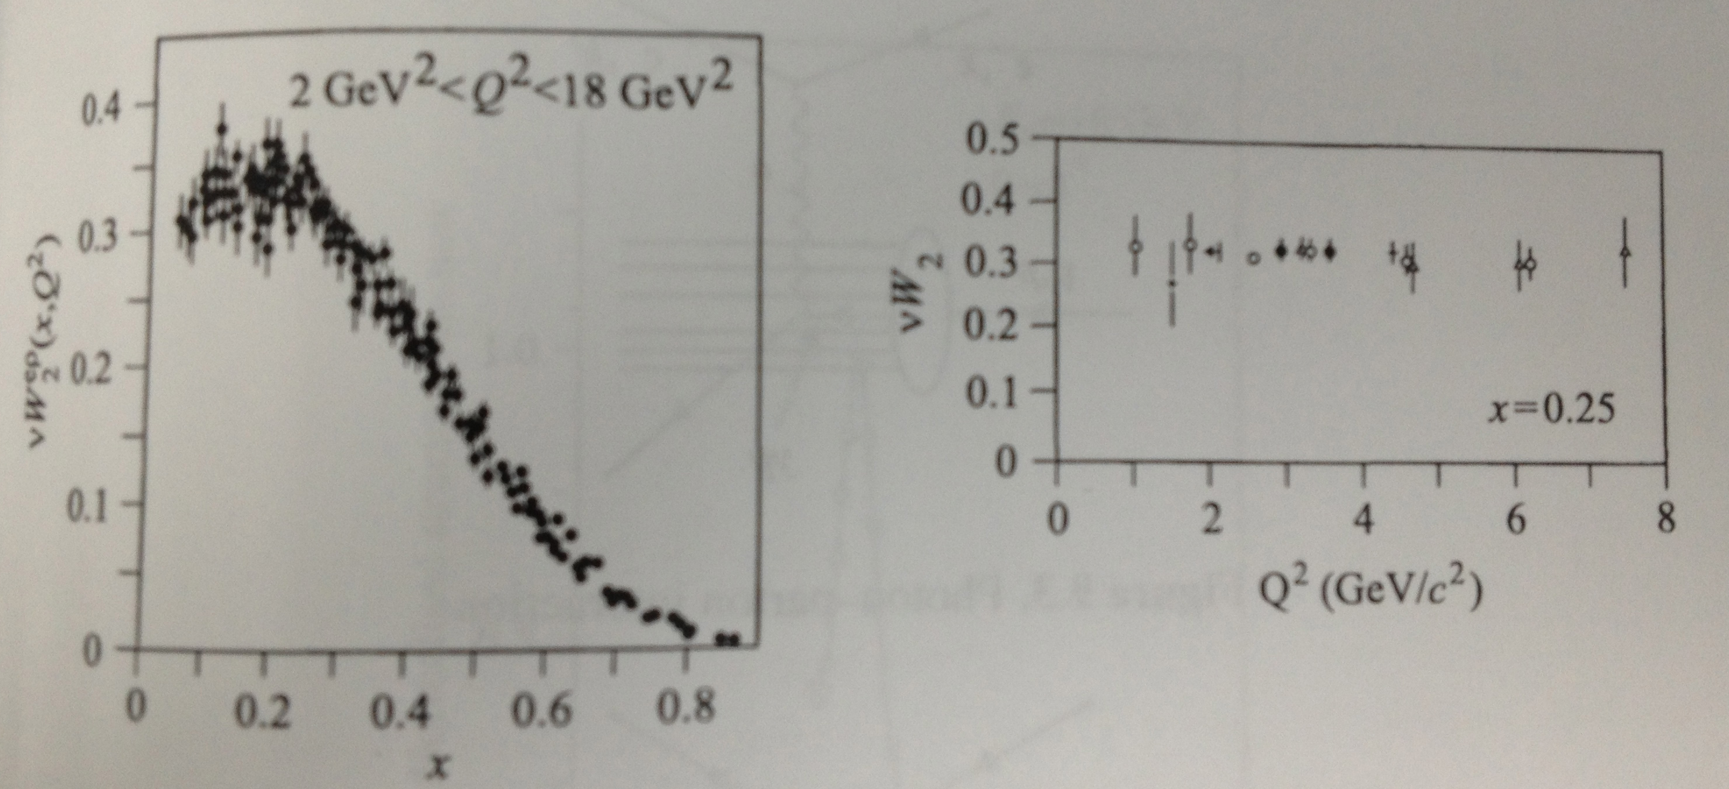
Discovery of ~Free Point Particles within Proton
Asymptotic Freedom!
“Weakly Interacting”
Structure functions appear to be independent of Q²
Bjorken’s interpretation, the partons are essentially non-interacting, although bound strongly within a proton!

Slide 9
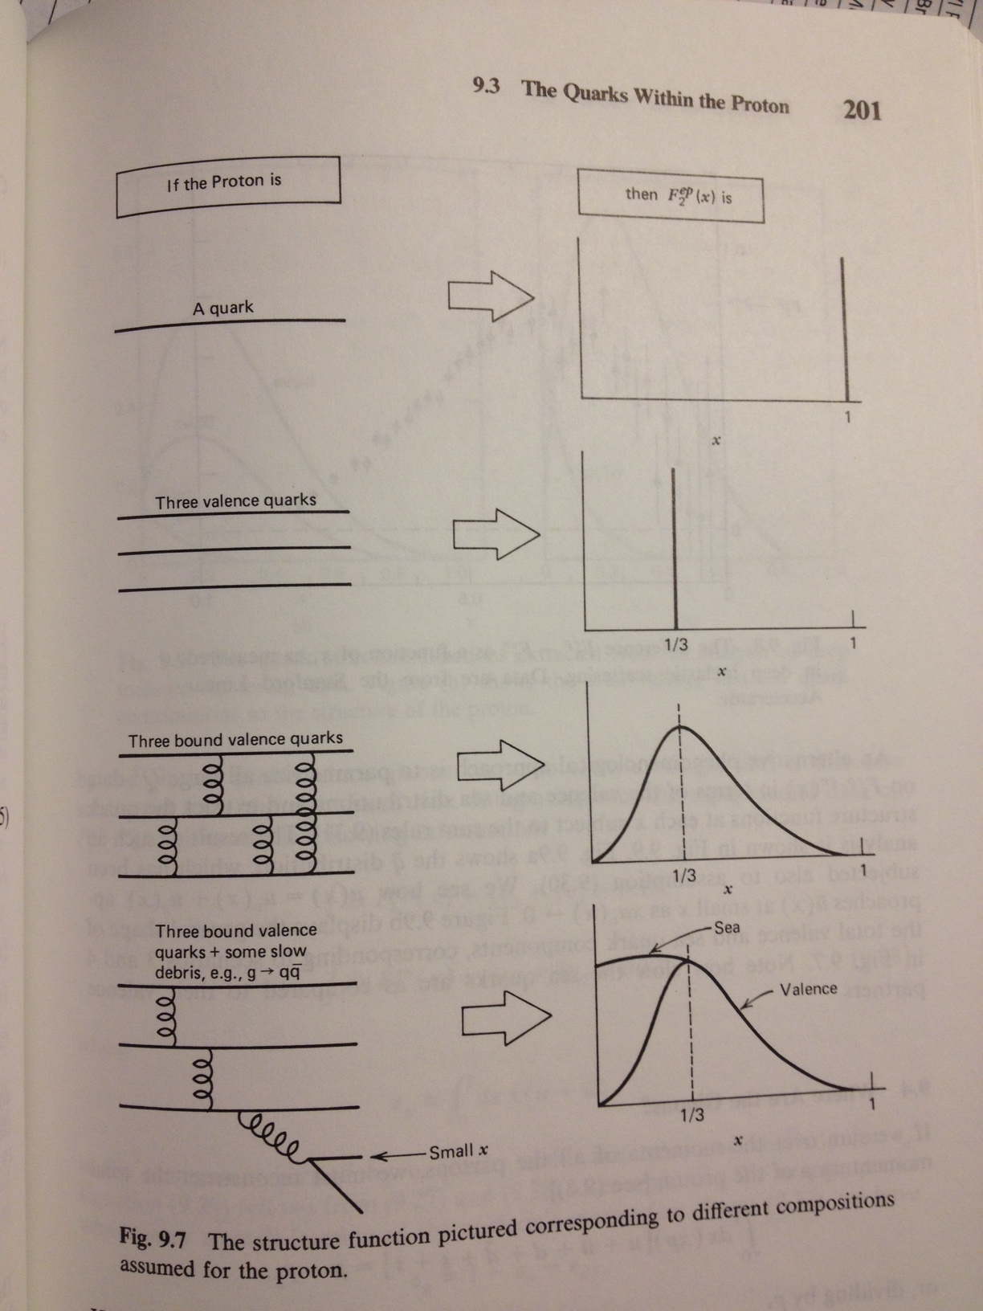
Proton Structure
High Q² virt. photons – probe short distance
Q² independence at “high” Q² implies that the partons are essentially free scattering sites
However, this scaling is only approximate
Large scaling violation at small x

Slide 10
F₂(x,Q²) Measurements
Increasing Q²
Fit these and other (neutrino) data to separate out quark (by flavor) and gluon distributions.

Slide 11
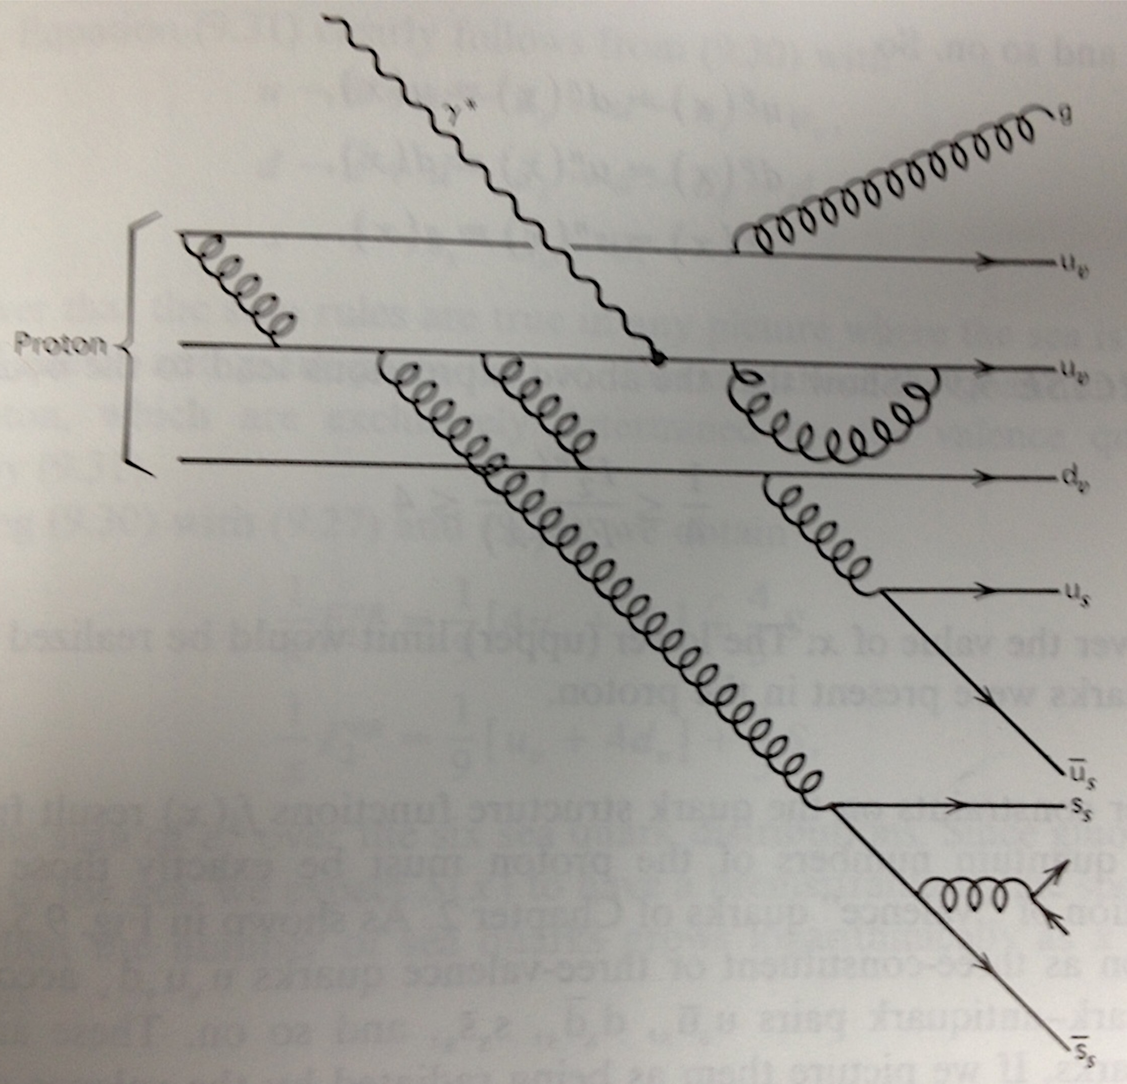
Proton As seen by Virtual Photon!

Slide 12
Quark-Parton Model
Proton | Parton
E | xE
p_{L} | xp_{L}
p_{T}=0 | p_{T}=0
M | m=xM
Experimentally the above sum rule using f_{i}(x) from measured F₂(x) ended up to be ~0.5 indicating that there is lot of neutral “stuff” in proton that carries half of its momentum. Stuff not interacting with photon is now interpreted as gluons.

Slide 13
Structure Functions ←→ Parton Distribution Functions

Slide 14
Sum Rules
Integrals of charge distribution, baryon numbers should yield +1 and +1 – for every sea-quark there should be an anti-quark

Slide 15
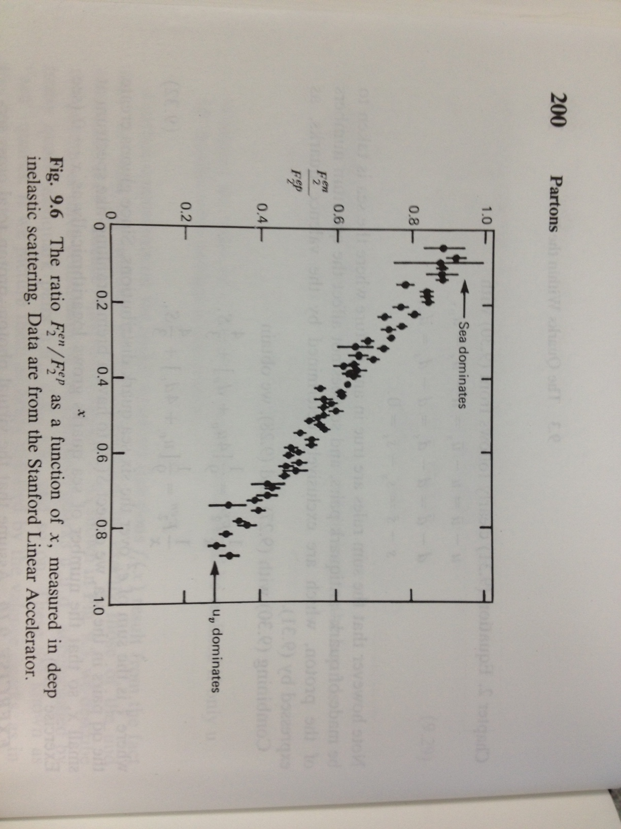
Flavor Separation

Slide 16
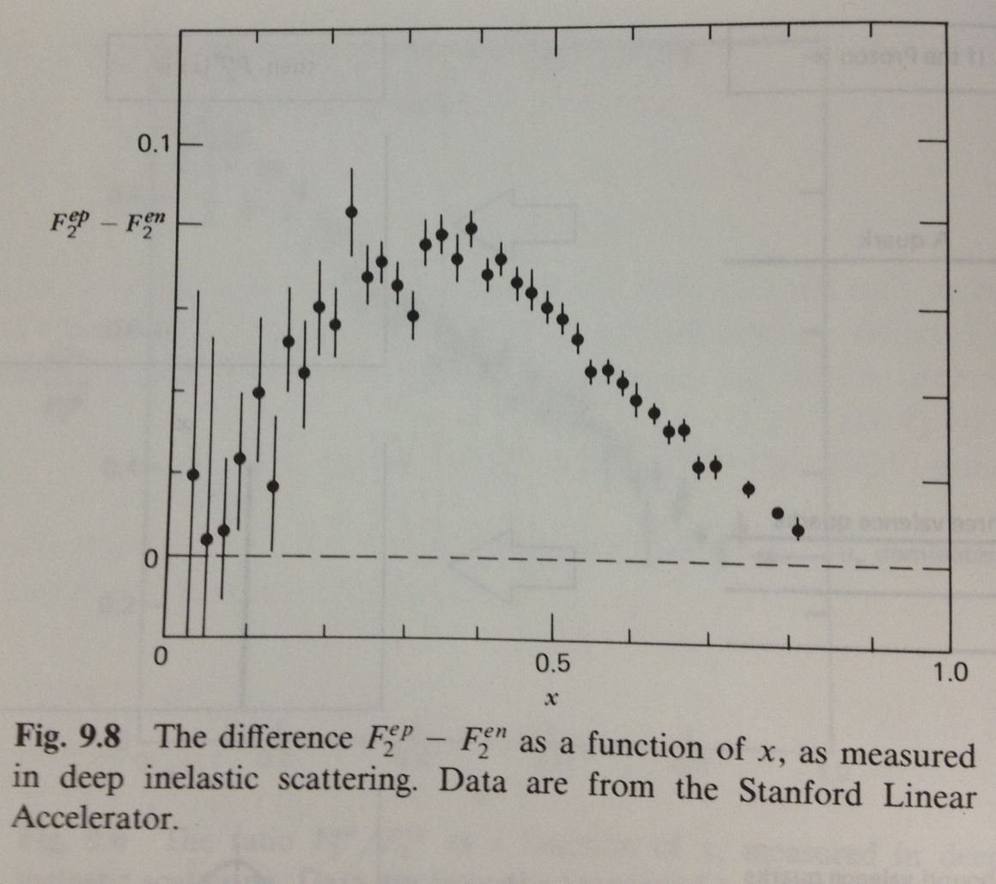
Valence Distribution

Slide 17
Indirect Discovery of Gluons

Slide 18
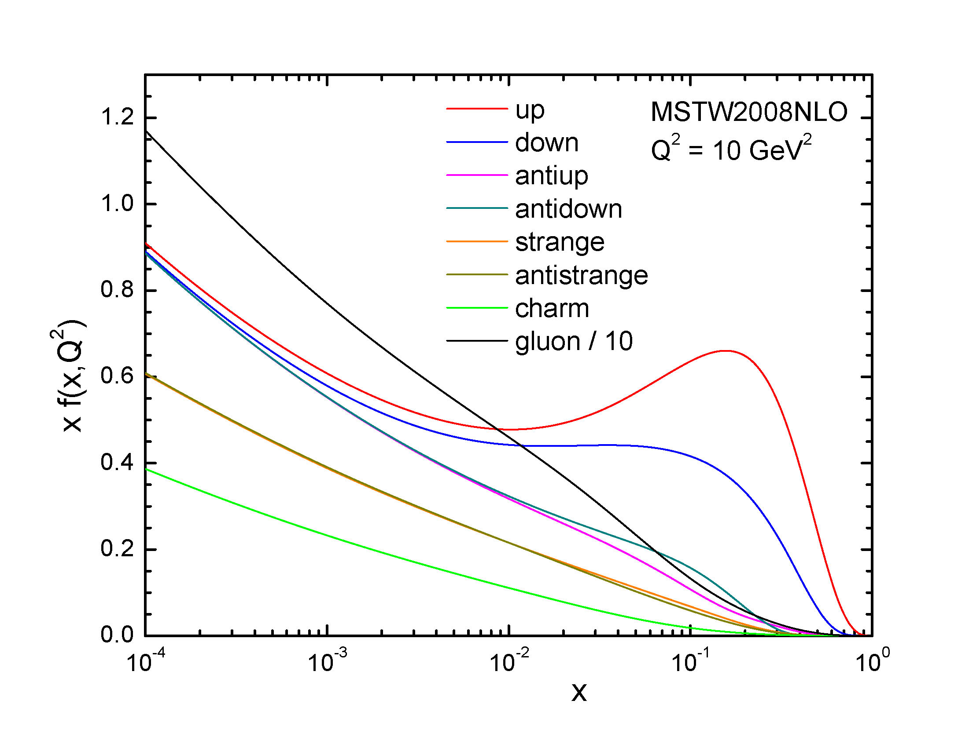
Parton Distribution Functions

