Slide 1
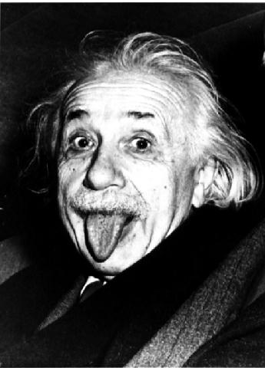
Relativistic Kinematics
Review basics → Particle Physics Style

Slide 2
Relativistic Kinematics
Laws of physics should be the same (invariant, retain the same form) in all inertial reference frames (reference frames moving with constant speed with respect to each other)
Newton’s laws are invariant under Galilean transformation
x’ = x + v₀ (t-t₀), t’ = t, v’ = v + v₀
Lengths and time intervals remain invariant in the two frames
However, Maxwell’s equations are not-invariant under Galilean transformation
but are invariant under Lorentz’s
Einstein: Speed of light is the maximum (revising Newton)

Slide 3
Four-vectors
Compact notation – simplifies computations
One can represent arbitrary motion filling in other elements
Tensor transformation:

Slide 4
Invariants and Metric
Length of a four-vector is invariant in Lorentz Trans.
To keep track of negative signs we use a “metric”

Slide 5
Scalar product of 4-vectors
For two four-vectors a and b:
Length of a four-vector
Interestingly, a² need not be positive
If, a² > 0, a is timelike 4-vector
If, a² < 0, a is spacelike 4-vector
If, a² = 0, a is lightlike 4-vector

Slide 6
Energy-Momentum 4-Vector
$p_{μ}p^{μ}=\frac{E^{2}}{c^{2}}−{\left|\vec{p}\right|}^{2}=m^{2}$ $c^{2}$
– an invariant (constant in all inertial reference frames)
Photon travels at same speed c in all inertial reference frames
Photon energy-momentum remains the same in all reference frames
Natural choice of units: set c = 1 and measure energy, momentum and mass in GeV

Slide 7
Some 4-Vector Examples

Slide 8
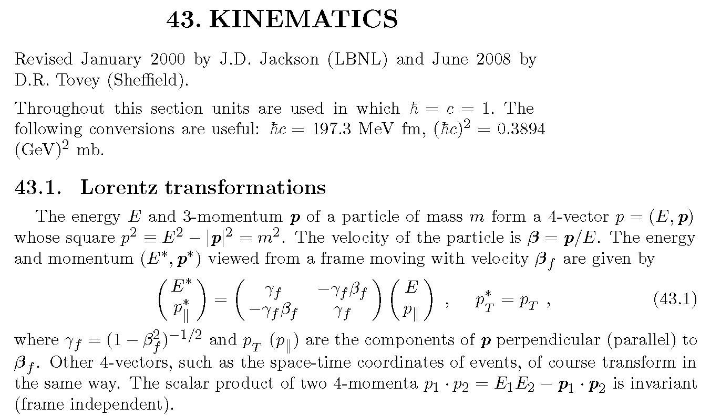
Relativistic Kinematics Summary
PDG Summary

Slide 9
Maxwell’s Equations in Manifestly Covariant Form
Classical Electrodynamics
Using Heaviside-Lorentz system of units, which avoids 4π factor
And, c=1!

Slide 10
Scalar & Vector Potentials

Slide 11
Gauge Invariance
In classical electrodynamics E & B fields are physical
Potentials are mathematical constructs
They make homogeneous equation automatic
But, potentials are not uniquely defined
Gauge transformation preserves field value
Gauge invariance → Conservation of Charge
This is global gauge invariance

Slide 12
The EM Wave Equation
Maxwells equations in terms of 4-vector potential: $∂_{μ}∂^{μ}A^{ν}−∂^{ν}\left(∂_{μ}A^{μ}\right)=J^{ν}$
Consider the region of space devoid of charges and currents: $J^{ν}=0$
$$∂_{μ}∂^{μ}A^{ν}−∂^{ν}\left(∂_{μ}A^{μ}\right)=0$$
We have freedom of choice of $A^{ν}$ - gauge invariance
The equation retains covariance on transformation: $A^{ν}→{\acute{A}}^{ν}=A^{ν}−χ^{ν}$
We can choose $A^{ν}$ such that $∂_{μ}A^{μ}=0,$ (Lorentz condition)
So, with Lorentz condition, $A^{ν}$ satisfies a wave equation with waves of $A^{ν}$ traveling at speed 1 (speed of light):
$∂_{μ}∂^{μ}A^{ν}=0$
Solutions of this equation are plane waves, with $k^{2}=0$ (light-like): $A^{μ}=Nε^{μ}e^{−ik.x}$

Slide 13
Collisions / Scattering
Classical
Mass is conserved: m_{A}+m_{B}=m_{C}+m_{D}
Momentum is conserved: p_{A}+p_{B}=p_{C}+p_{D}
Kinetic energy may or may not be conserved
Elastic (KE conserved)
Inelastic (KE not); sticky KE decrease; explosive KE increases
Relativistic
Energy is conserved: E_{A}+E_{B}=E_{C}+E_{D}
Momentum is conserved: p_{A}+p_{B}=p_{C}+p_{D}
Kinetic energy & mass may or may not be conserved
Elastic (KE and mass are conserved)
Same particles in initial and final state!
Inelastic
New particles created – could be lighter or heavier
A + B ➔ C + D
A + B ➔ C
A ➔ C + D
4-momentum conservation, p_{A}+p_{B}=p_{C}+p_{D}

Slide 14
Invariants & Conserved Quantities
Invariant quantity takes the same value in all reference frames
It is a scalar – does not transform like vectors/tensors …
Conserved quantity takes the same value before and after a physical process takes place, e.g., collision
Mass is invariant, but is not conserved!
Energy is conserved in collisions but is not invariant
Energy-momentum is a 4-vector
Not invariant but transforms in a specific way
Some quantities are conserved and are invariant
Electric charge, Lepton number …
Many quantities are neither conserved nor invariant
Velocity, …

Slide 15
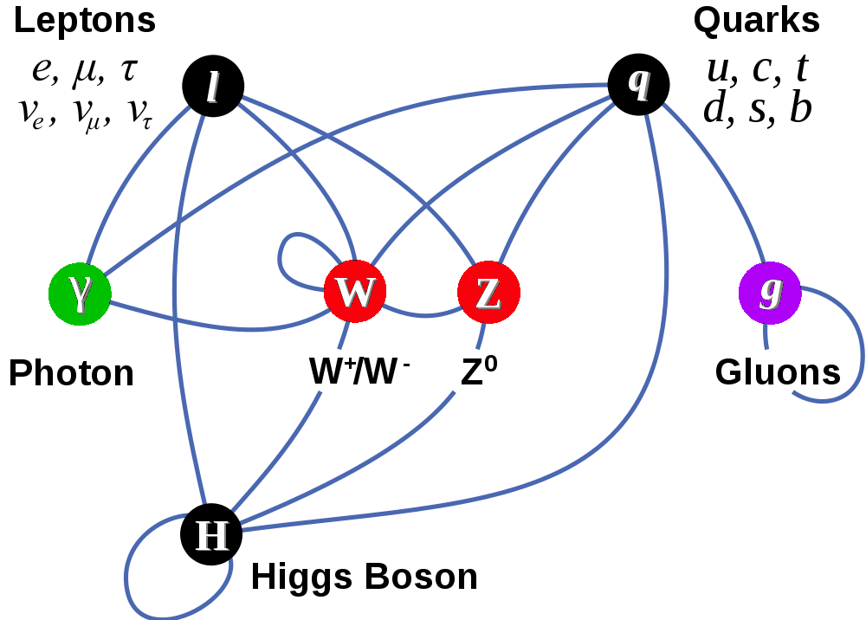
Interactions in The Standard Model
Matter Particles (fermions)
Interactions by exchange of vector bosons
Higgs boson is the edifice on which castle called the Standard Model is built

Slide 16
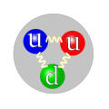
Particle Interaction Types
1
Quarks bound in hadrons via strong interactions
Baryons (spin-1/2)
3-quark states
Protons, neutrons
Mesons (scalars, vectors …)
quark-antiquark states
pions, kaons
Atoms bound together via electromagnetic interactions
Weak force responsible for radioactive decay
BUT, weak force is only active at short distances
W and Z should be massive and decay quickly
Electro-weak interactions have unified description at high energies
10⁻²
Proton
Pion
10⁻⁷
Relative
force strength
In this course, we will focus on high energy phenomena almost exclusively.

Slide 17
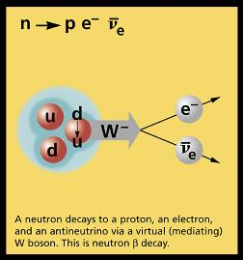
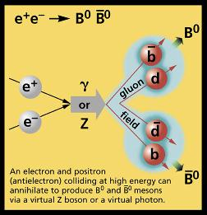
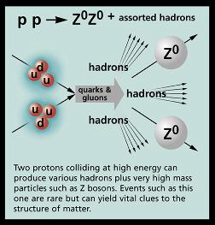
Particle Interactions
TeV-scale
MeV-scale
GeV-scale

Slide 18
Example 1 : Radiation
Charged leptons interact with photons
Can a free electron lose some of its energy by emitting a photon?
e–
γ
e–
Momentum conservation could be satisfied by that photon interacting with another electron in the medium.
Then what is this space-like (non-lightlike) photon?
“Virtual Photon”
Electrons lose energy only when they travel in a medium with charged particles!

Slide 19
Example 2: Annihilation
Charged leptons and anti-leptons interact with photons
Can an electron & a positron annihilate and convert their mass to energy?
e⁺
γ
e–

Slide 20
Real Z Production – e⁺e– collider
e⁺
Z
e–
Neglecting small electron mass E_{e}=E_{p}=45.5 GeV to make Zs (M_{Z}=91 GeV)

Slide 21
Center of Mass Frame
Some times calculations are easier considering center of mass frame
Proton-proton collision p p ➔ p p p p
Lab
CM
How about in head on symmetric pp collider?

Slide 22
CM vs “Lab” Variables
The invariant lengths are same in all reference frames

Slide 23
Example 3: eP Scattering
An electron with energy E scatters of a stationary liquid hydrogen nuclear target of mass M at an angle θ, with respect to its original direction, transferring it, momentum p and energy ν=E-E’, where E’ is the electron’s final energy.
e–
Hadronic system
γ∗
e–
p⁺
If the collision is inelastic the target breaks up, possibly leading to a number of hadrons in the final state.

Slide 24
eP - scattering
e–(p’)
W
e–(p)
γ∗(q)
p⁺(P)
Perhaps, create higher mass hadronic resonances, that eventually decay
Substructure of protons can be studied in terms of variables x and Q²
Detailed study of deep-inelastic scattering led to partons (quarks and gluons), with x being fraction of proton momentum carried by the “struck” parton!

