Slide 1
Physics 535 : Symmetries
Groups → Particle Quantum Numbers → Particle Zoo

Slide 2
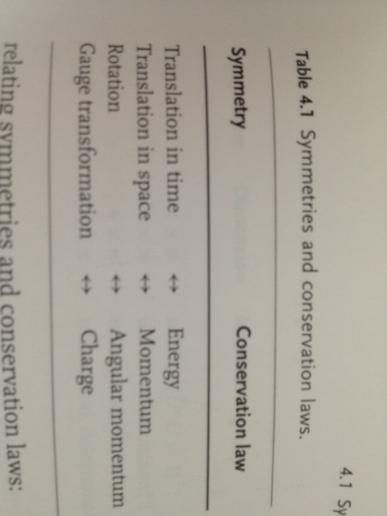
Symmetries
Symmetries play an important role in particle physics
  Noether: Symmetries ⬅➔ Conservation Laws
  Make progress when complete dynamics unknown
  Simplifies calculations
Group theory – mathematical description of symmetries
  Cursory look here; Formal course recommended !
{
Space-Time Symmetries
{ Internal Symmetry

Slide 3
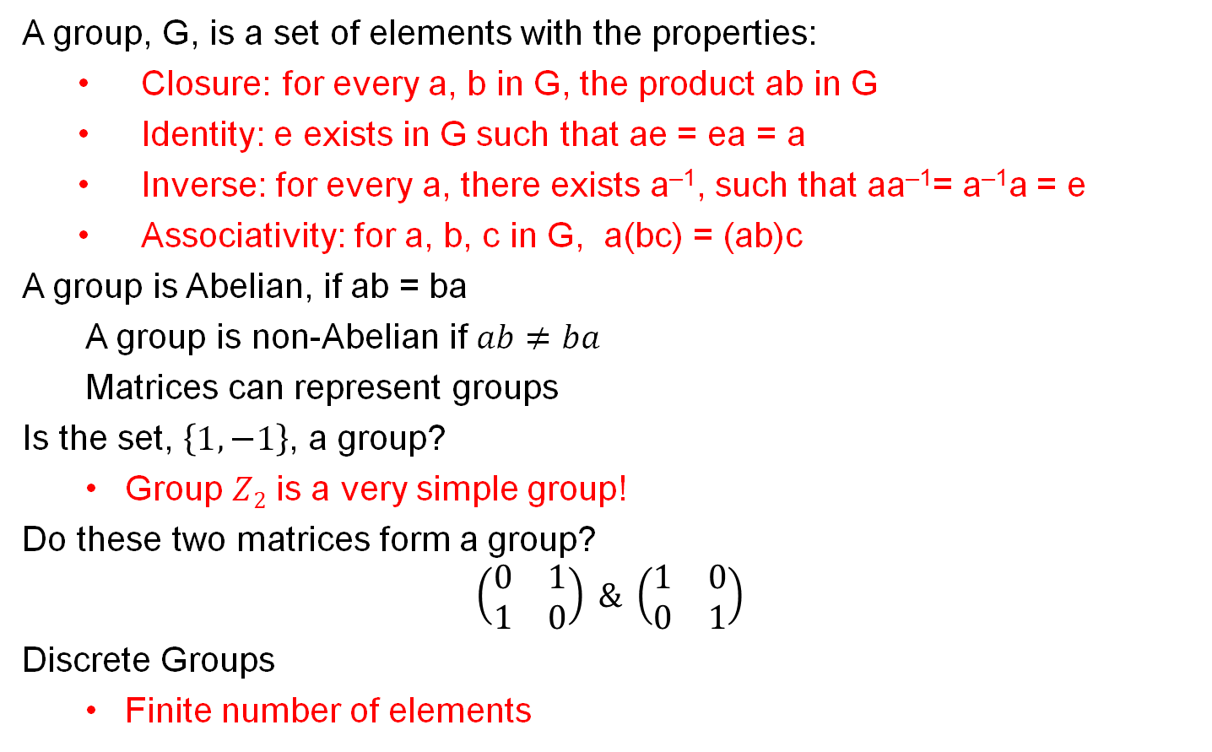
Remarks about Groups
A group, G, is a set of elements with the properties:
  Closure: for every a, b in G, the product ab in G
  Identity: e exists in G such that ae = ea = a
  Inverse: for every a, there exists a^{–1}, such that aa^{–1}= a^{–1}a = e
  Associativity: for a, b, c in G, a(bc) = (ab)c
A group is Abelian, if ab = ba
A group is non-Abelian if $ab≠ba$
Matrices can represent groups
Is the set, $\left\{1,−1\right\}$, a group?
  Group $Z2$ is a very simple group!
Do these two matrices form a group?
$$\left(\begin{matrix}0 & 1 \\ 1 & 0\end{matrix}\right) \& \left(\begin{matrix}1 & 0 \\ 0 & 1\end{matrix}\right)$$
Discrete Groups
  Finite number of elements

Slide 4
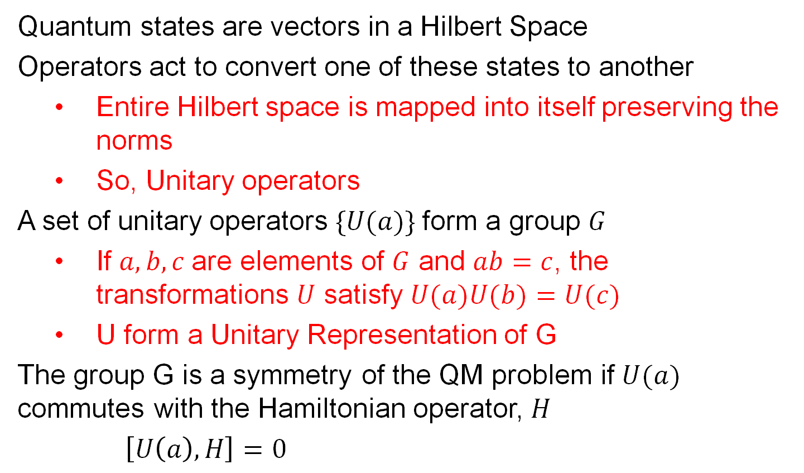
Groups and Quantum Mechanics
Quantum states are vectors in a Hilbert Space
Operators act to convert one of these states to another
  Entire Hilbert space is mapped into itself preserving the norms
  So, Unitary operators
A set of unitary operators $\{U(a)\}$form a group $G$
  If $a, b, c$are elements of $G$ and $ab=c$, the transformations $U$ satisfy $U(a)U(b)=U(c)$
  U form a Unitary Representation of G
The group G is a symmetry of the QM problem if $U(a)$ commutes with the Hamiltonian operator, $H$
$\left[U\left(a\right), H\right]=0$

Slide 5
Remarks about Continuous Groups
A group, G, is a set of elements with the properties:
  Closure: for every a, b in G, the product ab in G
  Identity: e exists in G such that ae = ea = a
  Inverse: for every a, there exists a^{–1}, such that aa^{–1}= a^{–1}a = e
  Associativity: for a, b, c in G, a(bc) = (ab)c
A group is Abelian, if ab = ba
We are mostly interested in continuous groups
  Elements are functions of real parameters g(α), α=α₁, α₂, α₃, … α_{r}
  Product is defined as: g(α)g(β)=g(γ(α,β))
  If γ is analytic function, the group is Lie group
    We are particularly interested in Lie groups
    Group G can be represented by a group of matrices, a➔M_{a}
    Many elements to one matrix, i.e., M_{a} does not fully specify a
    Fundamental representation ➔ build larger representations

Slide 6
Representations ⬅➔ Multiplets
In particle physics context
  Fundamental representation contains multiplet of fundamental particles
  Larger representations contain multiplets of bound states of fundamental representation
  Tricks for building the larger multiplets with rules exist
  Young’s tableau, for example

Slide 7
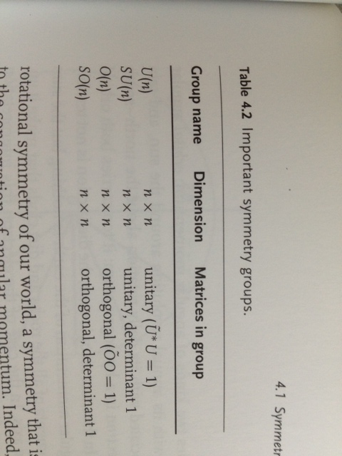
Some Lie Groups of Interest
Matrices should preserve lengths of vectors or norms of complex elements for relevance in physics
  i.e., orthogonal or unitary matrices

Slide 8
Hadrons : Baryons and Mesons
1930s: How do the nuclei with Z_{protons} and N_{neutrons} stay bound?
  A new strong force attracts protons and neutrons (baryons – heavy hadrons, ~900 MeV) independent of electric charge
  H. Yukawa, applied the exchange of “photons” idea to strong force
  Strong force is confined to nuclear distances only
    ➔ New particles with mass less than proton – Mesons predicted!
Unlike photon interactions, these strong interactions are confined to short distances.

Slide 9
Who ordered that?
A distraction
  A particle of mass ~105 MeV found in 1937
    Penetrating charged tracks seen in cosmic rays
    Tracks did not stop in lead plates as electrons would
  However, their weak interaction with matter at odds with behavior expected of strong force carrier (meson)
    This particle could not be the Yukawa’s meson
  Now identified as a heavier cousin of electron (muon)
http://www.aip.org/history/acap/topics/part2.jsp

Slide 10
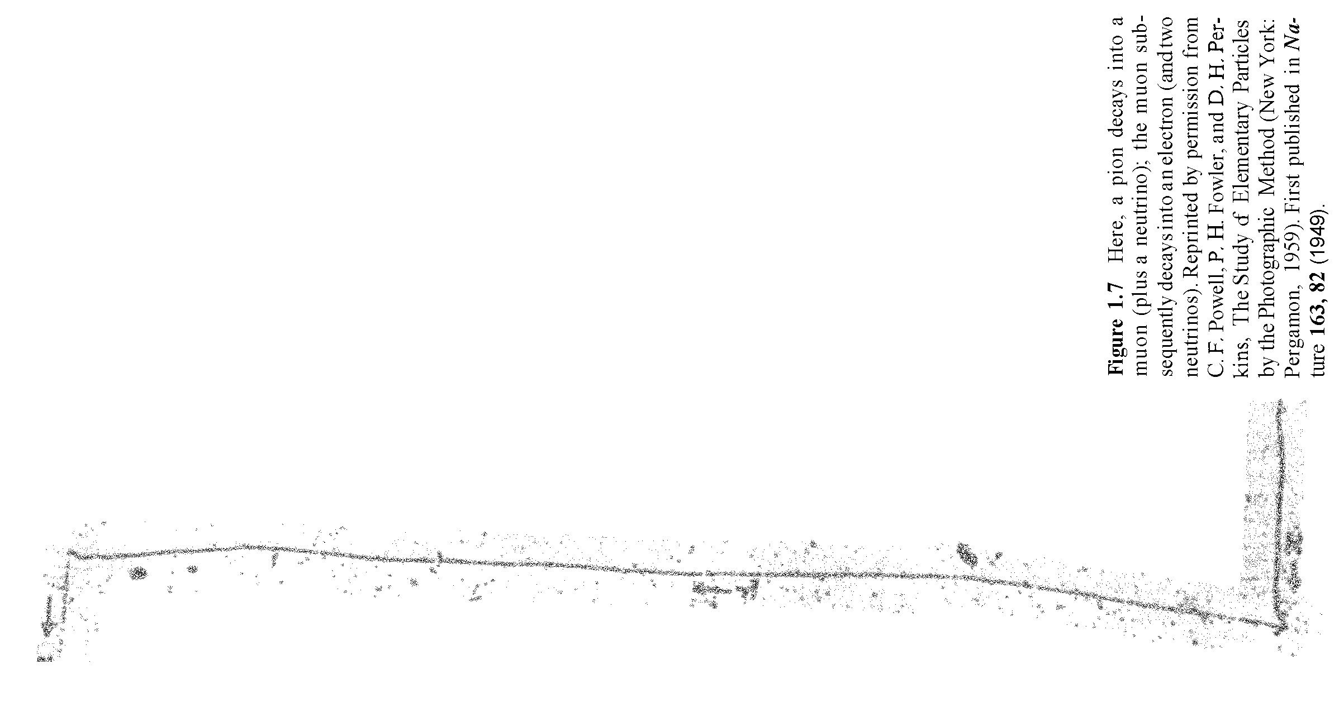
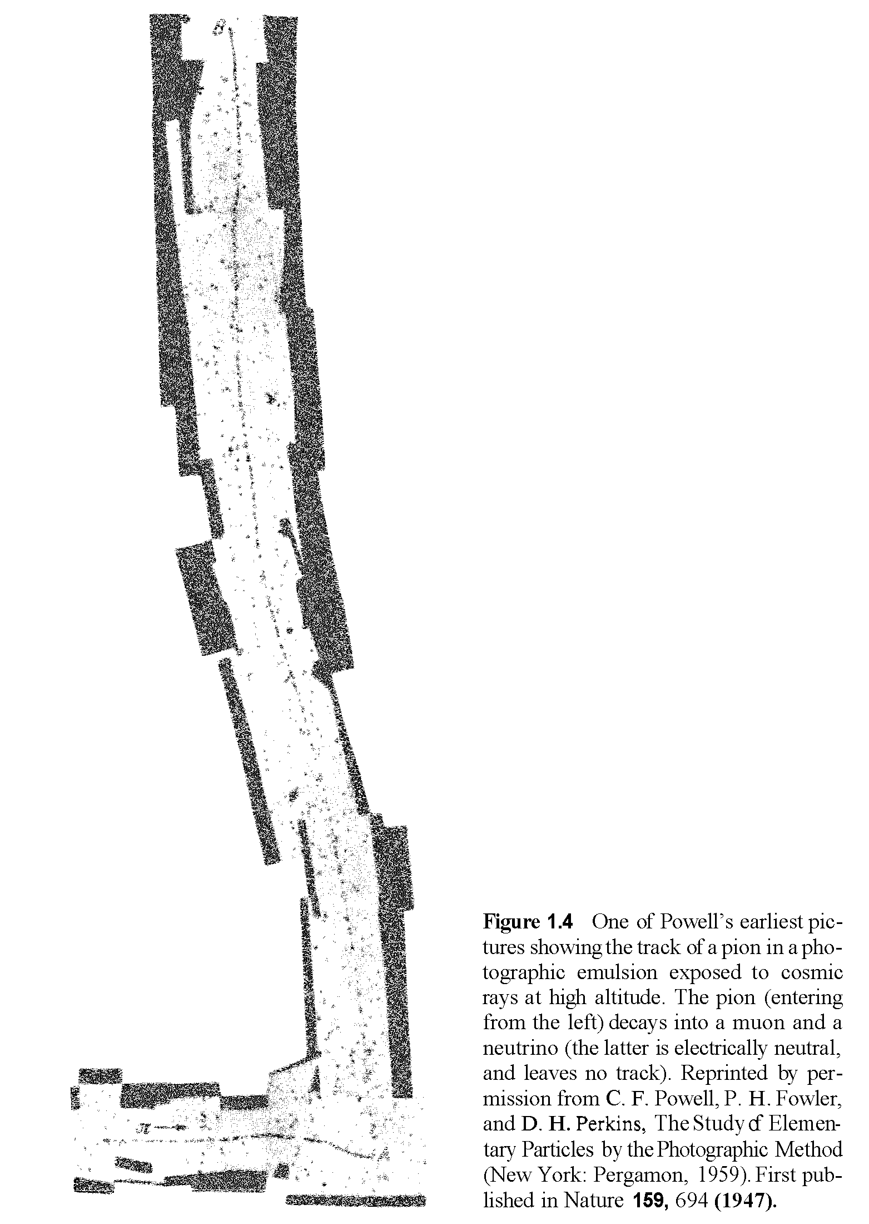
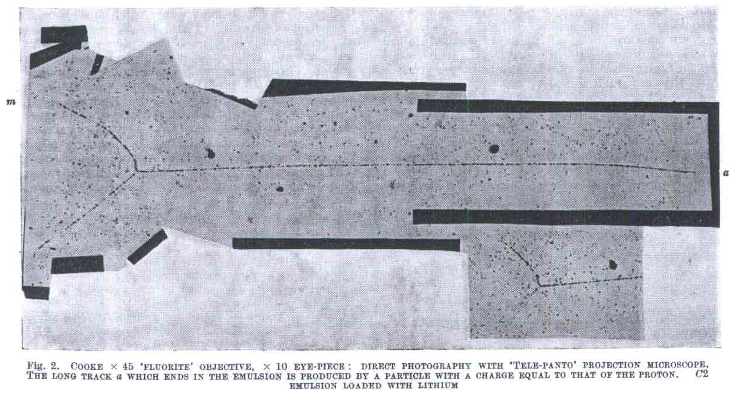
Discovery of Charged Pions
Further search by Powell et al (1946), by exposing
photographic plates at high-altitude, led to the
discovery of charged pions in cosmic rays
  In fact, π-mesons decay to μ ν
  Unlike μ, π-mesons easily
  disintegrate nuclei
http://www.nature.com/physics/looking-back/lattes/lattes.pdf

Slide 11
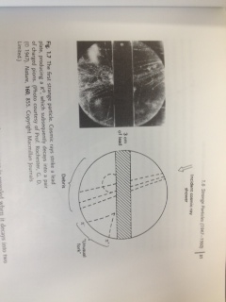
Discovery of Strange Mesons
Rochester and Butler (1947)
  Rare picture with two tracks making a V-fork
Invention of cyclotrons allowed making π^{±,0}, K^{±,0}, η,
ρ^{±,0}, ω, … and a plethora of other mesons and heavier cousins of protons, n, p, Σ^{±,0}, Λ, Ξ^{–,0}

Slide 12
Pion – Nucleon Scattering
Pion sources allowed study of pion-nucleon scattering
  Symmetry in π⁺ and π-
  Proton vs neutron rates
  Strong interaction are symmetric
  Proton vs neutron!
  Charged pion cross sections related …

Slide 13
Isospin
Proton – Neutron make a pair
  I_{Z} = +1/2 or -1/2
  2-component system
  Transform into one another
  Much like spin
Pions are Isospin 1 states
  I_{Z} = +1, 0, –1
Strong interactions between pions and nucleons indicate isospin invariance
Proton and neutron are clearly NOT building blocks
In any case, strange particles don’t fit in the picture

Slide 14
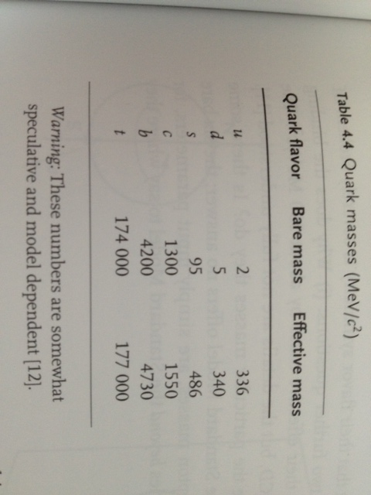
Flavor Symmetries are Not Exact
If symmetries were exact masses should be the same
{
}
Close – Isospin symmetry is very good!
uds – symmetry is worse, but is adequate to make the meson/baryon groupings as in quark model.

Slide 15
Example: u-d Flavor Symmetry
The light u and d quarks have about same mass
  Historically applied for proton-neutron
  In analogy with spin – we define and use isospin
U matrices form Lie Group SU(2)

Slide 16
SU(2)
Fundamental representation of SU(2), doublet, labeled 2
  Contains u and d quarks
  Another doublet, 2, contains their anti-quarks
Mesons are qq states
  Build the multiplet
  2 + 2 = 3 + 1
  Identify π mesons form the triplet and η meson the singlet

Slide 17
Gellman’s Eight-fold Way
Organized then known particles in interesting patterns
K⁰
K⁺
n
p⁺
Strangeness = 1
S = 0
π–
π⁰, η⁰
S = –1
S = 0
π⁺
Σ–
Σ⁰, Λ⁰
Σ⁺
Q = +1
Q = +1
S = –1
K–
S = –2
K⁰
Ξ–
Ξ⁰
Q = –1
Q = 0
Q = –1
Q = 0

Slide 18
Quark Model
  For SU(3) try Young’s tableau (see PDG tables for SU(n))
Masses are not identical, but are close
  Is there an underlying symmetry that is partly broken?
  Is there a substructure?
    Three quarks for muster mark!
Mesons: quark-anti-quark states
3 x 3 = 8 + 1
d
u
s
S = 0
S = +1
Q = +2/3
S = –1
s
S = 0
u
d
Q = –1/3
Q = –2/3
Q = +1/3

Slide 19
Mesons
Mesons: quark-anti-quark states
3 x 3 = 8 + 1
sd
us
Strangeness = 1
du
uu, dd, ss
π⁰, η⁰, ?
ud
S = 0
η’
Q = +1
S = –1
su
ds
Q = –1
Q = 0

Slide 20
Baryons
Since these are fermions, we ensure anti-symmetric nature by picking identical quarks with opposite spin
in meson combinations
– doesn’t work for Ω^{–1} ☹
Three quark combinations 3 x 3 x 3 = 10 + 8 + 1
  Missing Ω^{–1} in decuplet discovered as predicted!
  Bolstering the quark model
n, udd
p⁺, uud
Δ– ddd
Δ⁰ ddu
Δ⁺ duu
Δ⁺⁺ uuu
S = 0
S = 0
S = -1
Σ^{h–} sdd
Σ^{h0} sdu
Σ^{h+} suu
S = –1
Q = +2
Σ–, dds
Σ⁰, Λ⁰
uds
Σ⁺, uus
S = -2
Ξ^{h–} ssd
Ξ^{h0} ssu
Q = +1
Q = +1
S = –3
Ω^{–1} sss
S = –2
Q = 0
Ξ–, dss
Ξ⁰, uss
Q = –1
Q = –1
Q = 0
Also, why don’t we see the quarks in the laboratory?

Slide 21
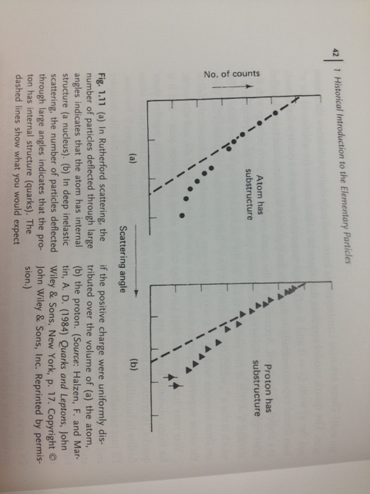
Protons do have substructure!

Slide 22
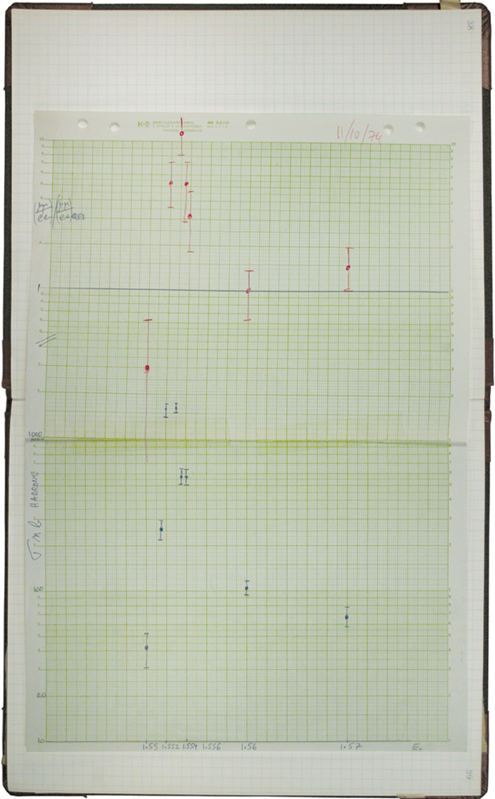
Charm Discovery
Simultaneous discovery – November revolution
  Discovery of resonance(s) in e⁺-e– annihilation at SLAC
  Muon-Anti-muon pair production at BNL
Event Rate (log scale)
CM Energy

Slide 23
Mesons
Including the charm – which is more massive.
sd
us
Strangeness = 1
du
uu, dd, ss
π⁰, η⁰, η’
ud
S = 0
Q = +1
S = –1
su
ds
Q = –1
Q = 0

Slide 24
Baryons
Including the charm
n, udd
p⁺, uud
S = 0
S = –1
Σ–, dds
Σ⁰, Λ⁰
uds
Σ⁺, uus
Q = +1
S = –2
Ξ⁰, uss
Ξ–, dss
Q = –1
Q = 0

Slide 25
Bottom
Discovery of Upsilon – bottom/anti-bottom resonance

Slide 26
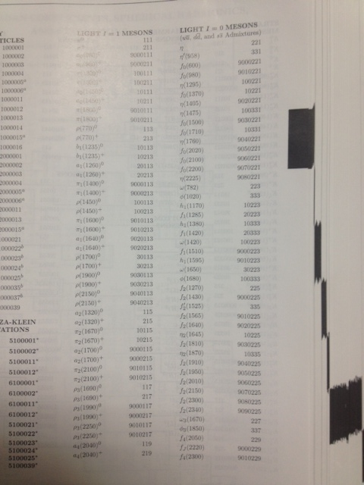
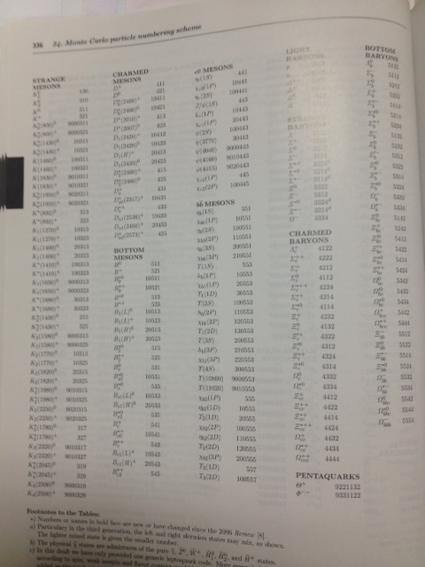
Particle Zoo!

Slide 27
Baryon Number Conservation
Why does the proton not decay?
  For instance, p⁺→e⁺γ could be a possiblity
  It hasn’t been observed – good thing for us!
  Baryon number, B=+1 for proton, is conserved
    Anti-baryons sport B=–1
    In terms of quarks, B_{q}=+1/3, and anti-quarks –1/3
    Additive quantum number – qqq gets B=+1
    Mesons have B_{mesons}=0
    Leptons have B_{leptons}=0
    Gauge bosons, B_{γ}=0 & B_{g}=0
  In above reaction B is not conserved so it is forbidden
    In fact there is no lepton in the initial state either

Slide 28
Lepton Number Conservation
Why doesn’t muon decay without neutrinos in final state?
  For instance, μ⁺→e⁺γ could be a possibility, but is not!
  In case of leptons it appears electron (L_{e}), muon (L_{μ}) and tau (L_{τ}) numbers are individually conserved
    So, μ⁺→e⁺ ν_{e} ν_{μ}
  Lepton number is, L
    L=+1 for e–, μ–, τ–, ν_{e} , ν_{μ}, ν_{τ}
    L=–1 for e⁺, μ⁺, τ⁺, anti-neutrinos
    Additive quantum number
    Quarks have L_{quarks}=0, Gauge bosons, L_{γ}=0 & L_{g}=0
  In the μ⁺→e⁺γ reaction, L is preserved, however,
  L_{μ} and L_{e} are not preserved, so it is forbidden
Following Noether, what is the symmetry which makes B and L’s conserved?

Slide 29
Weak Interactions
Weak interactions change flavor, unlike strong/em with isospin invariance
  Weak interactions can change flavor: u–d, c–s, e–ν_{e}, μ−ν_{μ}
    There are also non-flavor changing weak interactions …
    These doublets have significance – SU(2) of “weak-isospin”
    Bosons of SU(2) are W⁺, W– and Z⁰ (ignoring EW mixing)
  Example: Beta decay, n→peν_{e}
    B, L and L_{e} are conserved if ν is anti-electron-neutrino
  Example: Pion decay, π⁺→μ⁺ν_{μ}
    B and L are conserved, and so is L_{μ}, if ν is ν_{μ}
  For leptons, generation change is forbidden
    Conservation of L_{e}, L_{μ}, L_{τ}
  K and B mesons do decay to mesons of lower generations!
    No conservation of B_{u}, B_{c}, B_{t} numbers analogous to L_{e}, L_{μ}, L_{τ}
    But, what is the mechanism?

Slide 30
Cabibbo Mixing
Strange particles produced strongly (10^{–23} s) – copiously
  However, strange particles decay weakly (slowly, 10^{–10}s)
  Pair production of strange and anti-strange particles proceeds via strong force which is flavor independent
  The s-quark mixes with d-quark – which decays weakly
    Instead of s-quark, weak interaction couples to
    s’ = s cosθ_{c} – d sinθ_{c}
    Weak and strong interaction states are different!
    Allows K⁰ to decay to π⁺, π–
    θ_{c}
d
π–
s
K⁰
u
u
d
π⁺
d

Slide 31
Cabibbo – Kobayashi – Masakawa
Quark Mixing Matrix
Three generation quark mixing matrix (unitary – 4 parameters)

Slide 32
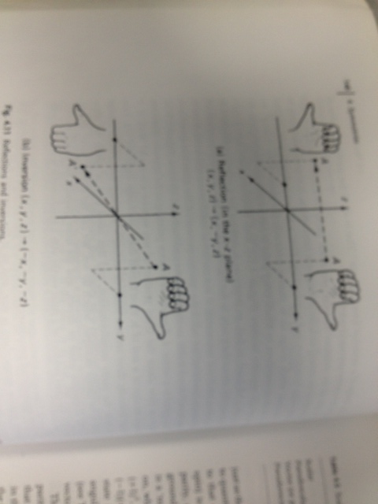
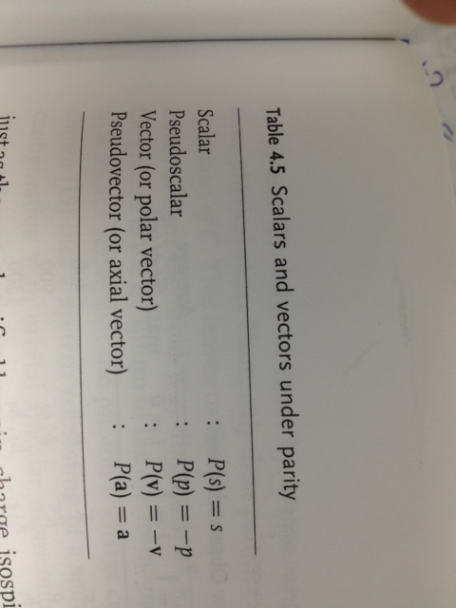

Discrete Symmetry: Parity
Discrete symmetry upon reflection is evident?
  Parity – reflection of all coordinates P: (x y z) → (–x –y –z)
  Doing twice gets back to original, P²=I
Cross product $a×b$ does not change sign under P
$a∙(b×c)$changes sign under P
Example usage of group $Z2$

Slide 33
Intrinsic Parity Assignment
Parity has eigen values ±1
  Scalars and axial vectors have P = +1
  Pseudoscalars and vectors have P = –1
Parity of fermion and anti-fermion are opposite
  Arbitrarily: quarks +1 and anti-quarks –1
  Parity of composite particles is the product of its constituents
  Including orbital angular momentum (not spin):
    P gets (–1)^{l} – an extra multiplicative factor
Parity of photon, a vector particle, i.e., with spin 1, has intrinsic parity –1
Examples
  Pseudo-scalar meson (π, K, …) : P_{qqBar} = (+1)(–1) = –1
  Vector mesons (ρ, ω, …) : P_{ρ} = (+1)(–1)(–1)⁰ = –1
    There are heavier states with non-zero orbital angular momentum
  Baryons : P_{qqq}=(+1)(+1)(+1) = +1

Slide 34
Parity Non-Conservation
Parity assumed to be conserved: EM and Strong decays do
  Two particles identical in all respects, e.g., mass, seen to decay to two or three pions
  Perhaps, they are the same particle (now K⁺) but parity is violated
  – Lee and Yang
  Their suggested study of parity conservation in weak interactions resulted in confirmation of maximal parity violation by C.S.Wu

Slide 35
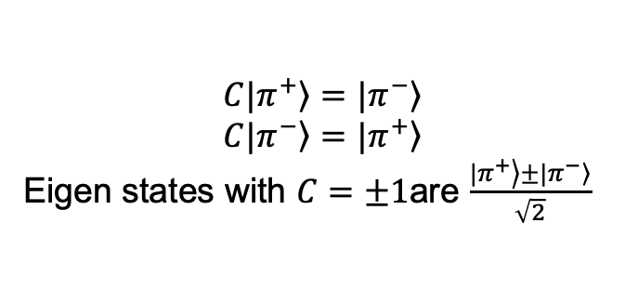
Charged Conjugation
$$C|\left.π^{+}\right\rangle =|\left.π^{−}\right\rangle$$
$$C|\left.π^{−}\right\rangle =|\left.π^{+}\right\rangle$$
Eigen states with $C=±1$are $\frac{|\left.π^{+}\right\rangle ±|\left.π^{−}\right\rangle }{\sqrt{2}}$
C operator takes particle to anti-particle
  Only particles which are their own anti-particles are C eigen states
    Photons and select neutral mesons: π⁰, η, η’, ρ⁰, φ, ω, ψ are
  Photon C-number is –1 as the EM field changes sign e–←→e⁺
  For mesons – multiplicative quantum number
    C = (–1)^{l+s}
  C is also violated by weak interactions

Slide 36
CP & Neutral Kaon System
Combined CP transformation has interesting consequences
2-pion mode faster
3-pion mode slower
So, one long-lived and another short-lived neutral Kaon
K_{S} and K_{L}
Δτ large
Δm small

Slide 37
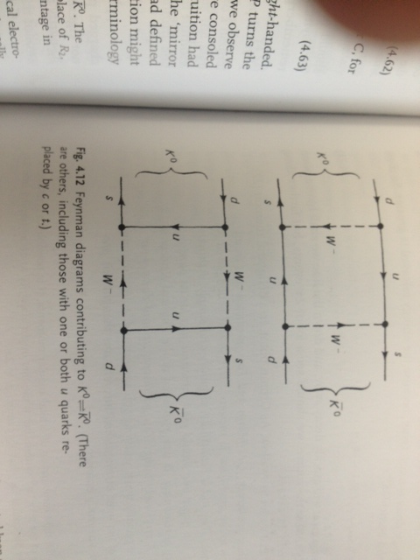
Neutral Kaon Mixing

Slide 38
CP Violation
It turns out CP is also violated
  Both CP violation in mixing
    Indirect – decay to 2π in K_{L} beam
  & Direct CP violation experimentally
    Particle decay rate different from that of
    its anti-particle
Necessary ingredient for explanation of matter dominance in our universe (but not sufficient)

Slide 39
G-Parity
Since few particles are eigen-states of C-Parity, its application is rather limited
Combining with Isospin rotation, we define G-Parity, which has more applications
  Rotate about 2-axis of Isospin, R₂
    I₃ goes to –I₃
    For instance, π⁺ goes to π–
  G = CR₂, where R₂=e^{iπI2}
    G = (–1)^{I}C
    For single pion, G = –1
    For state with n-pions, G = (–1)^{n}
    Example: ρ meson, I=1, C=–1, so G=+1
      So, it can decay to 2 pions, but not three

Slide 40
Decay of η Meson
The η meson does not decay strongly, why?
  Mass of η is large (548 MeV)
    Can produce up to 3 pions in strong final states
  Two pion state
    G-Parity is not an issue for 2-pion state:
      Initial state G for η meson, I=0, C=1, so G=1
      Two pion state is possible, (–1)(–1)=1
    But, Parity itself is a problem:
      Pseudo-scalar meson η ➔ P_{η}=–1, angular momentum = 0
      Final state parity for 2-pions, P_{π} P_{π} (–1)⁰=(–1) (–1) (–1)⁰ =+1
    So, two-pion state is not possible ☹
  G-Parity is not conserved for 3-pion state (–1) (–1) (–1)=–1
    So, three-pion state is not possible ☹
  So, strong interaction is forbidden
  Only electro-magnetic decays to two photons, three π⁰s, …

